Slide 1
Maxwell & Grayson
High school Technical Program Options

Slide 2
Maxwell High School of Technology
Located in Lawrenceville off Sugarloaf Pkwy and Cruse Road
GCPS Transportation provided from Shiloh HS to Maxwell
Technical Program options for Juniors and Seniors
Students attend Maxwell for 3 periods of the school day
AM Session (7:45 - 10:15)
Students earn 3-4 credits per school year; 3 elective and 1 academic (some programs)
Full Year Commitment once students are accepted into their program
Students must be on track for graduation and have limited discipline referrals and absences

Slide 3
Grayson Technical School
Located adjacent to Grayson High School
Students provide their own transportation
Technical Program options for Juniors and Seniors
Students attend Grayson Tech for 3 periods of the school day
AM Session (7:15 - 9:45) or PM Session (11:50 - 2:10)
Students earn 3-4 credits per school year; 3 elective and 1 academic (some programs)
Full Year Commitment once students are accepted into their program
Students must be on track for graduation and have limited discipline referrals and absences

Slide 4
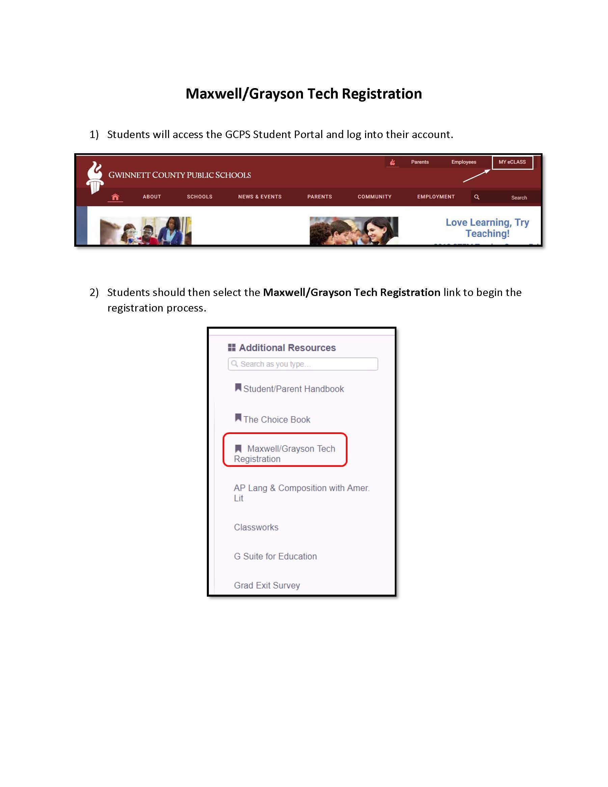
How to Apply?
Students can access the application on My eCLASS
There is an option that says “Maxwell/Grayson Application”

Slide 5
Questions and More Information
Please visit the school’s website to learn more about the programs at each specific school.
Maxwell High School
https://www.gcpsk12.org/maxwellhs
Grayson High School
https://www.gcpsk12.org/graysontech
Sign up on eclass to see your counselor with scheduling questions.

