Slide 1
SGHS20-21 girls soccer
Welcome

Slide 2
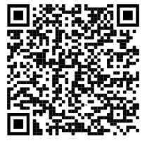
Player Contact information 20-21

Slide 3
Items that need to be filled out before you can be practicing

Slide 4
Dues are $300 we need to find sponsor we are doing fundraisers we also need parents to be involved to help the program

Slide 5
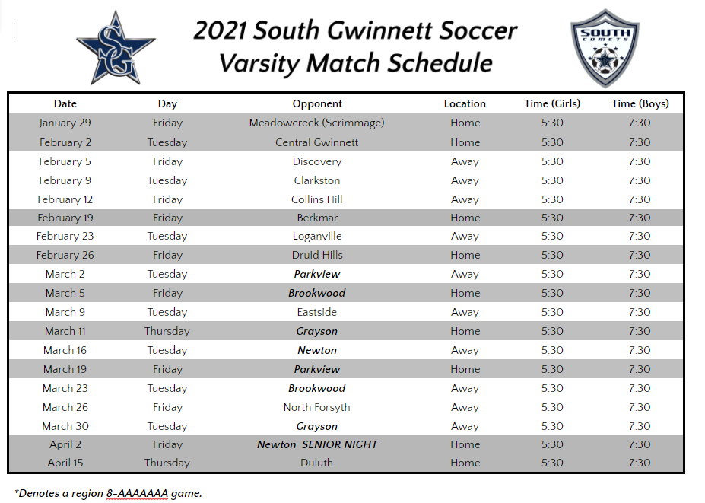

Slide 6
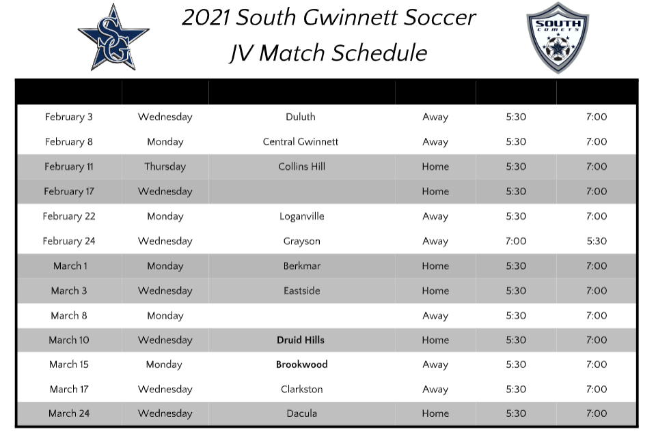

Slide 7
Core values 1. We don’t whine:. 2. The truly extraordinary do something every day: 3. And we want these four years of high school to be rich, valuable and deep 4. We work hard: 5. We don’t freak out over ridiculous issues or live in fragile states of emotional catharsis or create crises where none should exist: 6. We choose to be positive 7. We treat everyone with respect: 8. We care about each other as teammates and as human beings: 9. When we don’t play as much or we would like, we are noble and still support the team and its mission 10. We play for each other 11. We are well led: 12. We want our lives (and not just in soccer) to be never ending ascensions but for that to happen properly our fundamental attitude about life and our appreciation for it is critical

Slide 8
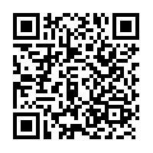

Slide 9
Preseason work outs
Pre season workouts will begin November 9
We will be having it 3 days a week Monday, Wednesday, Thursday
Tryouts:
January 11 first day of tryouts
January 15 last day of tryouts
Must attend all week
January 19 assign to teams
January 19 pay all dues
Parent meeting and introduction of teams TBA
First game January 29

Slide 10
Google classroom https://classroom.google.com/c/MTc2NDE0MTMxNzY2?cjc=a2ydyfn

Slide 11
Formation that we want you to learn for this upcoming year 1.4-2-3-1 2. 3-4-3 3. 3-5-2 4. 4-4-2 diamond 5. 4-1-4-1 6.4-3-3 triangle and flat

