Slide 1
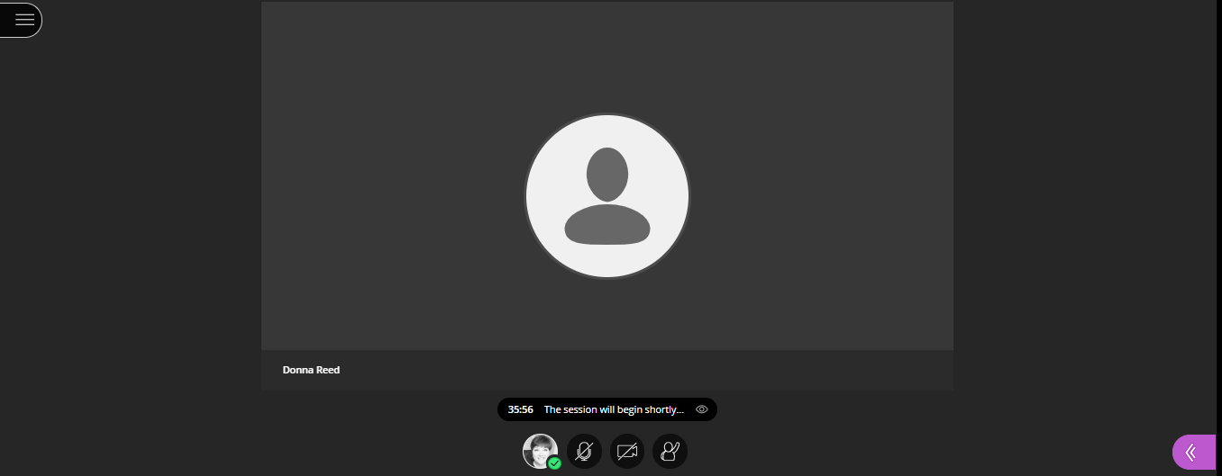
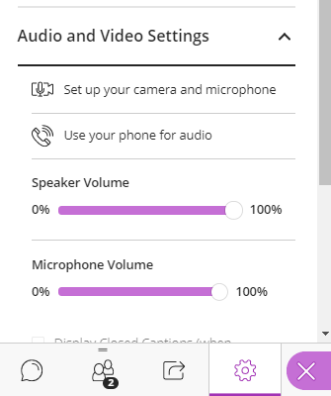
PDFs and Accessibility: Adobe Pro DC
Gwinnett County Public Schools
Select to access the
Chat and Audio options.
Audio is available via computer or phone
Microphones have been enabled (mute/unmute as necessary)

Slide 2
PDFs and Accessibility: Adobe Pro DC
Gwinnett County Public Schools – Fall 2020

Slide 3
Session Information
Session Length: Approximately 2 hours.
Session Structure: Presentation with hands-on practice opportunities
This session will be conducted using
PDF and Accessibility Workshop Resource Webpage
Adobe Acrobat Pro DC
Disclaimer: The content in this presentation was prepared for informational purposes only. This is not a certification course. The information contained herein is not intended to constitute legal advice and you should consult with your own attorney when developing your online accessibility program and policy. Blackboard assumes no liability in connection to this presentation and any information contained here in.

Slide 4
Session Topics
Review Common Accessibility Issues for Websites
Analyze Common PDF File Issues reported by Ally
Demonstrate Instructor Feedback
Evaluate and improve the Ally score for
a scanned Document
an existing pdf - where the original document is not available
an existing pdf - created from a Google Docs
Compare and Contrast Instructor Feedback results

Slide 5
Common Accessibility Issues for Websites.
Improper use of headers.
Incorrectly built lists.
Empty links or links without descriptive text.
Missing alternative text tags in images.
Using tables incorrectly.
Uploaded Files/Documents that are not built accessibly (scanned docs for example).
Color contrast issues.
Readability
Videos missing closed captioning or no transcript
Note: The Web Content Accessibility Guidelines are authored and implemented by the US Office of Civil Rights.

Slide 6
What does ALLY scan for in PDF Files?
Severe
Malformed
Major
Minor
No language or incorrect language set
Encrypted
Scanned (Not OCR)
Untagged
Images missing Alt Text
Color contrast
Headings missing
Headings which do not start at 1
Tables missing headers
Inappropriate Heading Structure
Headings which go beyond 6
Missing File Title
Images
Lists
This includes all pdfs created by a variety of methods.

Slide 7
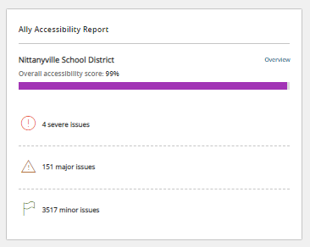
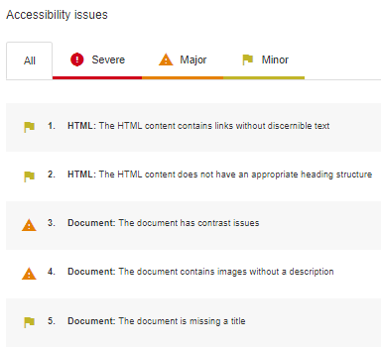
Accessing the Ally Report
Subsite or Section Workspace
Overview

Slide 8
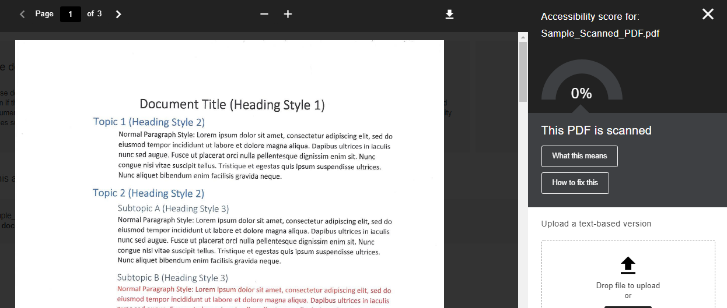
Instructor Feedback

Slide 9
Where do I edit my file?

Slide 10
Document modification path – pdf examples
Scanned Document
(.pdf)
.pdf
No Original Available (.pdf)
ADOBE Pro
ADOBE Pro
.pdf

Slide 11
Document modification path – MS Word examples
MS Word (.docx)
MS Word (.docx)
MS Word
.docx
MS Word
.pdf
MS Word (.docx)
.docx or .pdf
.pdf
ADOBE Pro

Slide 12
Document modification path – Google Docs examples
Google Doc
ADOBE Pro
.pdf
Google Docs
.docx
ADOBE Pro
.pdf
Google Docs
.docx
MS Word
.pdf
.pdf

Slide 13
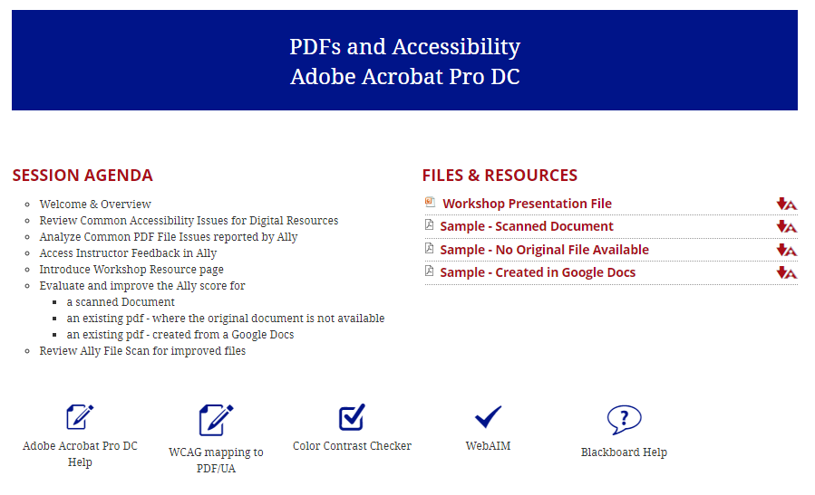
Workshop Resource Webpage
https://gcpsk12.org/PDFsandAccessibility
Notes:
https://gcpsk12.org/PdfsandAccessibility

Slide 14
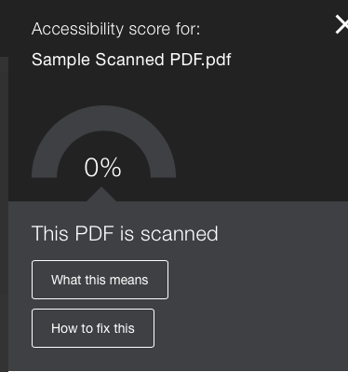
Scanned PDF (non-OCR)
Let’s raise the score…
Apply Optical Character Recognition
Assign Document Title
Set Document Language

Slide 15
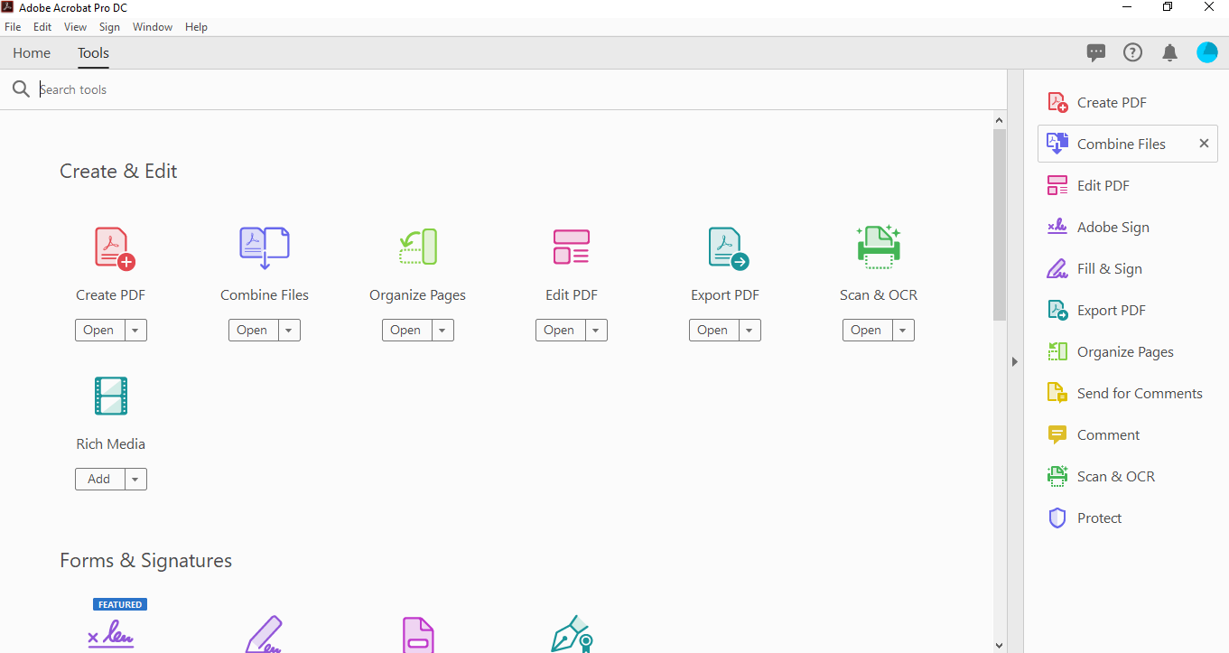
Getting Started

Slide 16
Add Accessibility feature to Toolbar
Notes:
Previously called the “Full Check Tool” – in May 2020 release, now called Accessibility.

Slide 17
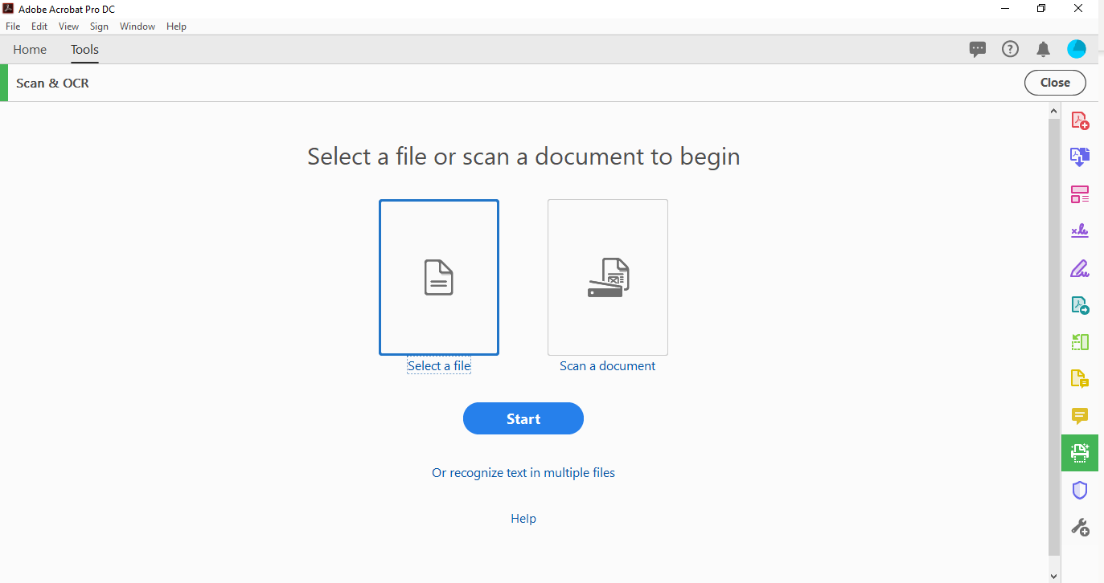
Upload the Scanned Document
Notes:
If Ally has indicated that your document is scanned, then it is best to modify using the “Select a file or scan a document” to begin.

Slide 18
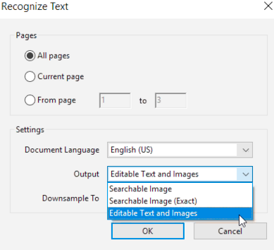
Recognize Text
OCR (Optical Character Recognition)
Electronic or mechanical conversion of images of typed, handwritten or printed text into machine-encoded text.

Slide 19
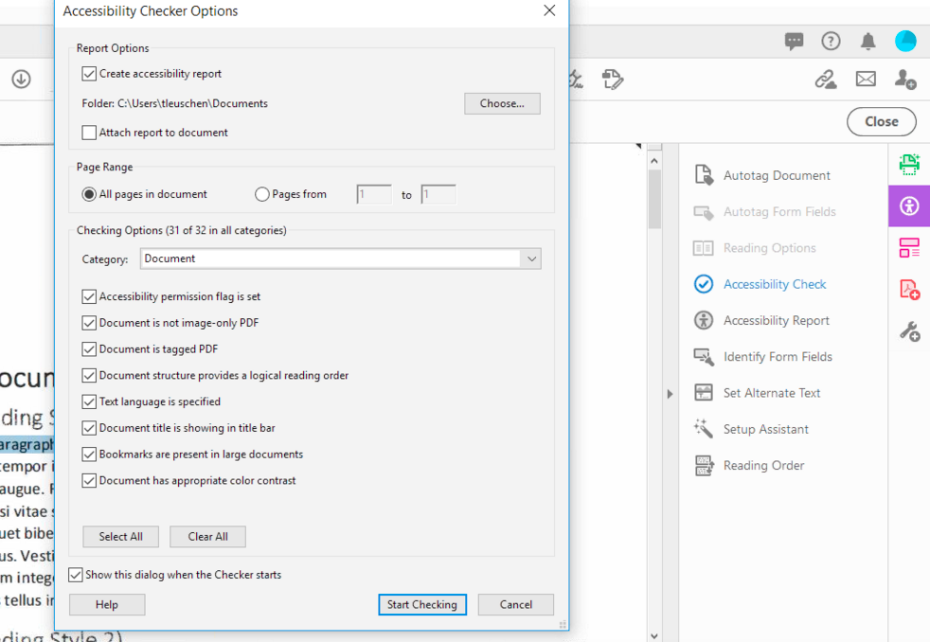
Initiate Accessibility Tool
Select Tool
Select Check
Start Checking

Slide 20
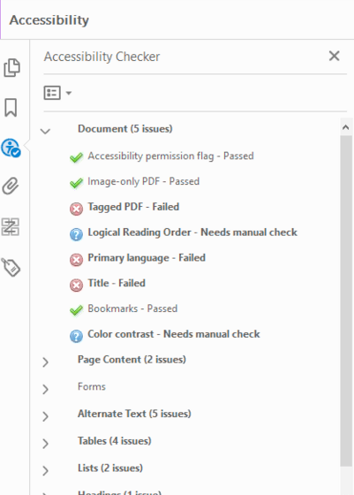
Accessibility Checker Results
Passes Adobe Accessibility Check
Adobe Suggests a Manual Check
Fails Adobe Accessibility Check
This Photo by Unknown Author is licensed under CC BY-SA

Slide 21
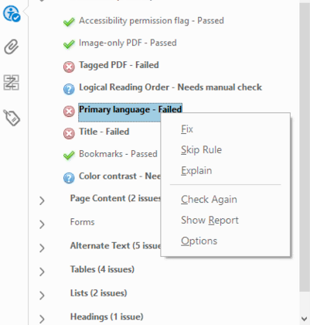
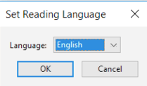
Set the Reading Language (Via Accessibility Checker)
Notes:
Setting the document language in PDF prompts most accessible devices to decode the information in the appropriate language.

Slide 22
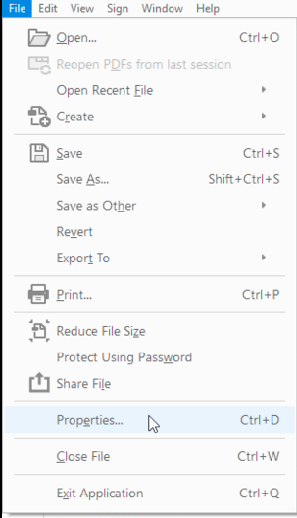
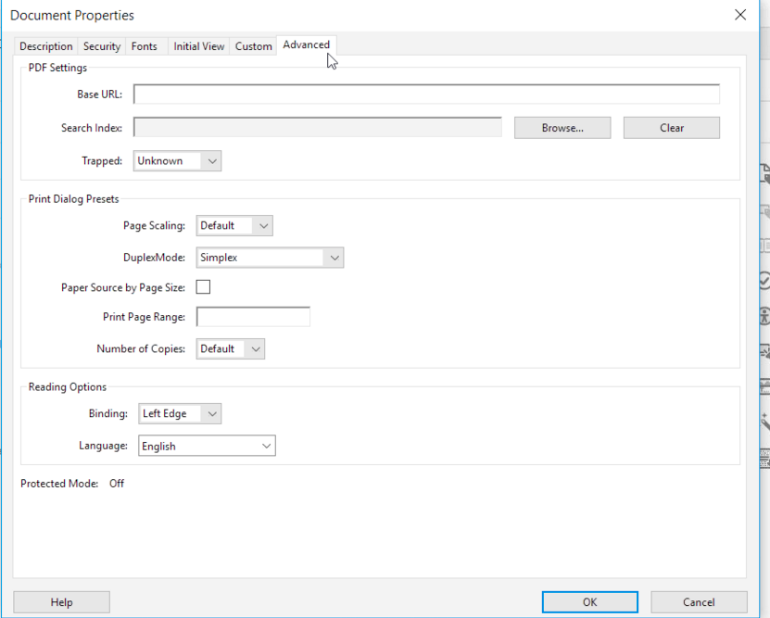
Set the Reading Language (Via File Properties)
2
3
1
4

Slide 23
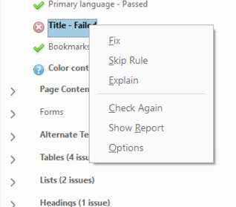
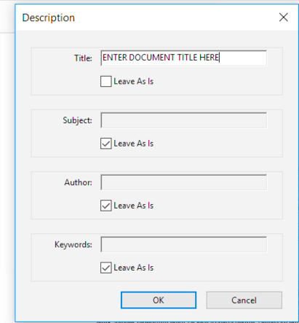
Set the Document Title (Via Accessibility Checker)

Slide 24
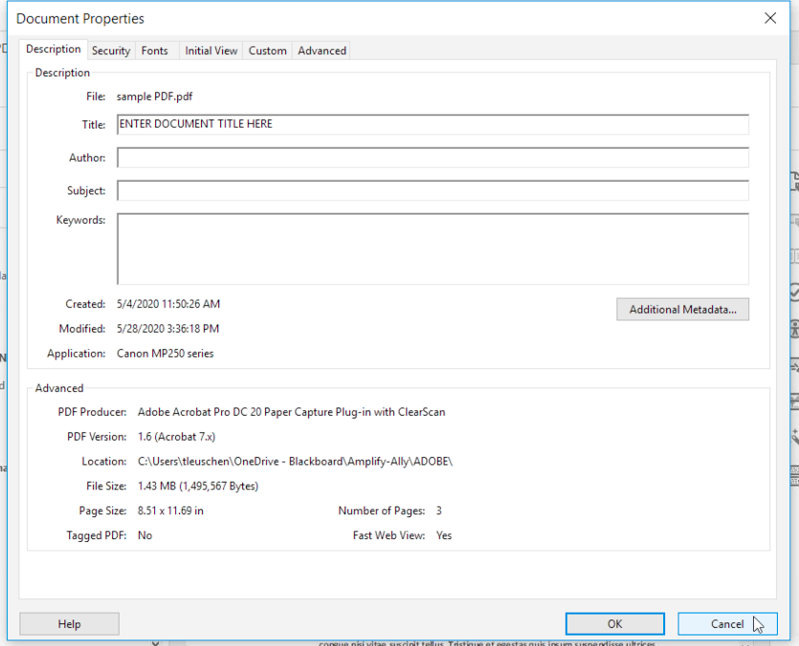
Set the Document Title (Via File Properties)
2
1
3

Slide 25
Edit “Look” for System Fonts Usage
SCANNED
AFTER TEXT EDIT AND CLEAR BACKGROUND IMAGE

Slide 26
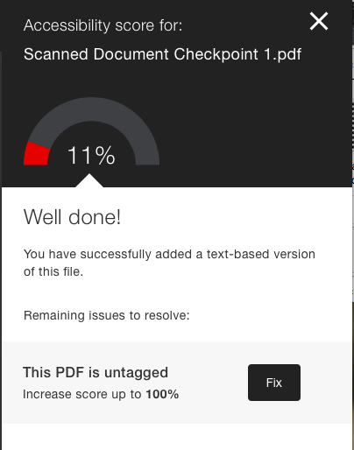
How are we doing? – Ally Checkpoint 1
Original Score -> 0%
Scanned Document saved as PDF
Checkpoint Score -> approx. 11%
Set Language
Set File Title
Recognized Text

Slide 27
Adobe Pro
No Original Source Available
Let’s learn more…
Identify Basic Reading Order
Add missing alternative text tags in images.
Correct color contrast issues.
Modify links.

Slide 28
What is “Tagging”?
Tagging PDFs provides a logical structure for file content.
Identifies Heading structures, tables, images, links, etc.
Tags are recognized by assistive devices. (screen readers, keyboard navigation, and other assistive software or hardware)

Slide 29
Getting Started
Notes:
Customize Tool List

Slide 30
Initiate Accessibility Tool
Select Tool
Select Check
Start Checking

Slide 31
Sample Content

Slide 32
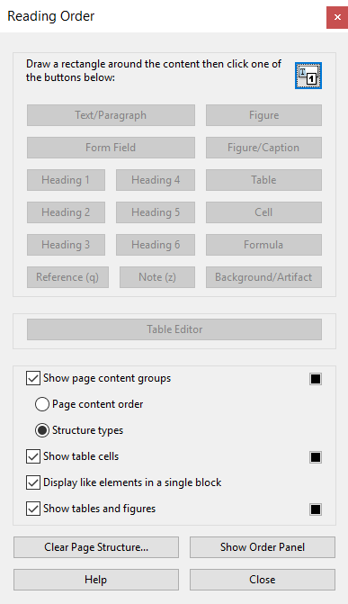
Reading Order

Slide 33
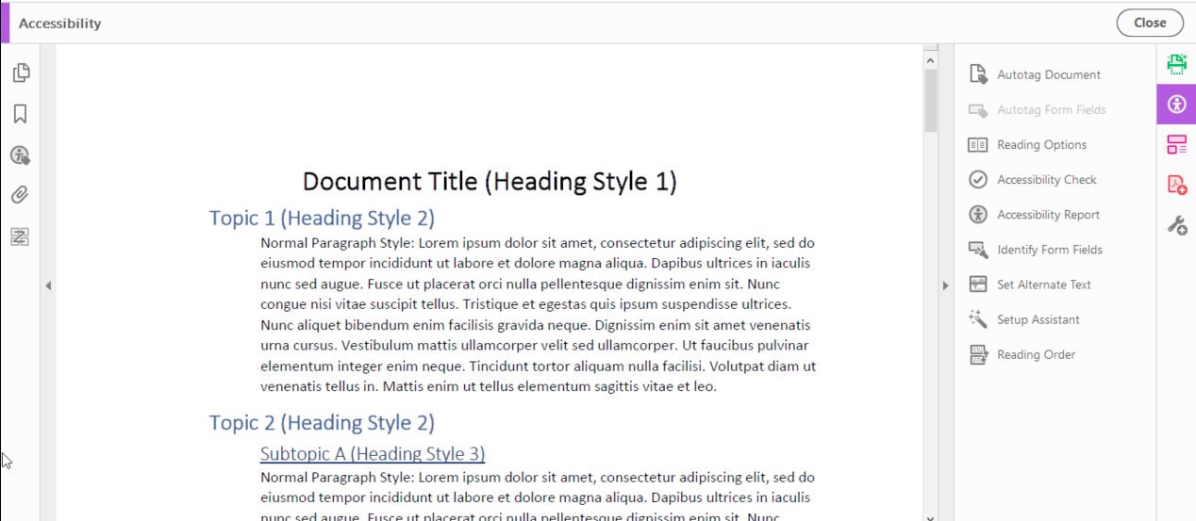
Initiate Accessibility Tool

Slide 34
Images
Alt Text allows assistive technologies to convert images into words.
Guidelines for Images:
Avoid unrelated images or mark as Background/Artifact
Alt Text should be clear, concise, and descriptive. (1 – 2 Sentences)
Avoid using the same text for every image.
Don’t include “image of…” or “picture of…” as part of alt text
If the image is an infographic you should use alt text to provide the information conveyed in the object.

Slide 35
Image & Alt Text
Figure: Image only
Figure/Caption: Image and caption text.
Background/Artifact: Ignore (decorative lines or shapes)

Slide 36
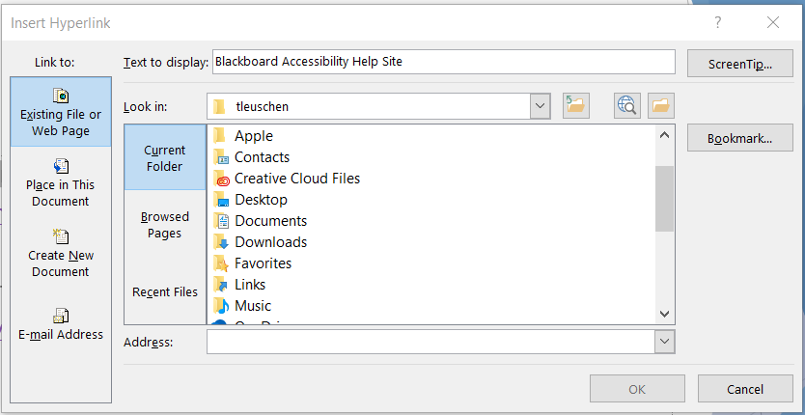
Links
Descriptive Text (for sharing electronically)
Descriptive Text and Short URL (for sharing electronically and as a printout.)
Screen Tip
Notes:
Alt Text:

Slide 37
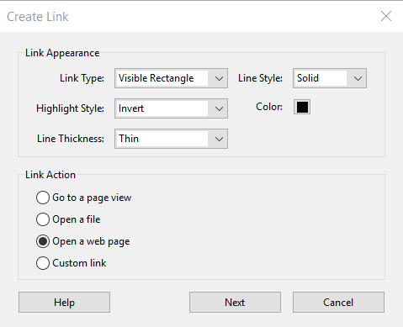
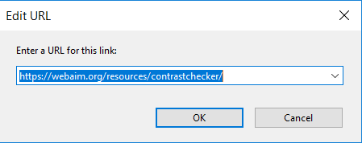
Links
Best Practice
Notes:
https://webaim.org/resources/contrastchecker/

Slide 38
Color Contrast
Low contrast can make content difficult to read
Check contrast for WCAG AA rating (4.5:1 Ratio)
Notes:
Find out what color you’re using in the document (add to Custom Colors) using the color pallet.

Slide 39
How are we doing? – Ally Checkpoint 2
Checkpoint 1 Score -> 11.7 %
Set Language
Set File Title
Recognized Text
Checkpoint Score ->

Slide 40
Adobe Pro
Google Doc saved as a .pdf
Building on what you know…
Assign Document Title
Set Document Language
Identify Table
Apply Missing Tags
Heading Structure
Image
Table
Notes:
Open the PPT file

Slide 41
Getting Started
Notes:
Customize Tool List

Slide 42
Initiate Accessibility Tool
Select Tool
Select Check
Start Checking

Slide 43
Initiate Accessibility Tool

Slide 44
Reading Order

Slide 45
Set the Reading Language (Via Accessibility Checker)

Slide 46
Set the Document Title (Via Accessibility Checker)

Slide 47
Tables
Use simple table structure
Cells should be defined
Table Headers need to be defined
Tables should include a summary
Tables should not contain
split cells
merged cells
nested tables

Slide 48
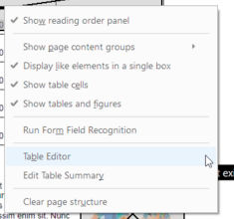
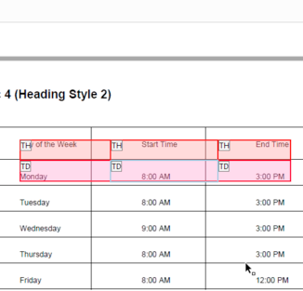
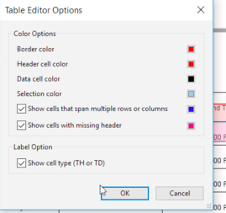
Table

Slide 49
Table

Slide 50
Session Topics
Review Common Accessibility Issues for Digital Resources
Analyze Common PDF File Issues reported by Ally
Demonstrate Instructor Feedback
Evaluate and improve the Ally score for
a scanned Document
an existing pdf - where the original document is not available
an existing pdf - created from a Google Docs
Compare and Contrast Instructor Feedback results

Slide 51
Have Questions or need Further Assistance?
Send an email to Blackboard Accessibility Support
Submit a FootPrints Ticket

