Slide 1
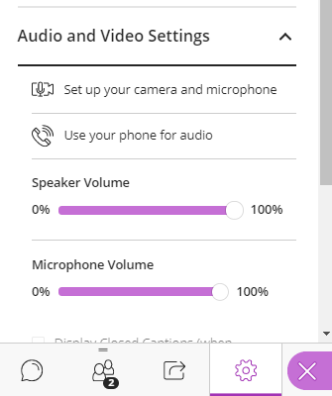
Presentations and Accessibility: PowerPoint and Google Slides
Gwinnett County Public Schools
Select to access the
Chat and Audio options.
Audio is available via computer or phone
Microphones have been enabled (mute/unmute as necessary)

Slide 2
Presentations and Accessibility: PowerPoint and Google Slides
Gwinnett County Public Schools - Fall 2020
Workshop Presenter: Tamatha Leuschen

Slide 3
Session Information
Session Length: Approximately 2 hours.
Session Structure: Presentation with hands-on practice opportunities.
This session will be conducted using
Presentations and Accessibility Workshop Resource Page
Office 365 Desktop App: PowerPoint
Google Slides shared file
Disclaimer: The content in this presentation was prepared for informational purposes only. The information contained herein is not intended to constitute legal advice and you should consult with your own attorney when developing your online accessibility program and policy. Blackboard assumes no liability in connection to this presentation and any information contained here in.

Slide 4
Session Topics
Review Common Accessibility Issues for Websites
Analyze common .pptx file issues as reported by Ally
Demonstrate Instructor Feedback
Evaluate and improve the Ally score for a
MS PowerPoint Presentation
Google Slides Presentation
Compare and Contrast Instructor Feedback results

Slide 5
Common Accessibility Issues for Websites
Improper use of headers/slide titles.
Incorrectly built lists.
Empty links or links without descriptive text.
Missing alternative text tags in images.
Using tables incorrectly.
Uploaded Files/Documents that are not built accessibly (scanned docs for example).
Color contrast issues.
Readability
Videos missing closed captioning or no transcript
Note: The Web Content Accessibility Guidelines are authored and implemented by the US Office of Civil Rights.

Slide 6
What does ALLY scan for in .pptx files?
Severe
Malformed
Major
Minor
No language or incorrect language set
Images missing Alt Text
Color contrast
Headings missing
Headings which do not start at 1 or exceed 6.
Tables missing headers
This includes Microsoft PowerPoint and Google Slides.

Slide 7
Evaluate and Improve for Web Friendly
PowerPoint
Improper slide titles.
Incorrectly built lists.
Empty links or links without descriptive text.
Missing alternative text tags in images.
Using tables incorrectly.
Color contrast issues.
Google Slides
Improper use of headers and slide titles.
Incorrectly built lists.
Empty links or links without descriptive text.
Missing alternative text tags in images.
Using tables incorrectly.
Color contrast issues.

Slide 8
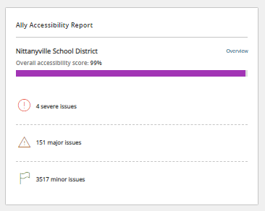
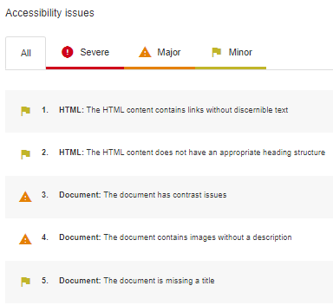
Accessing the Ally Report
Subsite or Section Workspace
Overview

Slide 9
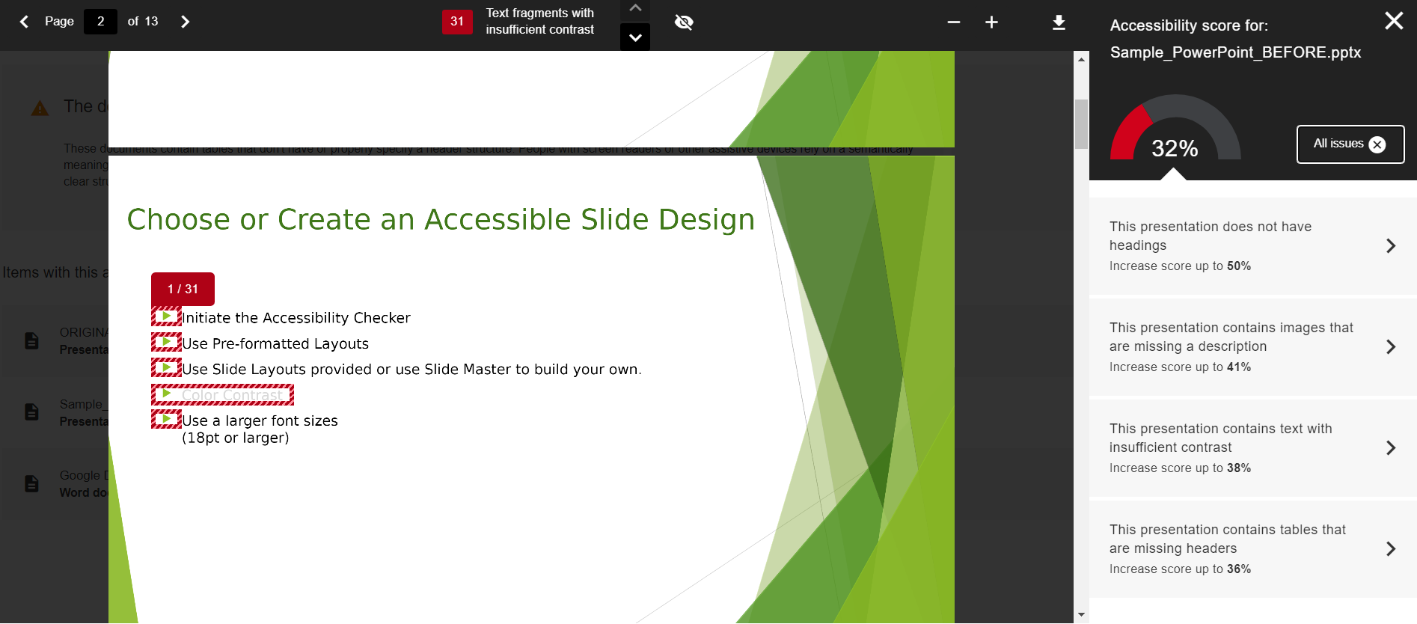
Instructor Feedback

Slide 10
Workshop Resource Webpage
https://gcpsk12.org/PPTXandAccessibility
Notes:
https://gcpsk12.org/PPTXandAccessibility

Slide 11
PowerPoint
Download the Sample PowerPoint Presentation
Open the Presentation File
Enable Editing
Show Ribbon and Tabs
Initiate Accessibility Checker

Slide 12
Microsoft Accessibility Checker
Errors
Warnings
Tips
Very difficult or impossible for people with disabilities to access.
In most cases but not all content is difficult to access.
Content that can be accessed but could be better organized or presented .
Notes:
Prior versions may have the accessibility checker under File and inspect

Slide 13
Choose or Create an Accessible Slide Design
Use Pre-formatted Layouts
Color Contrast
Use a larger font sizes (18pt or larger)
Notes:
Turned on Accessibility Checker
Modify Layout to Blue (Design / Variants / Blue Warm)
Fix Color Contrast Issue

Slide 14
Contrast
Low contrast can make content difficult to read
Check contrast for WCAG AA rating (4.5:1 Ratio)

Slide 15
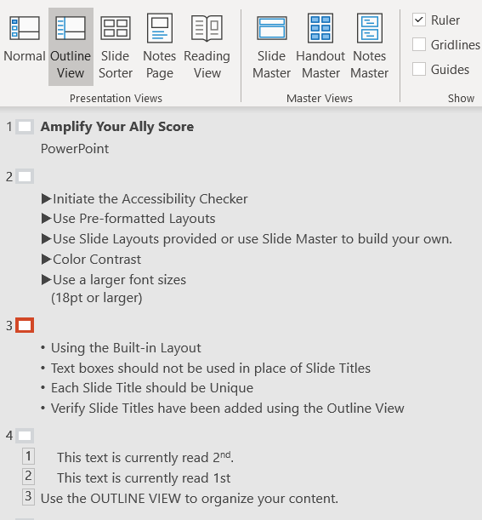
Slide Titles
Using the Built-in Layout
Unique Slide Title
Verify in the Outline View
NOTE: The Ally document check enforces a minimum of 1 title for every 7 slides in a PowerPoint document.
CAUTION! Just because it “looks” like a Title, doesn’t mean it is.
Notes:
Outline View (View Menu)

Slide 16
Reading Order
Use the SELECTION PANE (Home, Arrange) to organize your content.
Reading order is BOTTOM to TOP (Layers)
You may hide Objects visually, but still read by Screen Readers

Slide 17
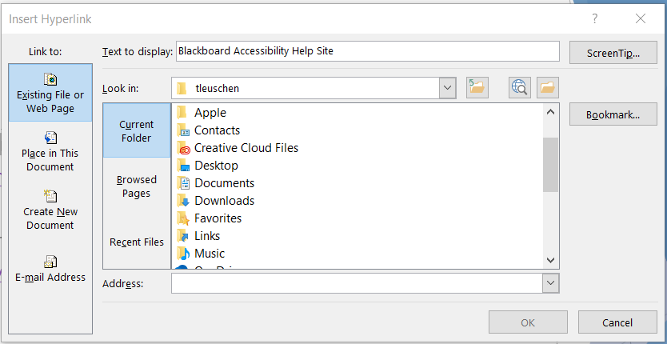
Links
Descriptive Text (for sharing electronically)
Descriptive Text and Short URL (for sharing electronically and as a printout.)
Screen Tip
Notes:
Alt Text:

Slide 18
Lists
Use Built-In Feature
Requires Paragraph Return (not line return)
Consider “Numbering” when order matters
Consider “Bullets” when order doesn’t matter
Note: Using built-in list tools is recommended when creating accessible lists.

Slide 19
Images
Alt Text allows assistive technologies to convert images into words.
Guidelines for Images:
Avoid unrelated images or mark as Decorative
Alt Text should be clear, concise, and descriptive. (1 – 2 Sentences)
Avoid using the same text for every image.
No need to include “image of…” or “picture of…” as part of alt text
If the image is an infographic you should use alt text to provide the information conveyed in the object.
Notes:
Alternative Text: Circle Graph representing an Overall Accessibility Score of 92%.

Slide 20
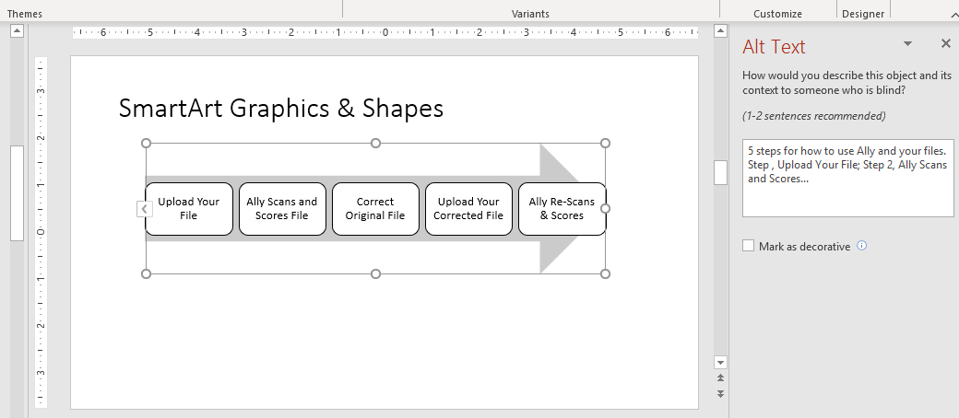
SmartArt Graphics & Shapes
It is also suggested to
Add Alternative Text or Mark as Decorative.
Avoid Unrelated Graphics, Shapes, etc.
Notes:
5 steps for how to use Ally and your files. Step 1 , Upload Your File; Step 2, Ally Scans and Scores...

Slide 21
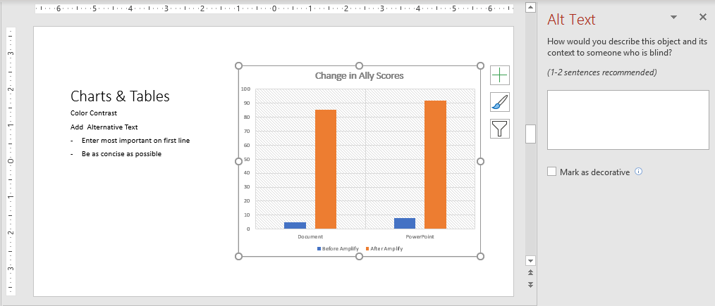
Charts
When using Charts, it is suggested to
Check Color Contrast
Add Alternative Text
Enter most important on first line
Be as concise as possible
Notes:
Clustered column chart comparing values of two Ally scores for two types of files.

Slide 22
Tables
Color Contrast
Choose a built in Table Design
Use simple table structure
Specify column header information
Add Alternative Text
Tables should not contain split cells, merged cells, or nested tables

Slide 23
Before Saving your PowerPoint File
PowerPoint
Title
PDF
Set Language
Save as .pptx
Title
Initiate Tags
Save as PDF
PowerPoint for Mac: Caution exporting to PDF will not yield an accessible, tagged PDF
Notes:
PowerPoint for Mac - Caution exporting to PDF will not yield an accessible, tagged PDF document.

Slide 24
Instructor Feedback – View Your PPT Improved Score
Upload the improved file.
Ally will immediately Score the new document.

Slide 25
Google Slides
Sign-in to your Google Account.
Follow the Link provided.
Open the Google Slides “Sample File”
Make a Copy of the file.
Rename the file.
Notes:
Open the Google Slide Sample

Slide 26
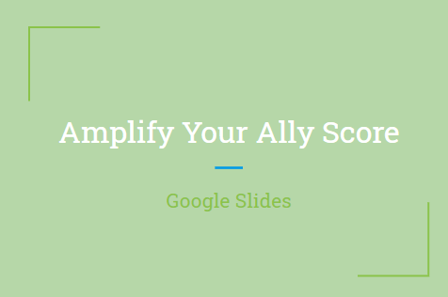
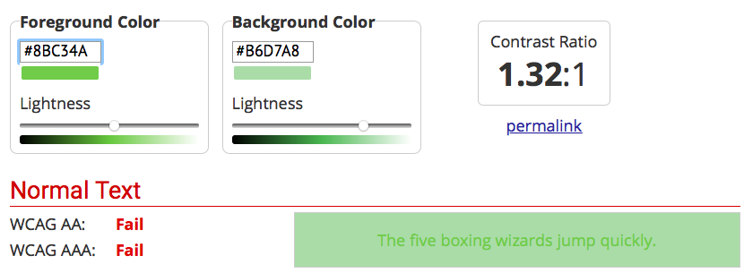
Choose or Create an Accessible Slide Design
Use Pre-formatted Layouts.
Adjust the Master colors (Color Contrast)
Use a larger font sizes (18pt or larger)
1.32:1 (Text to Background color ratio)
Notes:
Fix Color Contrast Issue : Master Slide background change to #073763 (Dark Blue #3)
Background Icon
Choose Dark Blue #3
Add to Theme
Or
Slide
Edit Master (Select “Master Slide)
Background
Dark Blue #3
CLEAR Formatting for to check the default size.

Slide 27
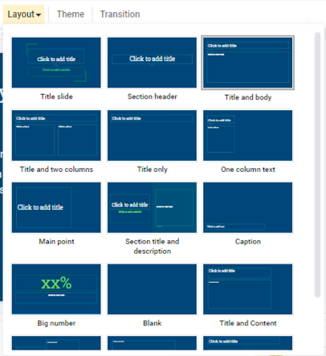
Slide Titles & Layout
Using the Built-in Layout
Unique Slide Title
NOTE: The Ally check enforces a minimum of 1 title for every 7 slides in a .pptx file.
Notes:
Correct the Slide Title

Slide 28
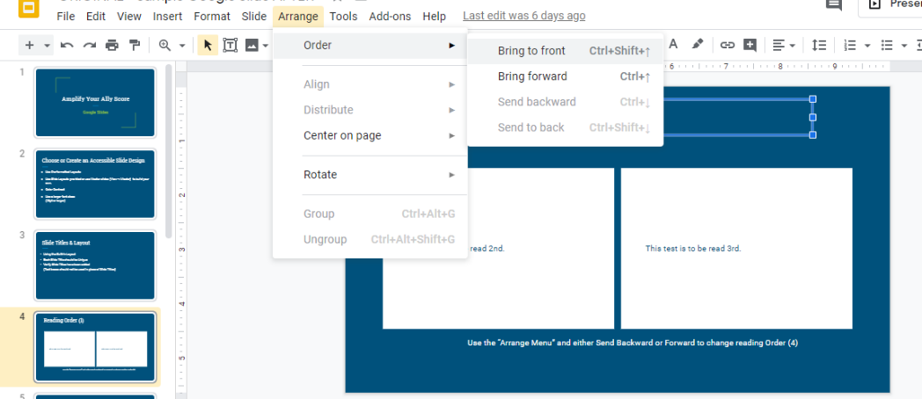
Reading Order
Check the order using your “tab” key.
Send BACKWARD raises the selected item higher in order.
Send FORWARD lowers the selected item in order.
Notes:
Tab to show order
Starting Order 2, 1, 3, 4
FIX: Select Box 1 and Arrange “Send Backward”
Test again to show it starting with 1, 2, 3, 4

Slide 29
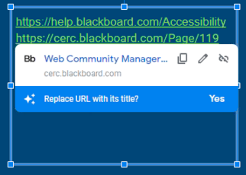
Links
Descriptive Text (for sharing electronically)
Descriptive Text and Short URL (for sharing electronically and as a printout.)
Notes:
Blackboard Accessibility Help Site
Amplify Training Series Website

Slide 30
Lists
Use Built in Paragraph List Tools
Consider using numbers when order matters.
Consider using bullets when order is not important.

Slide 31
Images and Alternative Text in Slides
Alt Text allows assistive technologies to convert images into words.
Guidelines for Alternative Text:
Title should be clear and concise (1 short sentence).
Description should be more detailed.
Avoid using the same text for every image.
Unrelated or decorative images may be marked as (ALT=“”)
Don’t include “image of…” or “picture of…” as part of alt text
If the image is an infographic you should use alt text to provide the information conveyed in the object.
Notes:
Alt Text:

Slide 32
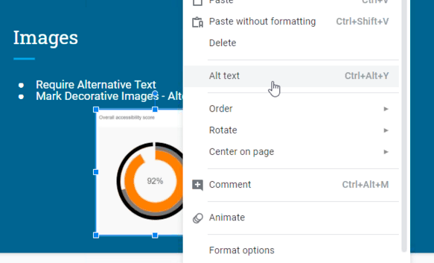
Adding Alternative Text
Notes:
Title:
Description:

Slide 33
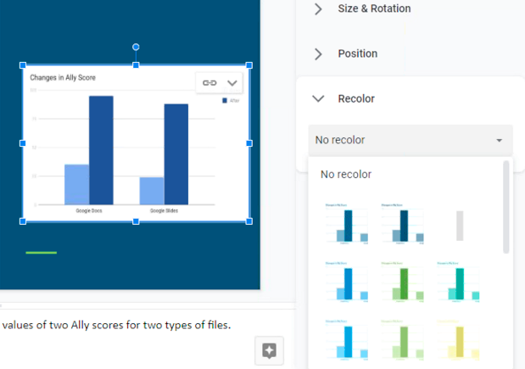
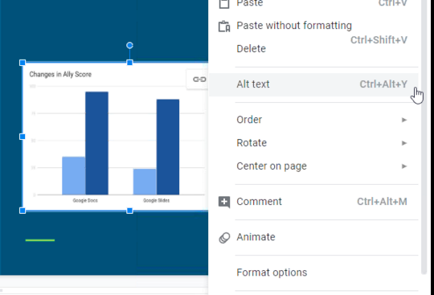
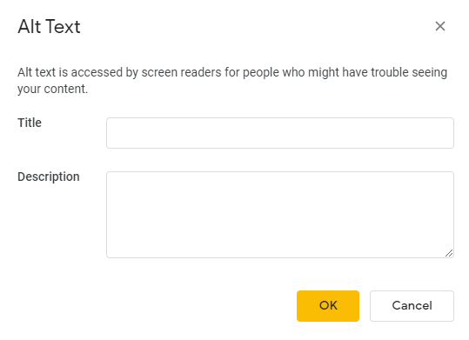
Charts
Review Format Options
Check Color Contrast
Modify using Recolor
Alternative Text
Enter most important info first
Consider including chart type
Be as concise as possible
Notes:
Color change: Light 2
Title: Ally Score Chart
Description: Clustered column chart comparing values of two Ally scores for two types of files.

Slide 34
Tables
Check Color Contrast
Use simple table structure
Add Alternative Text
Tables should not contain
split cells
merged cells
nested tables
Consider using alternative methods/programs to specify column/row header information.

Slide 35
Download Slides as File Type
.pptx
Choose .pptx
.pdf
Choose .pdf
For Consideration
For Consideration
Alternatives to Tables
Set Language
Tagging
File Title
Alternatives to Tables
Modify in PowerPoint
Modify in Adobe

Slide 36
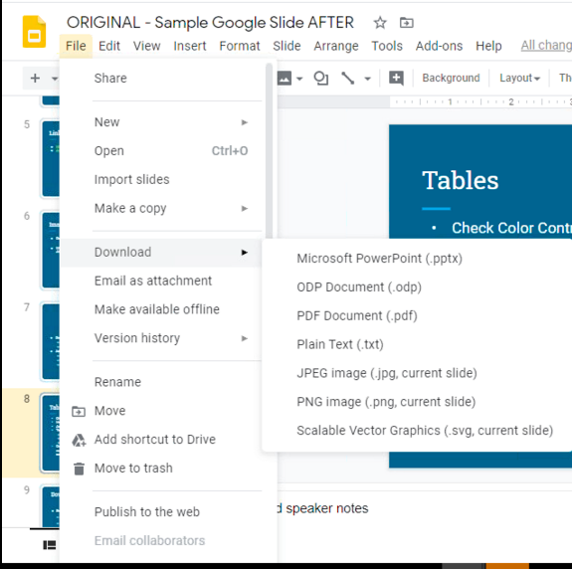
Download
File
Download
Choose a File Type
.pptx
.pdf

Slide 37
Instructor Feedback – View Your Improved Score
Upload the corrected file
Ally will immediately Score the new file.

Slide 38
Session Topics
Review Common Accessibility Issues for Websites
Analyze common .pptx file issues as reported by Ally
Demonstrate Instructor Feedback
Evaluate and improve the Ally score for a
MS PowerPoint Presentation
Google Slides Presentation
Compare and Contrast Instructor Feedback results

Slide 39
Have Questions or need Further Assistance?
Send an email to Blackboard Accessibility Support
Submit a FootPrints Ticket

