Slide 1
SOPHOMORE PARENT INFORMATION NIGHT
DULUTH COUNSELING TEAM
MAXWELL HIGH SCHOOL
GWINNETT TECH COLLEGE

Slide 2
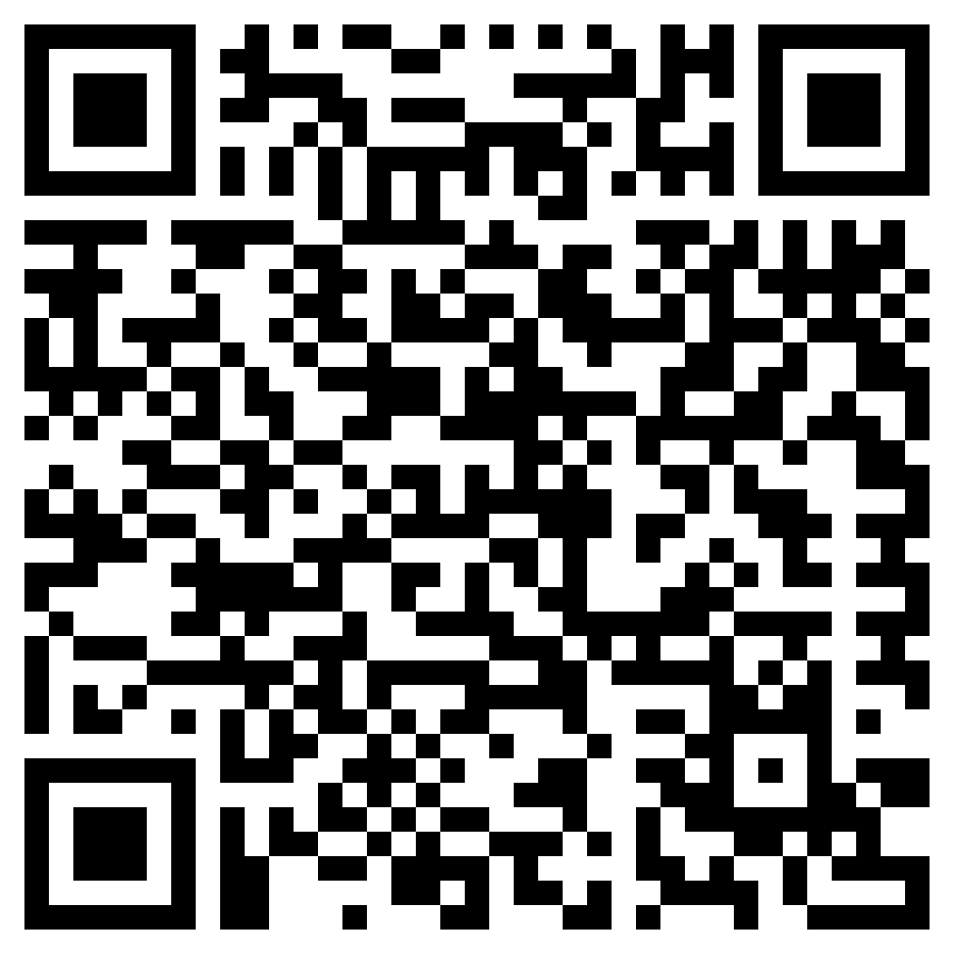
Meet the Counseling Team!

Slide 3
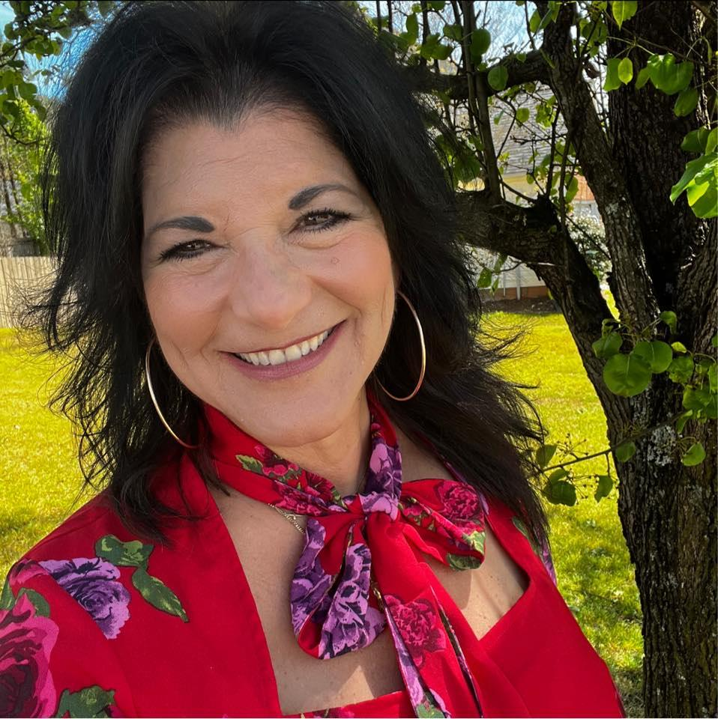
PARENT INSTRUCTIONAL COORDINATOR
Milagros Lockhart
Parent instructional coordinator
Provides support for families
Room 6-106
Office hours 6:45 AM- 2:45 PM
770 814 5562

Slide 4
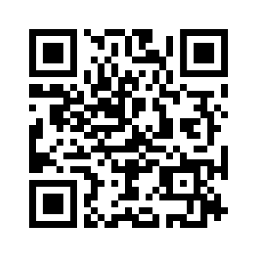
PARENT SQUARE
This unified communications platform is designed to keep parents and guardians informed and encourage greater engagement and connection with your child’s school and Gwinnett County Public Schools.

Slide 5
PARENT SQUARE HOW IT ALL WORKS

Slide 6
BENEFITS OF PARENT SQUARE
Check attendance
Grades
Discipline
Course History
Class Schedule
Other Pertinent Documents

Slide 7
GRADUATION REQUIREMENTS
Areas of Study Required: | 23 TOTAL CREDITS
Language Arts | 4*
Mathematics | 4*
Science | 4*
Social Studies | 3*
Modern/Classical Languages and/or Technical Education and/or Fine Arts | 3*
Health and Personal Fitness | 1
Electives | 4
5.0 credits needed to be promoted to Sophomore status
11.0 credits needed to be promoted to Junior status
17.0 credits needed to be promoted to Senior status
*2 years of World Language required for four year universities*
.50 CREDIT IS EARNED PER CLASS
1.00 CREDIT IS EARNED PER YEAR
.50 CREDIT CAN BE EARNED PER SEMESTER

Slide 8
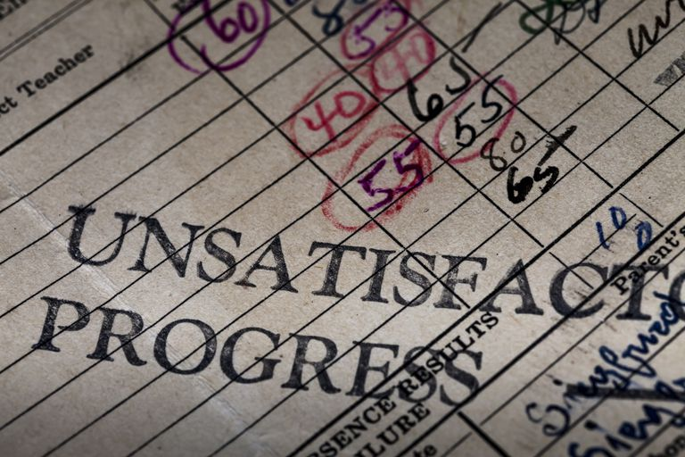
EXTRA HELP RESOURCES
C25 – P2P Tutoring Available
ore/After School
Khan Academy
NTI Room – during lunch periods
Peer to Peer tutoring (e-class)
Teacher help before and after school. ( talk to your teacher)
NTI Room during all lunch periods.
Credit Recovery ( failing grade must be no lower than 50)Please see your counselor
Public Library( provide tutoring online Tutor.com)
This Photo by Unknown Author is licensed under CC BY-SA

Slide 9
PSAT FOR ALL DULUTH’S SOPHOMORES OCTOBER 29TH (Free of Charge)
Why Should I Take PSAT?
Prepares students for the SAT
Opens doors to colleges
Connects students to scholarship opportunities - NMSQT
Increases access to Advanced Placement (AP) & college credit
For more information go to:
https://collegereadiness.collegeboard.org

Slide 10
Official SAT Practice for Free Khan Academy
PRACTICE MATERIAL
https://www.khanacademy.org

Slide 11
Sophomore Core Curriculum Lesson
Review Individual Graduate Plan
Complete Career Assessment
Discuss Dual Enrollment – Spring 2025
Maxwell / Grayson
Review PSAT Score Analysis- December Advisement

Slide 12
BRIDGE BILL LESSON: Building A Solid Foundation
Career Interest
Work Values
Strength Exploring
Career Skills
Personality
Character
Soft Skills

Slide 13
MENTAL HEALTH IS GOOD HEALTH
Counselors have many resources for counseling outside of school.
KidsNet referral
APEX referral
Community Resources
Group counseling options
GCPS referral list by Health Insurance coverage

Slide 14
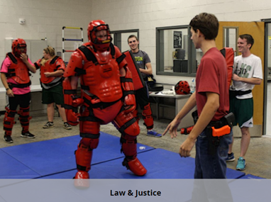
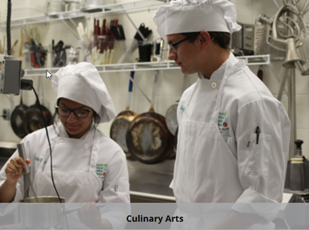
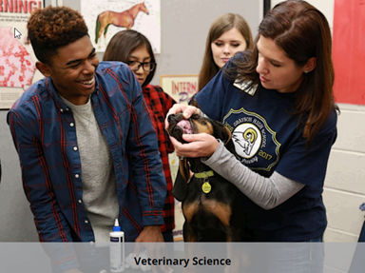
Grayson Technical High School
TRANSPORTATION PROVIDED

Slide 15
Maxwell High School of Technology Success!
Dr. LaVonna Groce

Slide 16
18 Maxwell Programs
Animation and Digital Media
Culinary Arts
Flight Operations
Architectural Drawing
Early Childhood Education
General Automotive Technology
Carpentry
Electronics
Graphic Design
Collision Repair I
Fire & Emergency
HVACR
Law Enforcement
Personal Care Services
Therapeutic Services
Manufacturing
Therapeutic Services
Welding

Slide 17
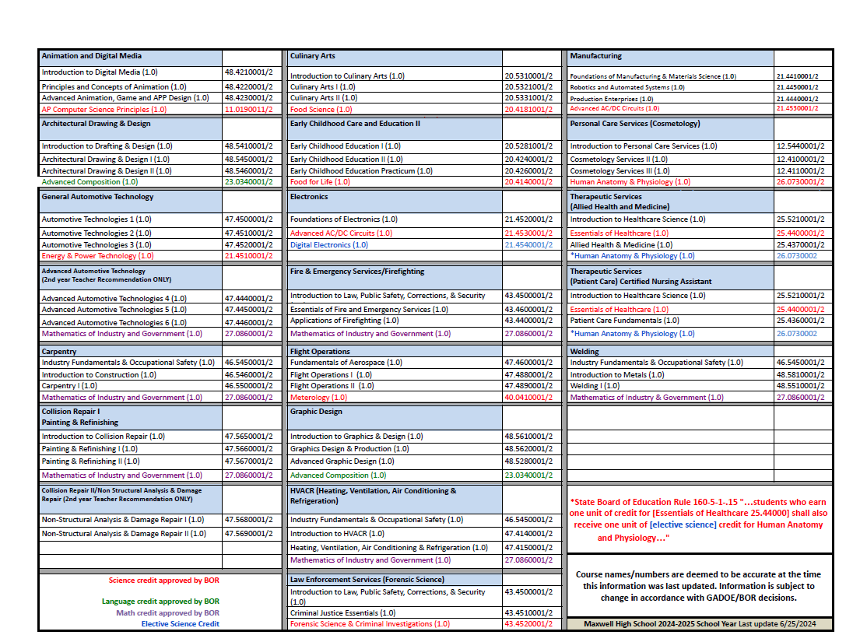

Slide 18
Typical Day of a Maxwell Student
Students receives 3 to 4 credits
In class for 2 ½ to 3 hours with a 10 min break
Students spends half the day at Home School and half the day at Maxwell
No lunch is served at Maxwell, students eat lunch at the home school and attend Maxwell during Morning or Afternoon
Students mostly take the bus from homeschool to Maxwell
Chick-Fil-A is available for purchase on Tuesday and Thursday

Slide 19
Great Learning Experience Job information – Work Ready/ Employment after high School Maxwell Teacher- Great future recommendation Work Experience- you are gaining work experience from your Maxwell Program Interested in getting into the field of your program in the future- ask your teacher if they know names of companies that may hire, colleges to attend
As a Student at Maxwell High School, you gain…

Slide 20
Maxwell Clubs
SkillsUSA
HOSA (Future Health Professionals)
Maxwell Student Ambassadors

Slide 21
Work Ready Program Advisement and Social Emotional Learning Program at Maxwell
Advisement Program that focuses on learning Work readiness skills.
Social Emotional Learning
lessons and tasks
Skills: interview skills, work communication skills, dress, etiquette.
Teaches Employability skills to all Maxwell students.

Slide 22
Certification within Industry
OSHA 10, NCCER Construction Level !
SERV Safe
CPR
S.P.2 Collision Safety Certification
S.P.2 Collision Pollution Prevention Certification
S.P.2 Ethics and You Certification
E.OP.A. assessment for Painting and Refinishing A.S.E. Certification ( with a Passing Score)
E.O.P.A. Assessment for No n- Structural repair A.S.E. ( with a passing score )
I-Car P.D.P.- E.E. student certification ( with Passing score)
Revit User Certification Exam
And More

Slide 23
Maxwell High School of Technology Video:
Click on the link and enjoy! (6 minutes long): https://www.youtube.com/watch?v=oY4x3euBDeI

Slide 24
Thank You!
For more Information:
Head Counselor
Dr. LaVonna Groce
770-338-4604
Counselor
Ms. Stephanie Medlin
770-338-4605

Slide 25
GWINNETT TECHNICAL COLLEGE
Ms. Jennifer Rodriguez

