Slide 1
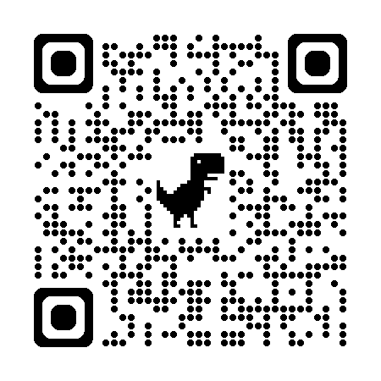
August 24, 2024
Presented by Duluth High School Counselors & Title I Department
SlidesSlides
Senior Parent Night
Class of 2025
Please sign in using the QR Code.
Welcome DHS Parents!

Slide 2
1S
Introductions
Senior Class Information
2
Application for Graduation
College Planning Tips
Tonight’s
Agenda
3
Financial Aid Presentation
4
PROBE College & Career Fair
Location: Old Gym

Slide 3
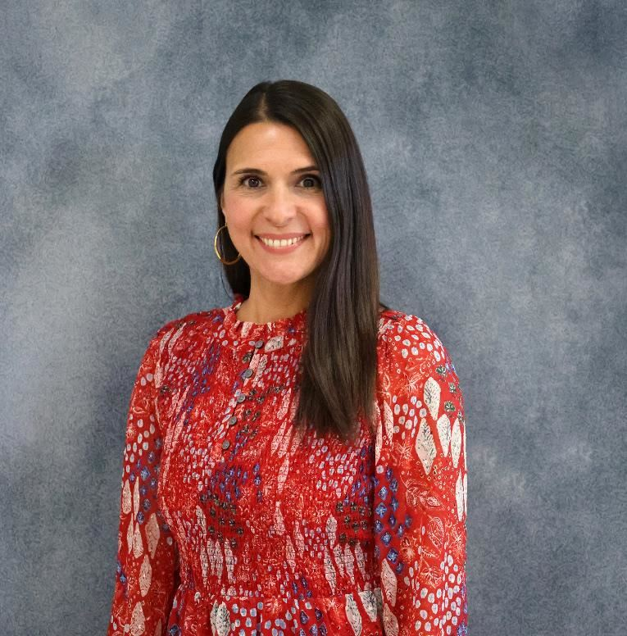
Hello!
A word from our new principal,
Ms. Cindy Kinchen

Slide 4
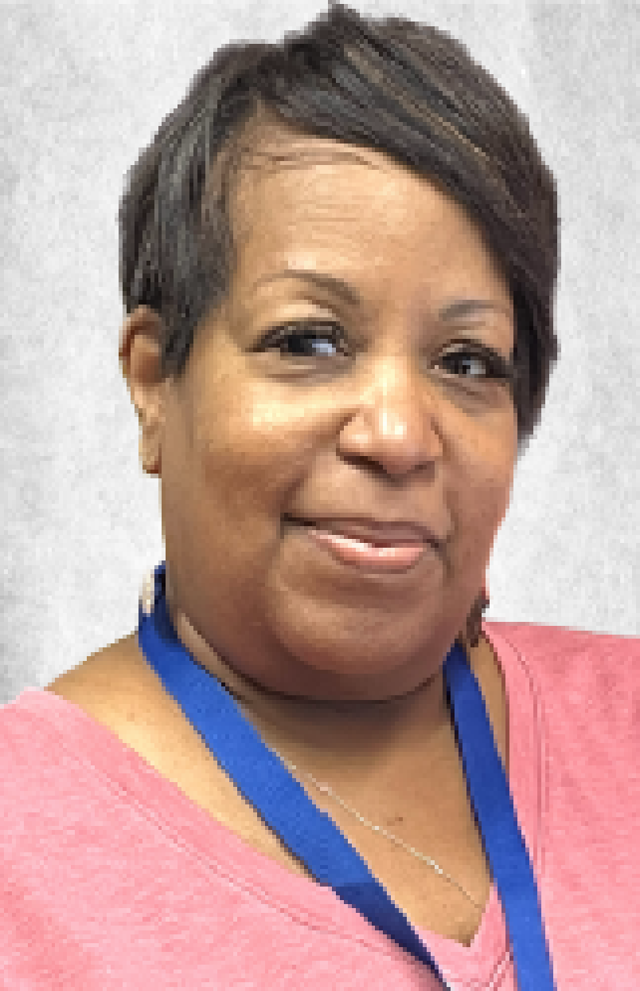
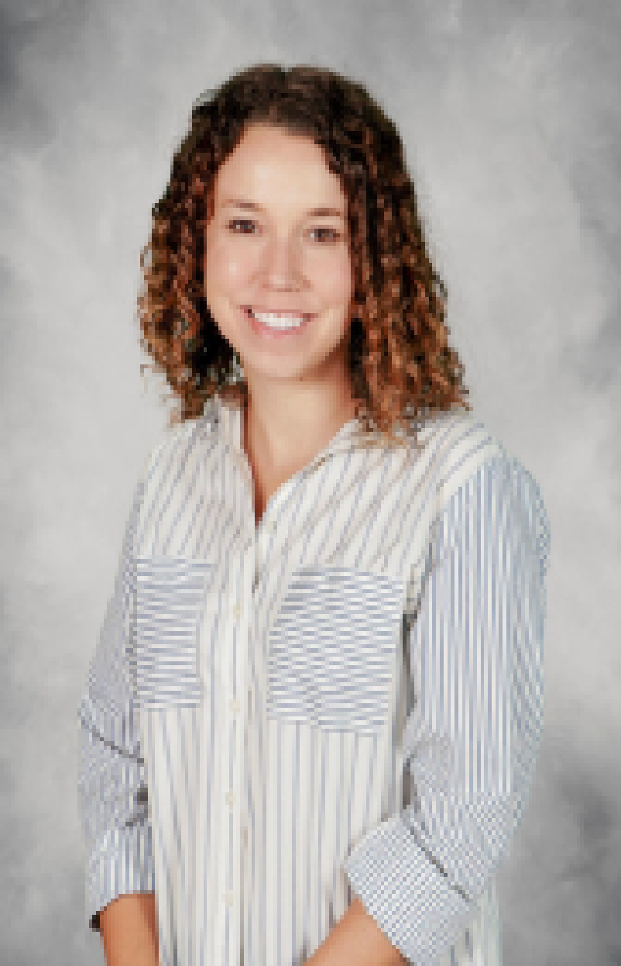
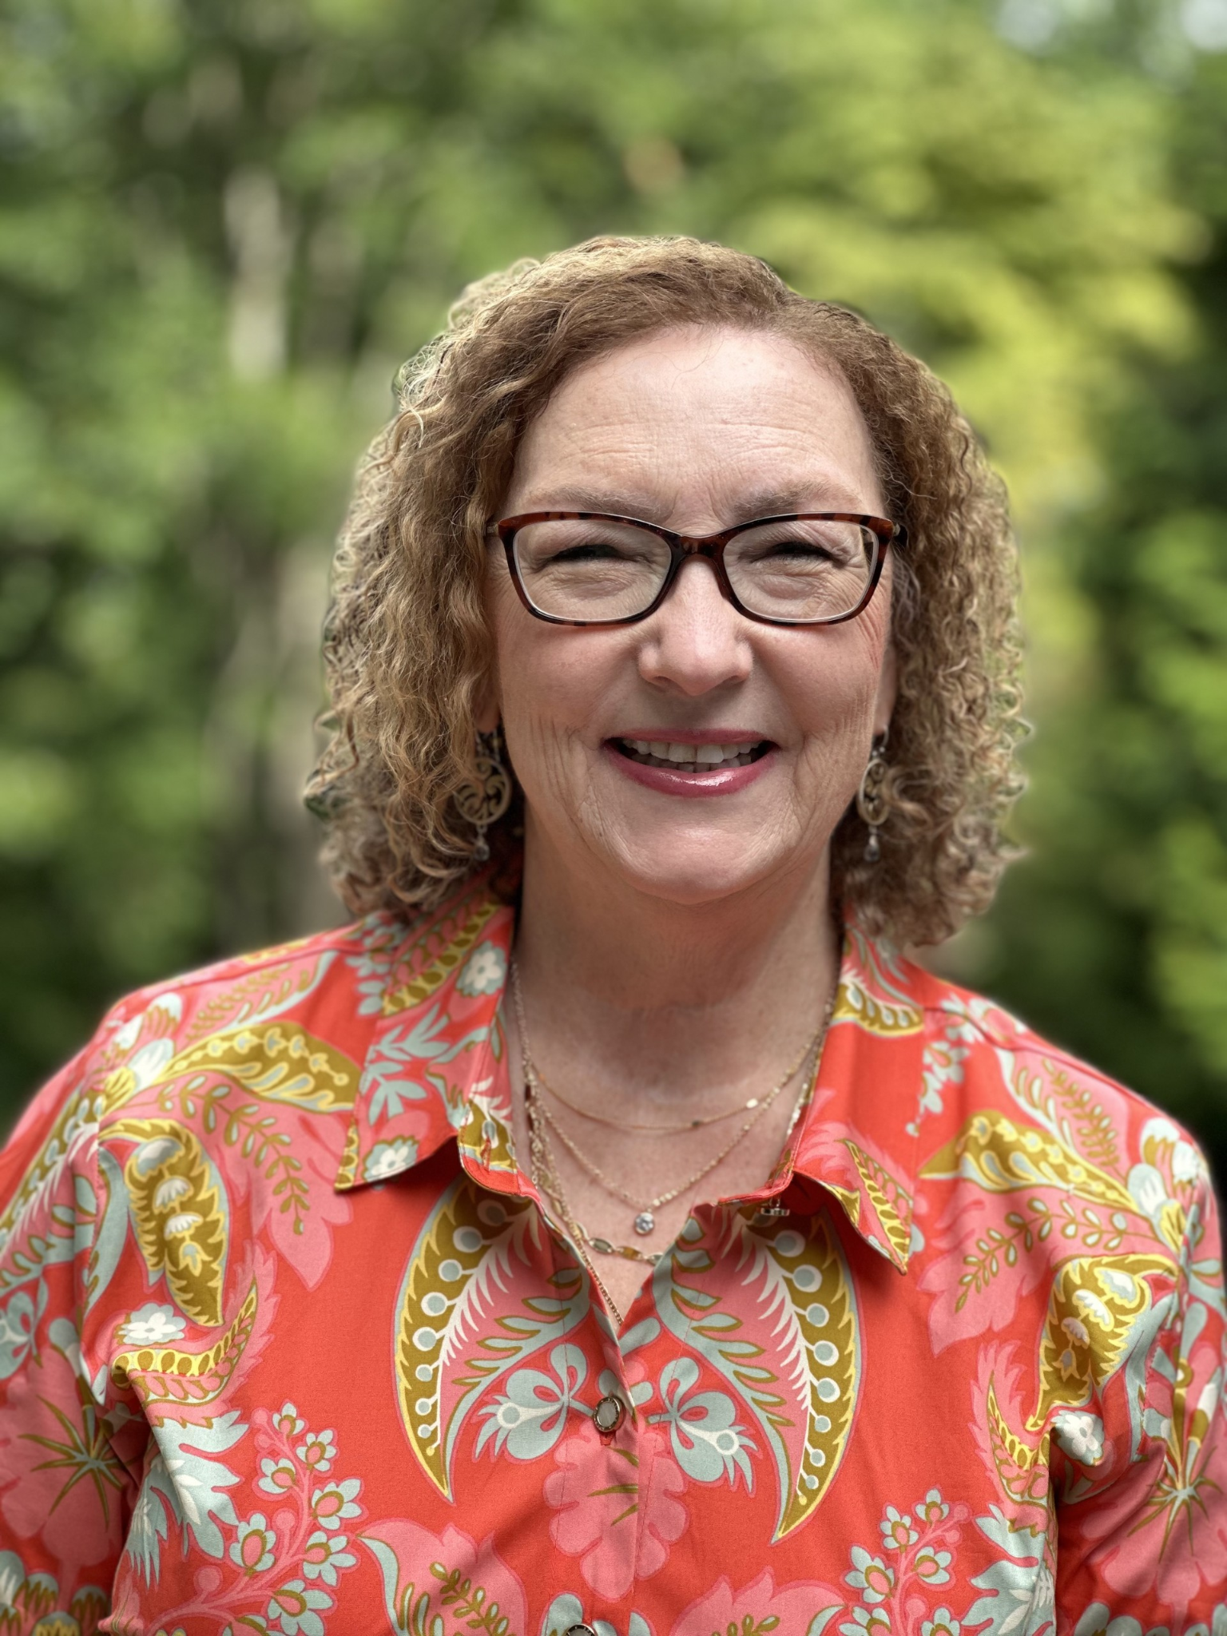
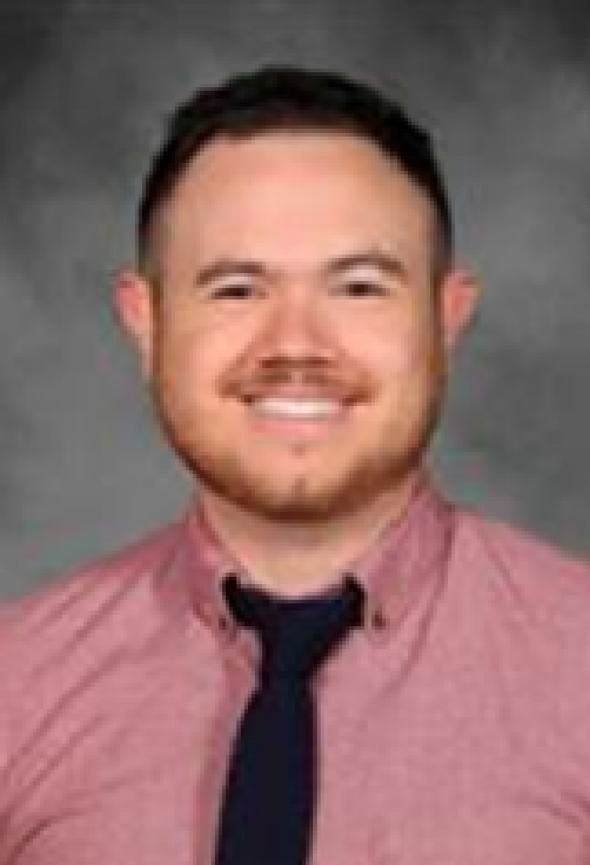
OUR COUNSELORS
Mrs. Coffey Ms. Ingwersen Mrs. Tepker Mr. Lilly
A-Ce Ch- Cl Go-La Le-Ok

Slide 5
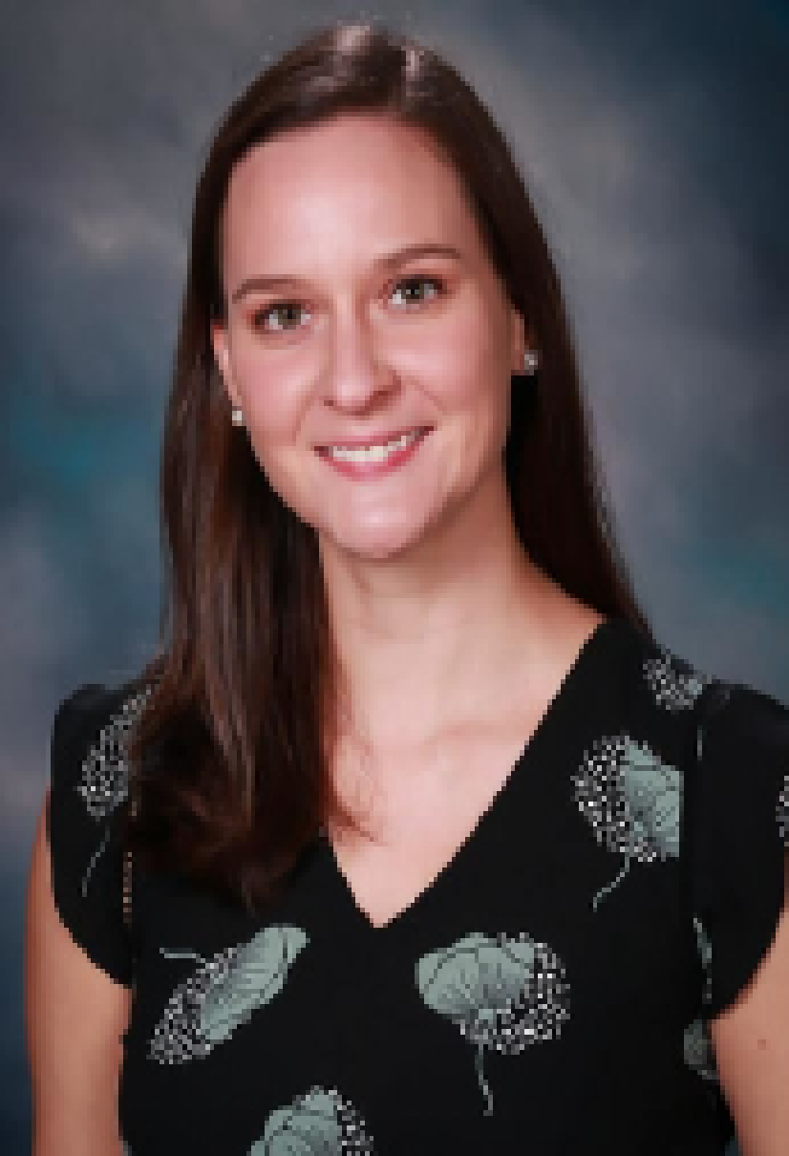
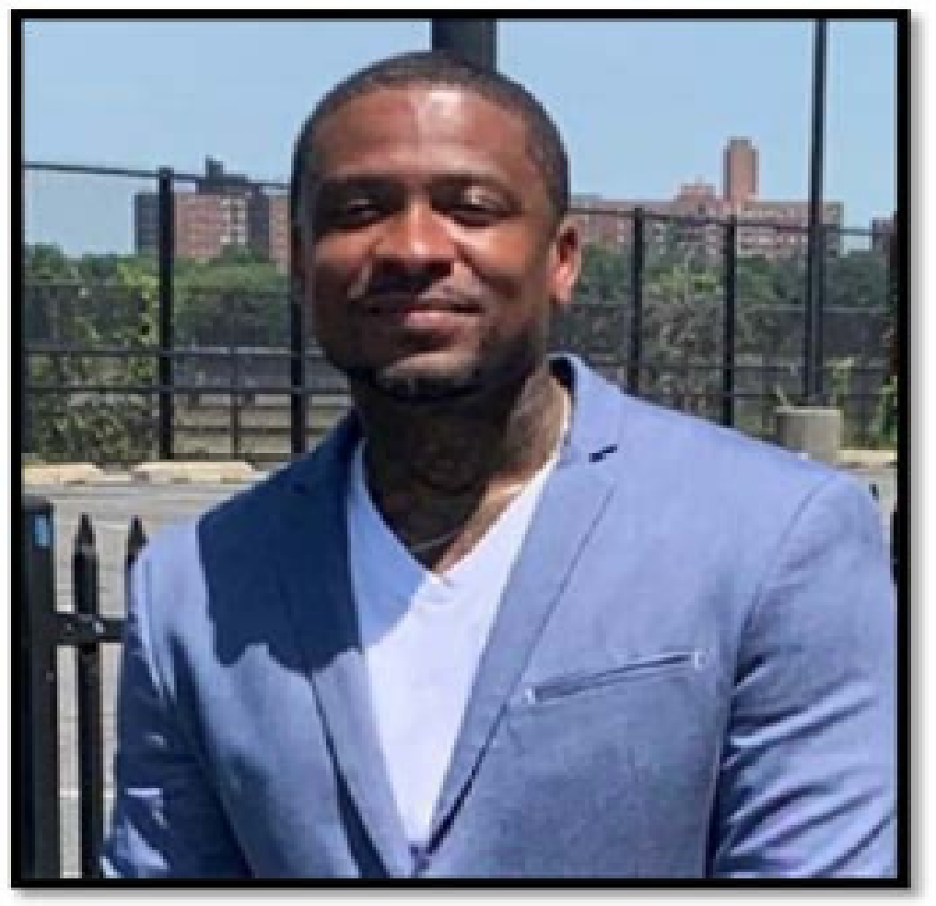
OUR COUNSELORS
Ms. Summers Mrs. Smith Mr. Miller Mrs. McClammey
Ol-Se Sh-Z 9th Grade 9th Grade

Slide 6
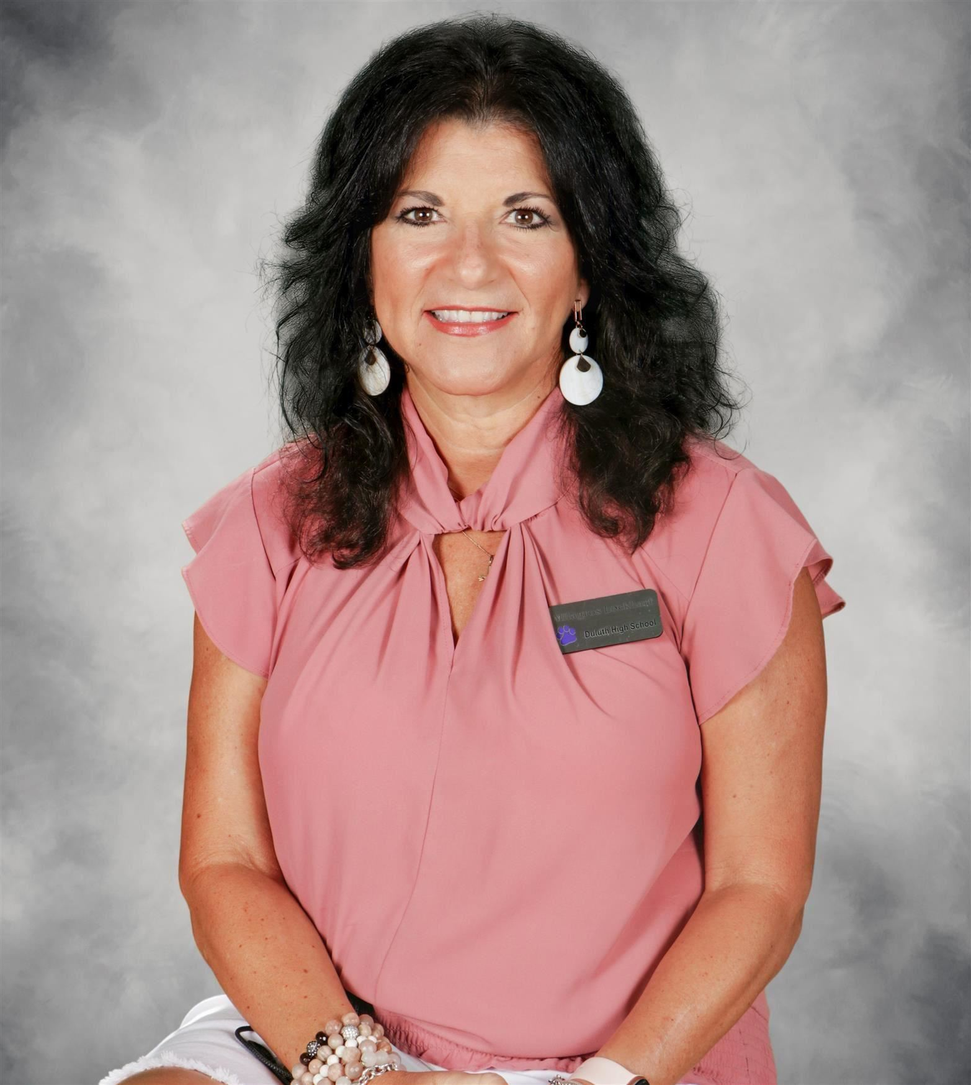
DHS Family Center
Mrs. Milagros Lockhart
Parent Instructional Coordinator
Room 6-106
6:45AM-2:45PM
770-814-5562
milagros.lockart@gcpsk12.org

Slide 7
Senior Class Information
Duluth High School
Class of 2025
Presented by Mrs. Jacqueline Cain
Jacqueline.cain@gcpsk12.org

Slide 8
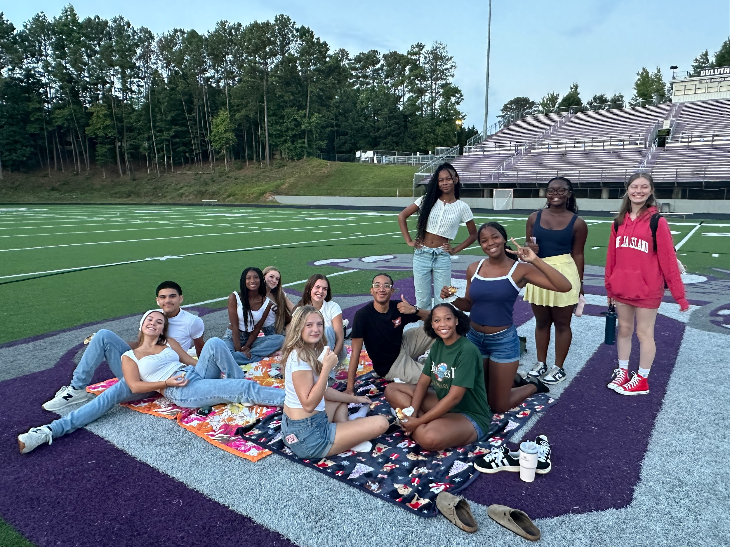
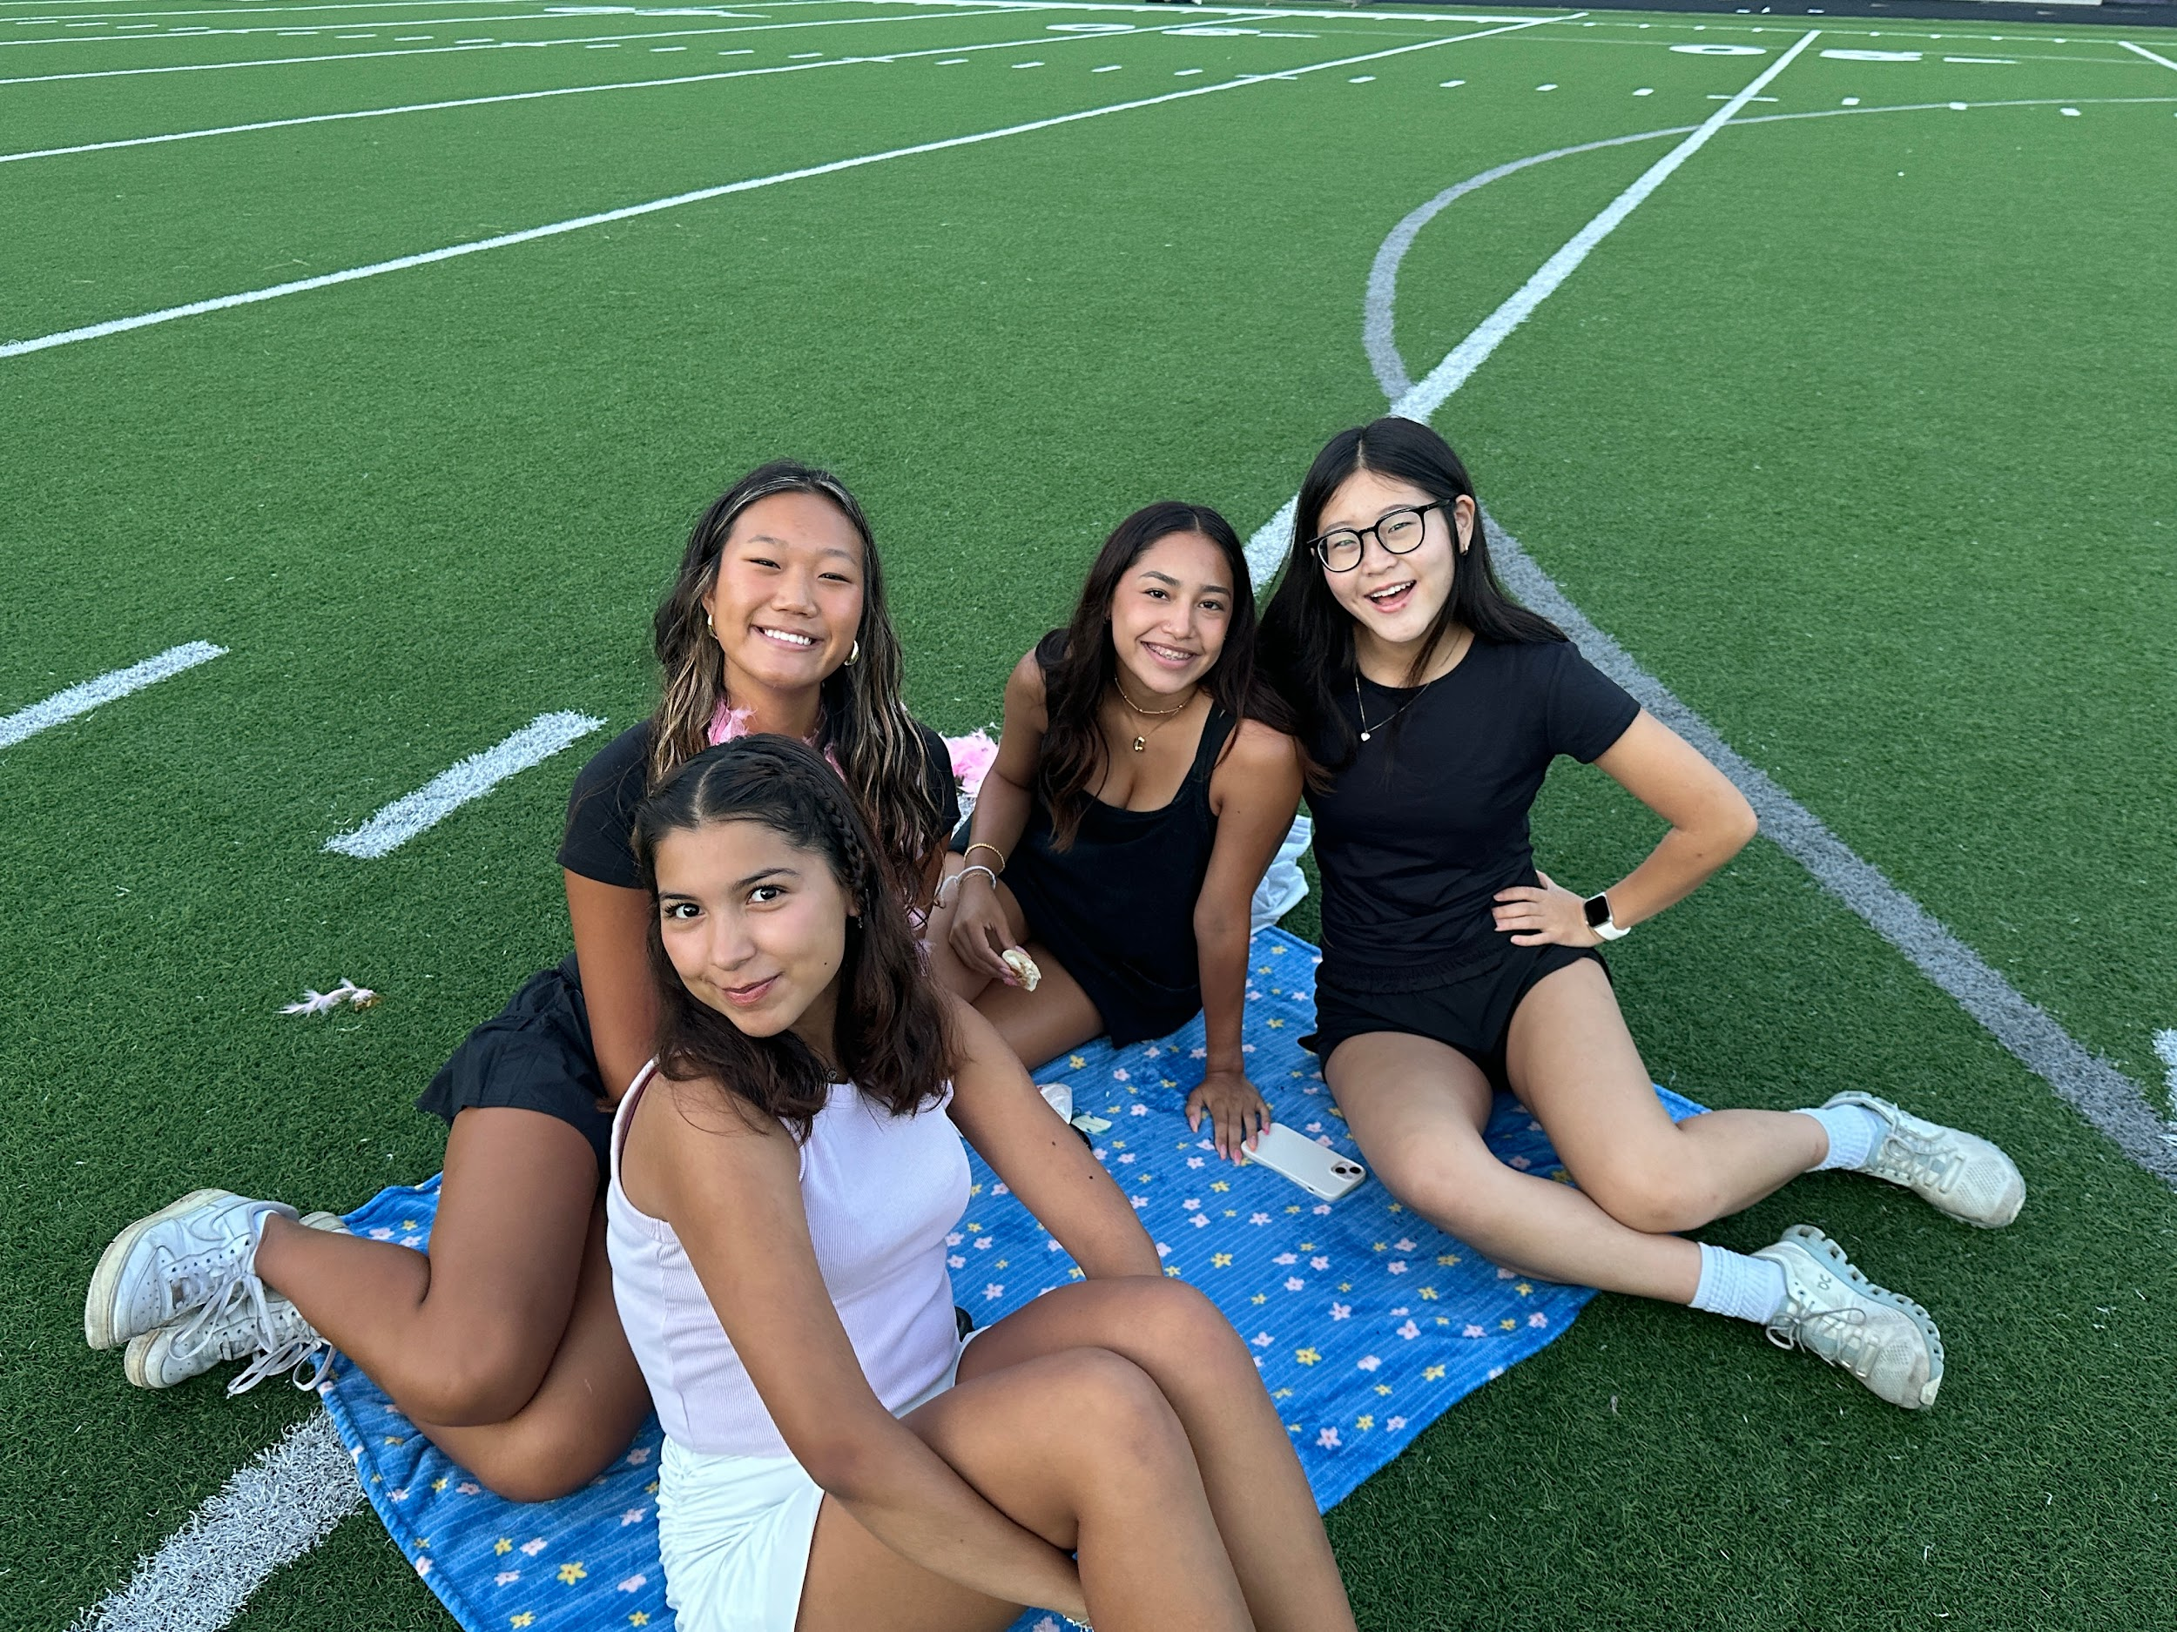
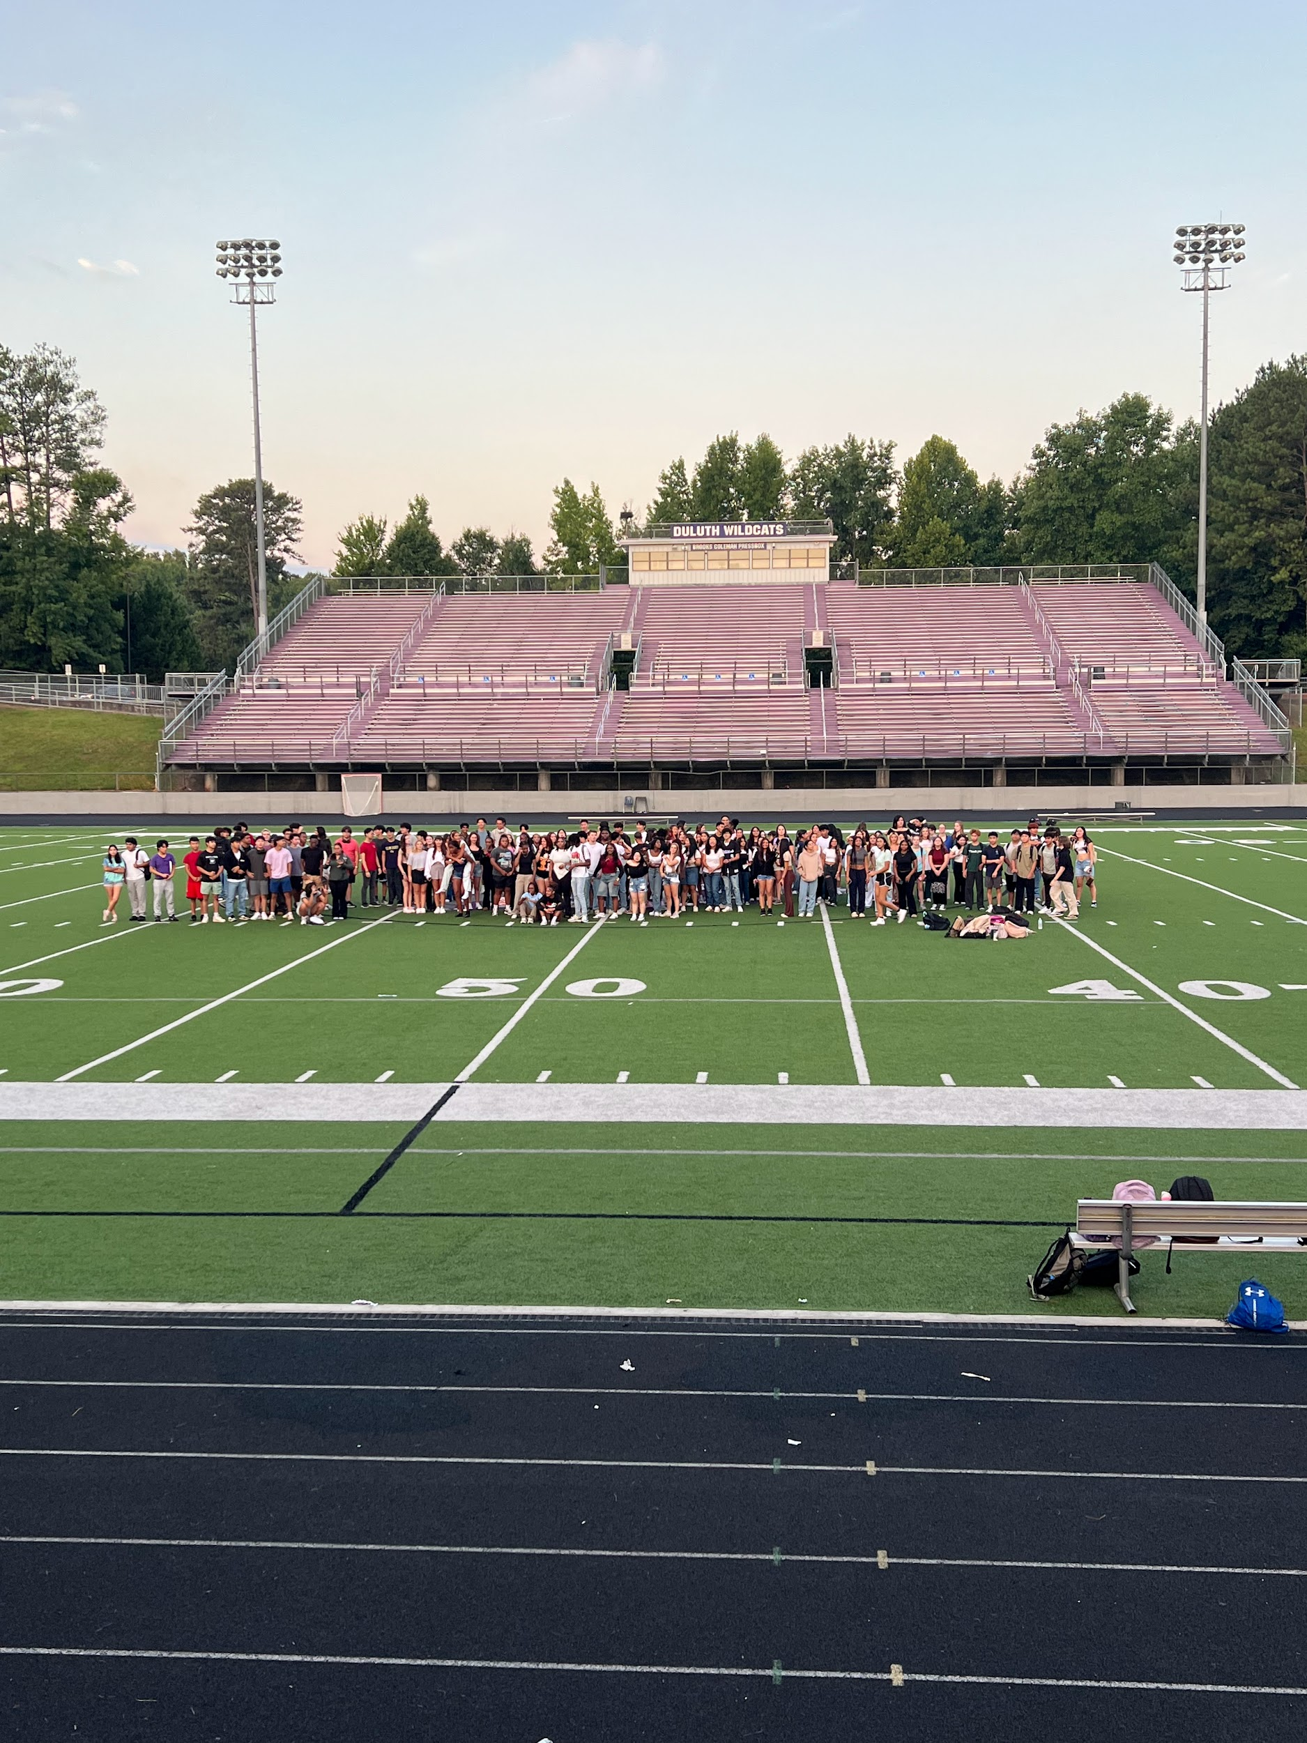
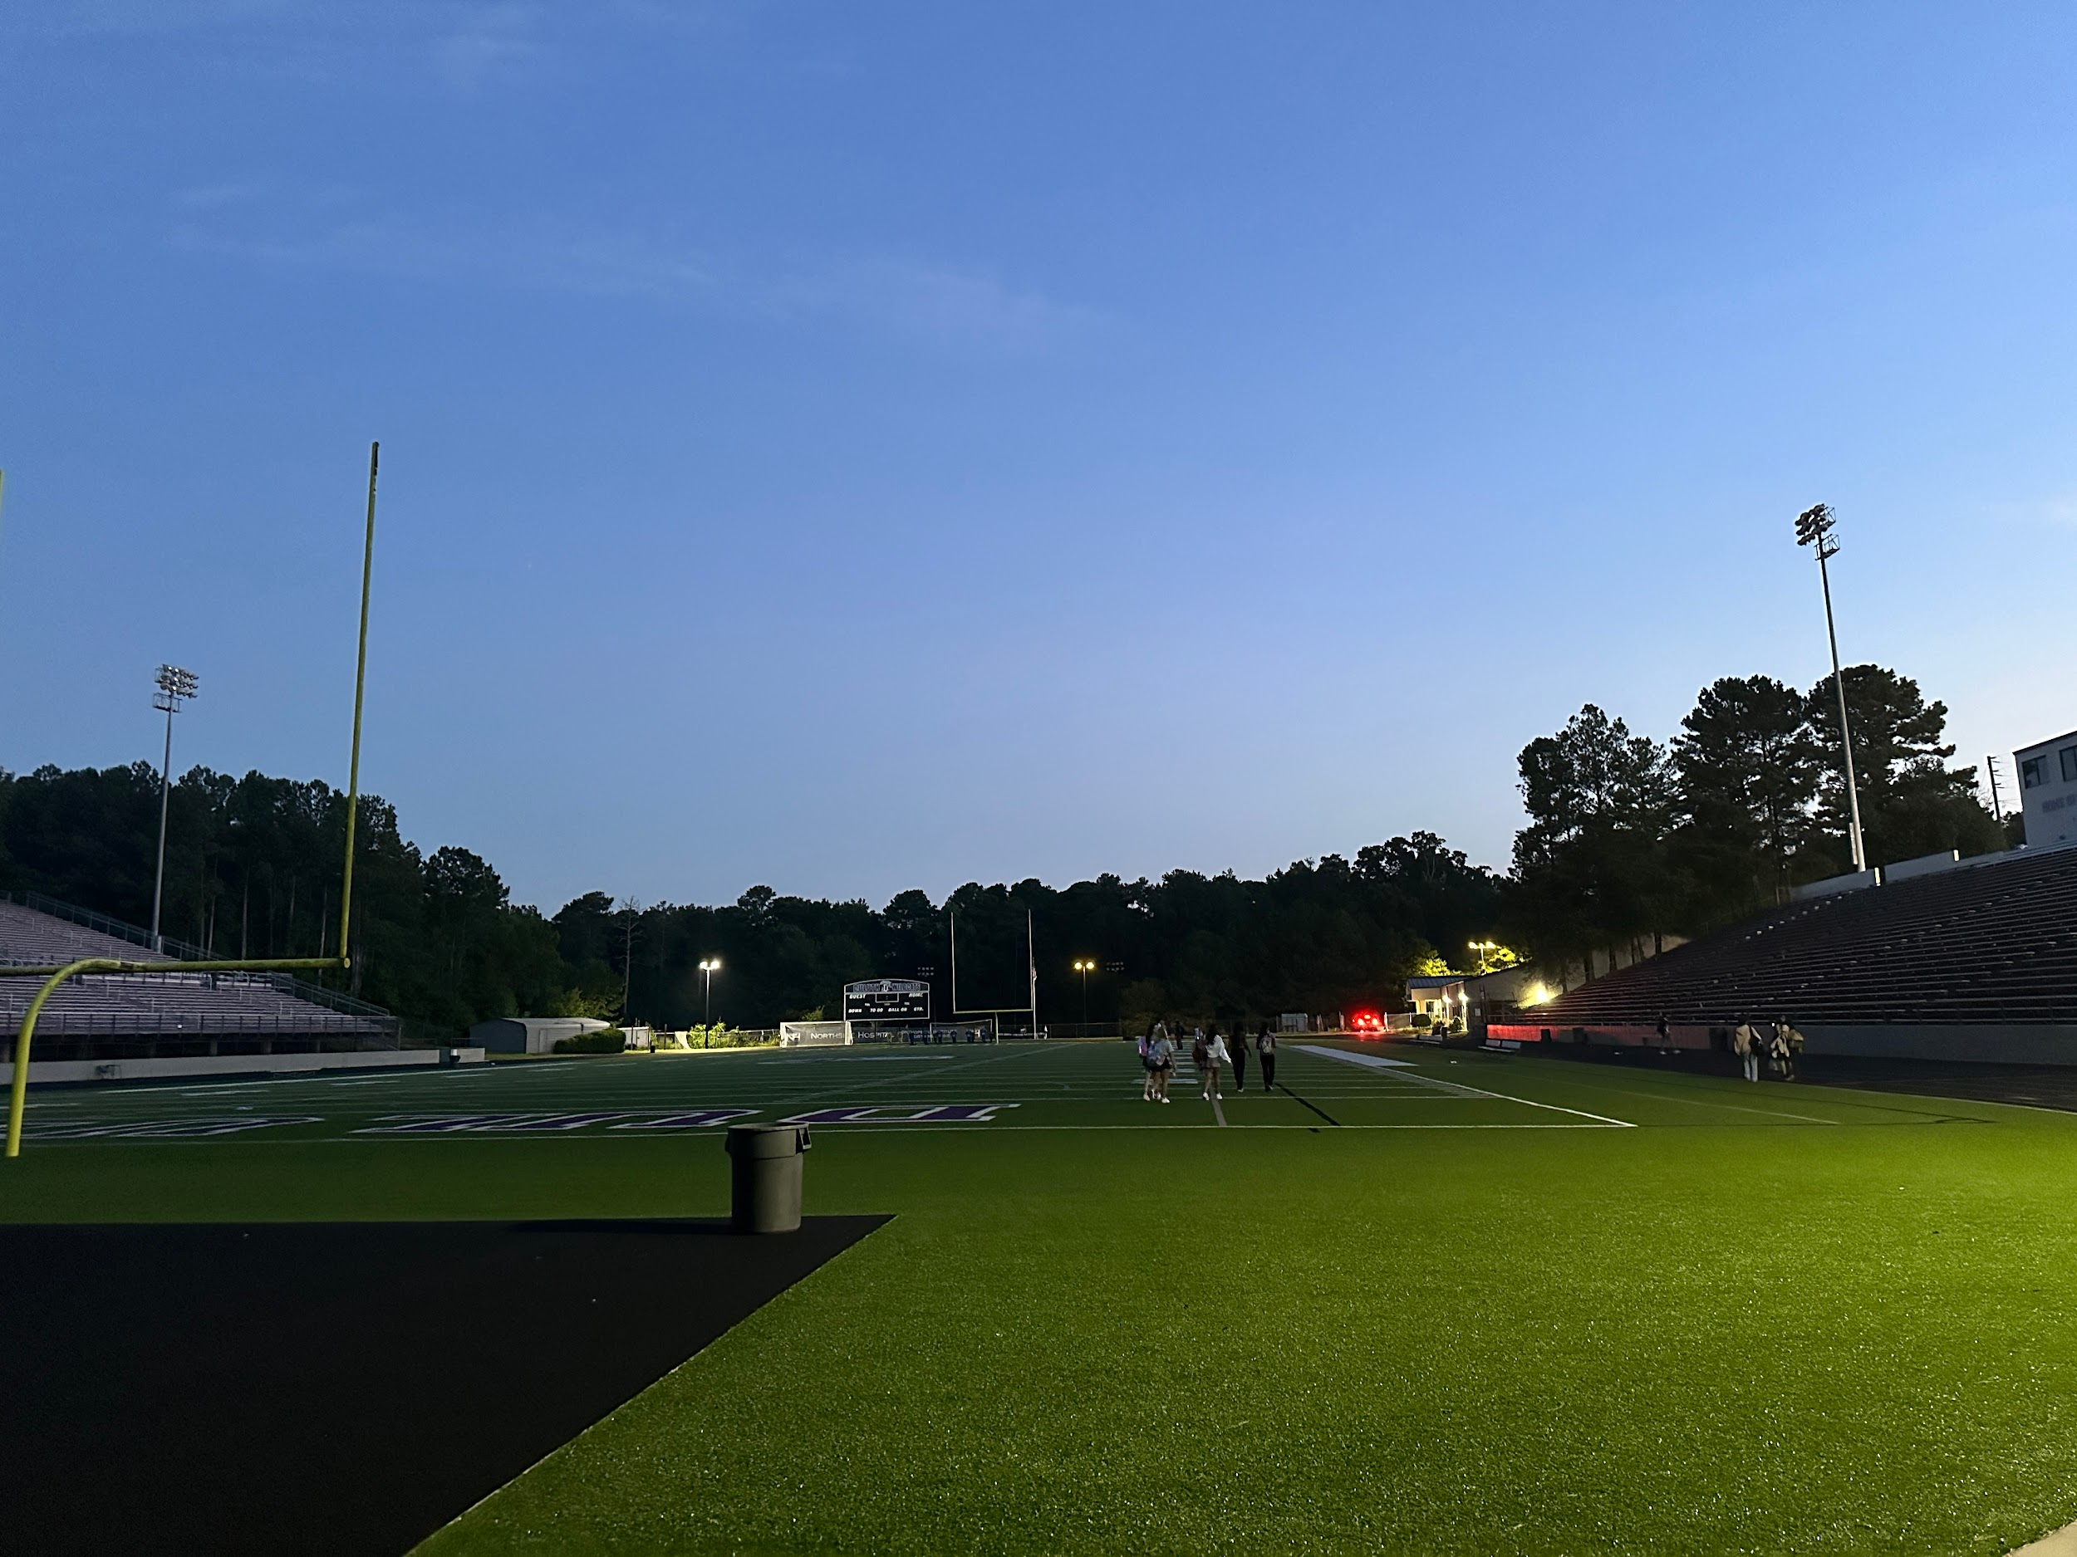
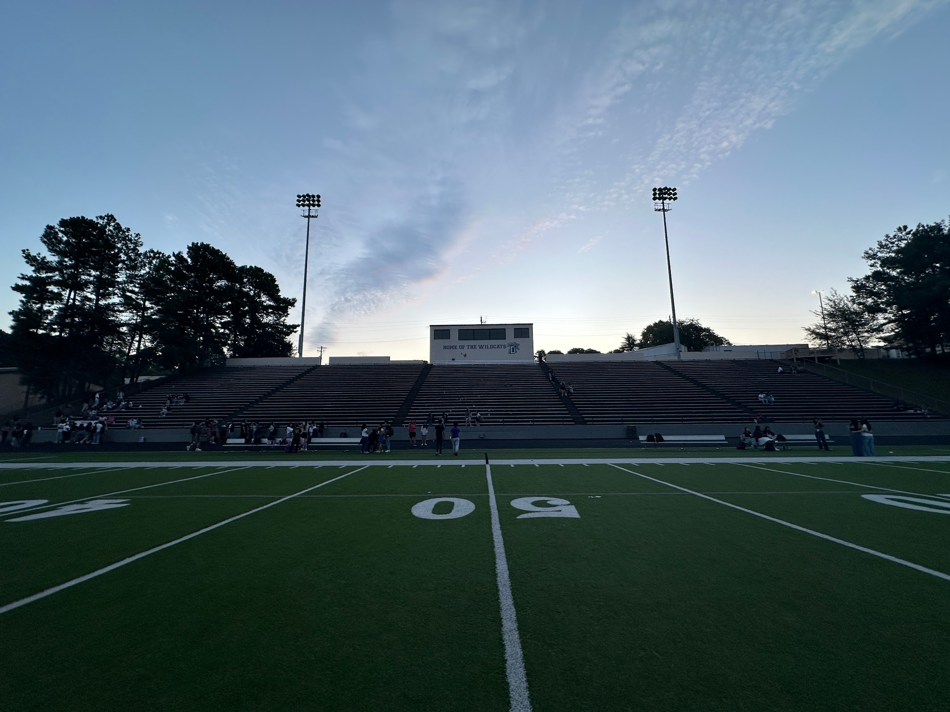
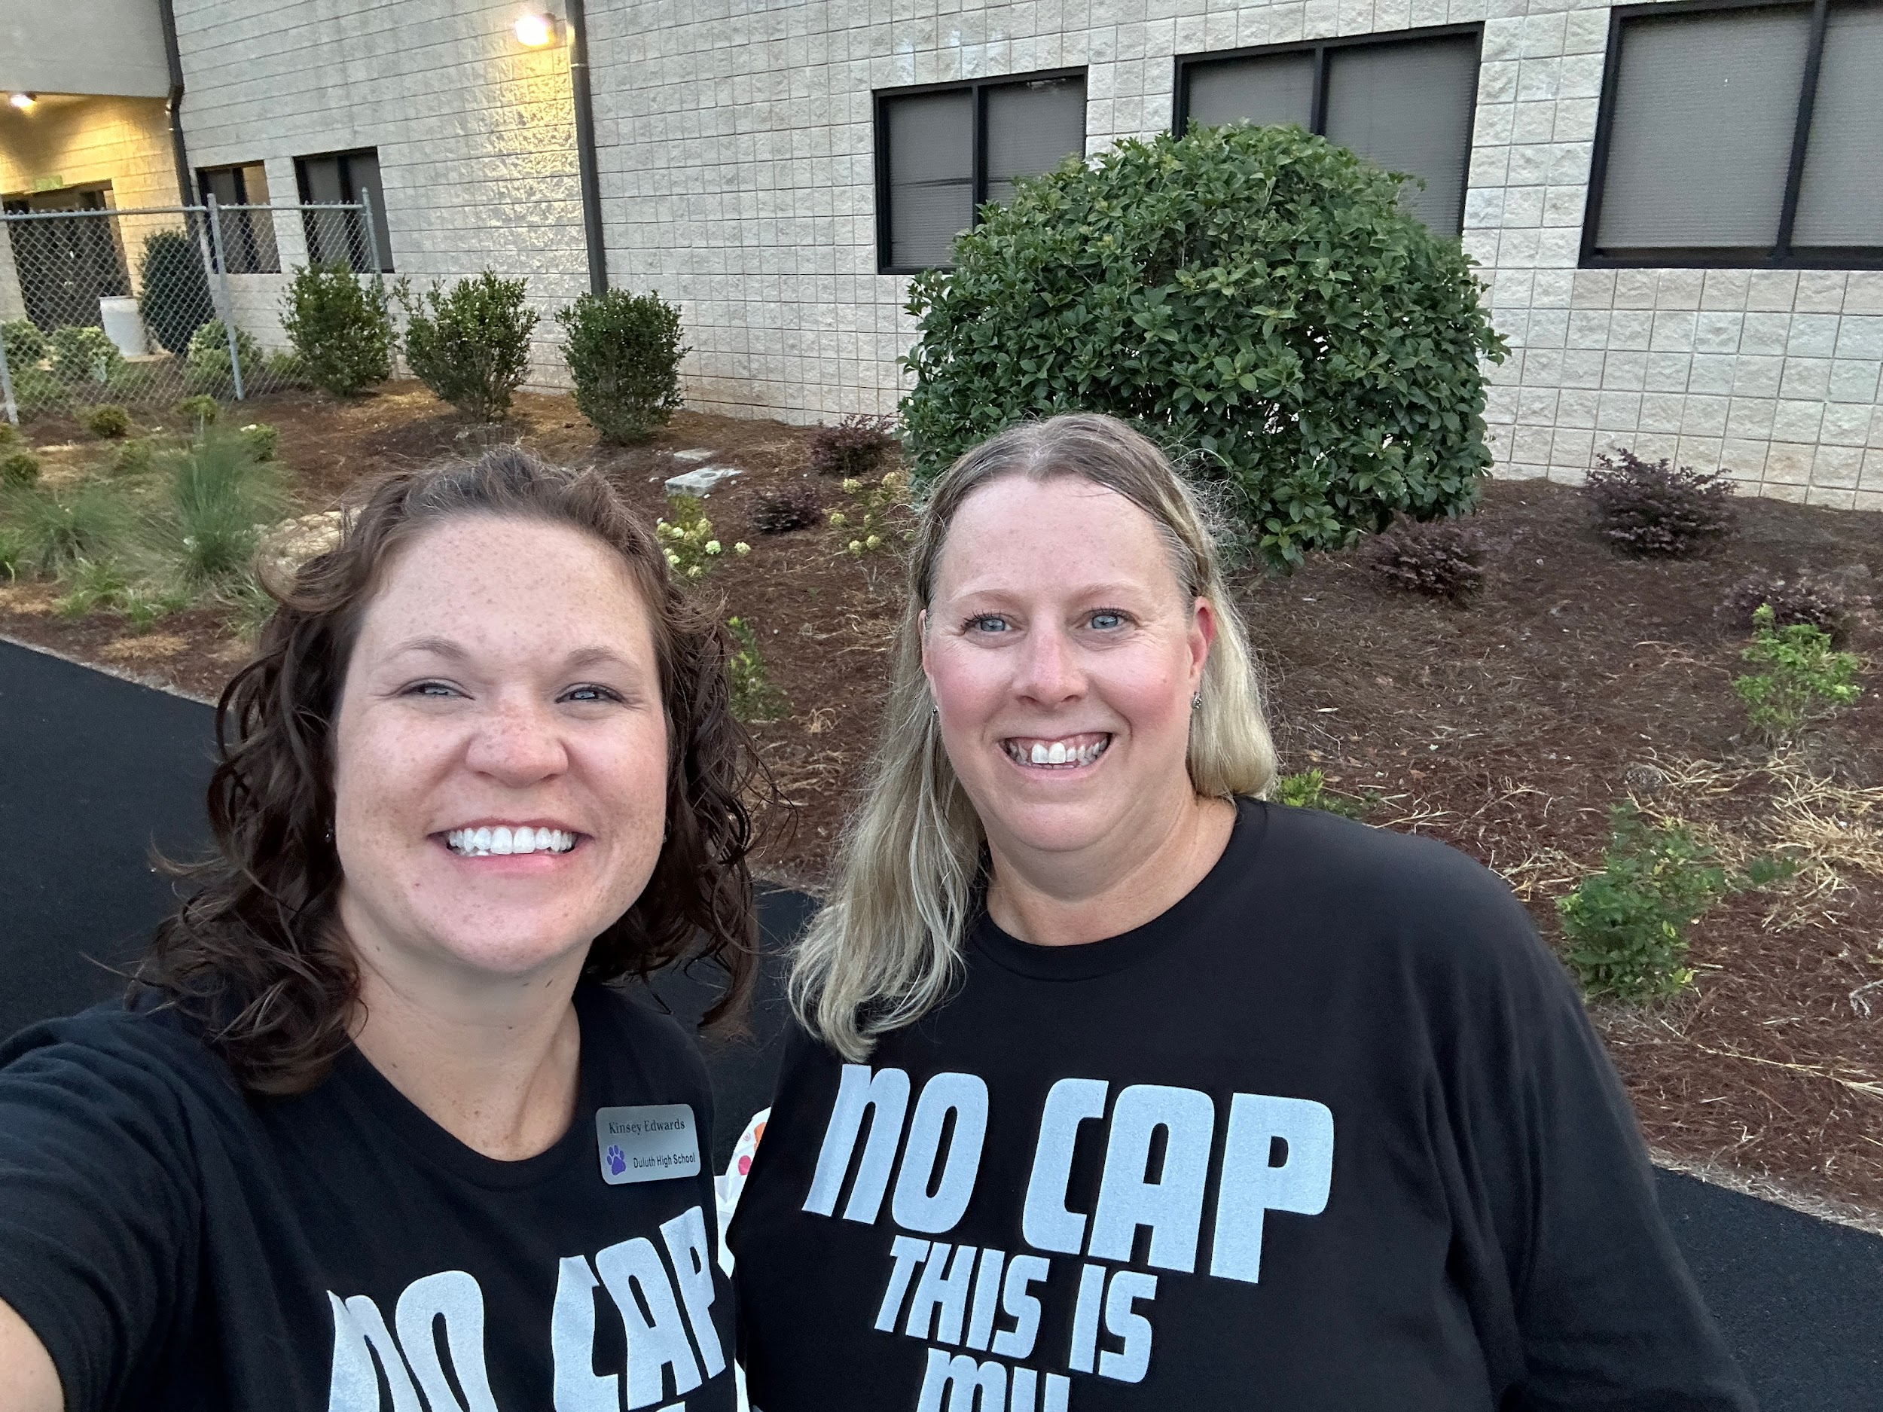
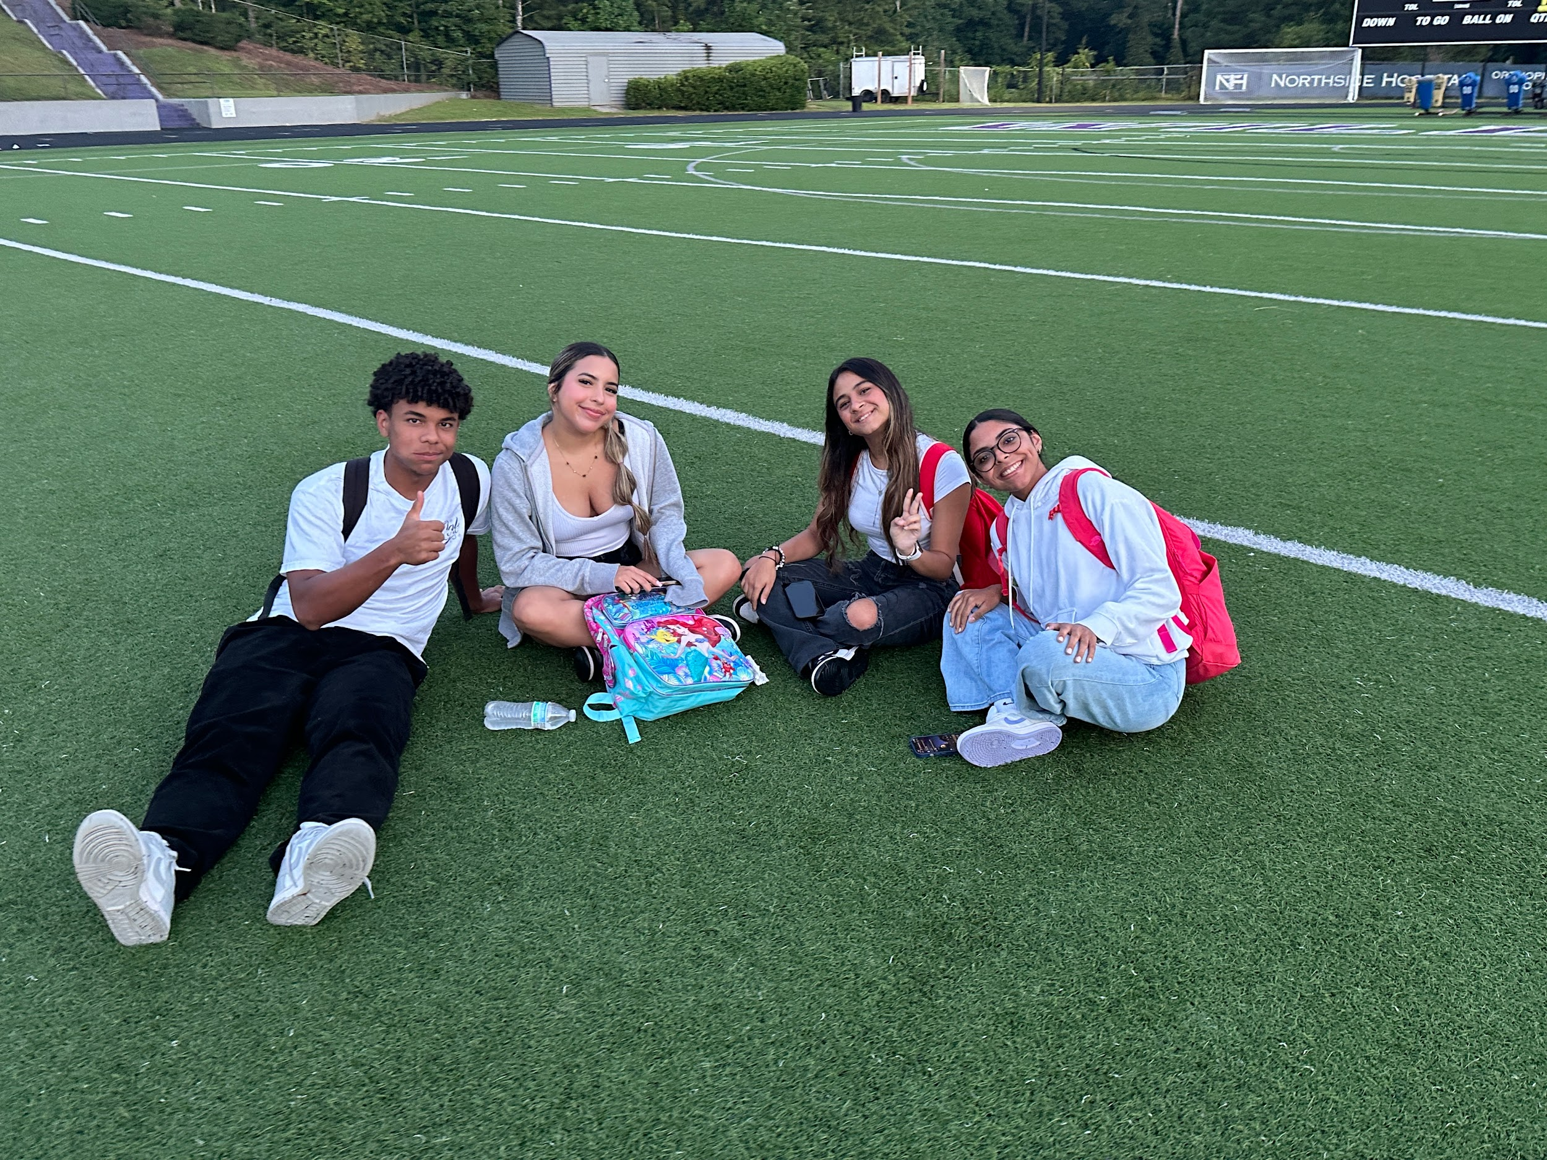
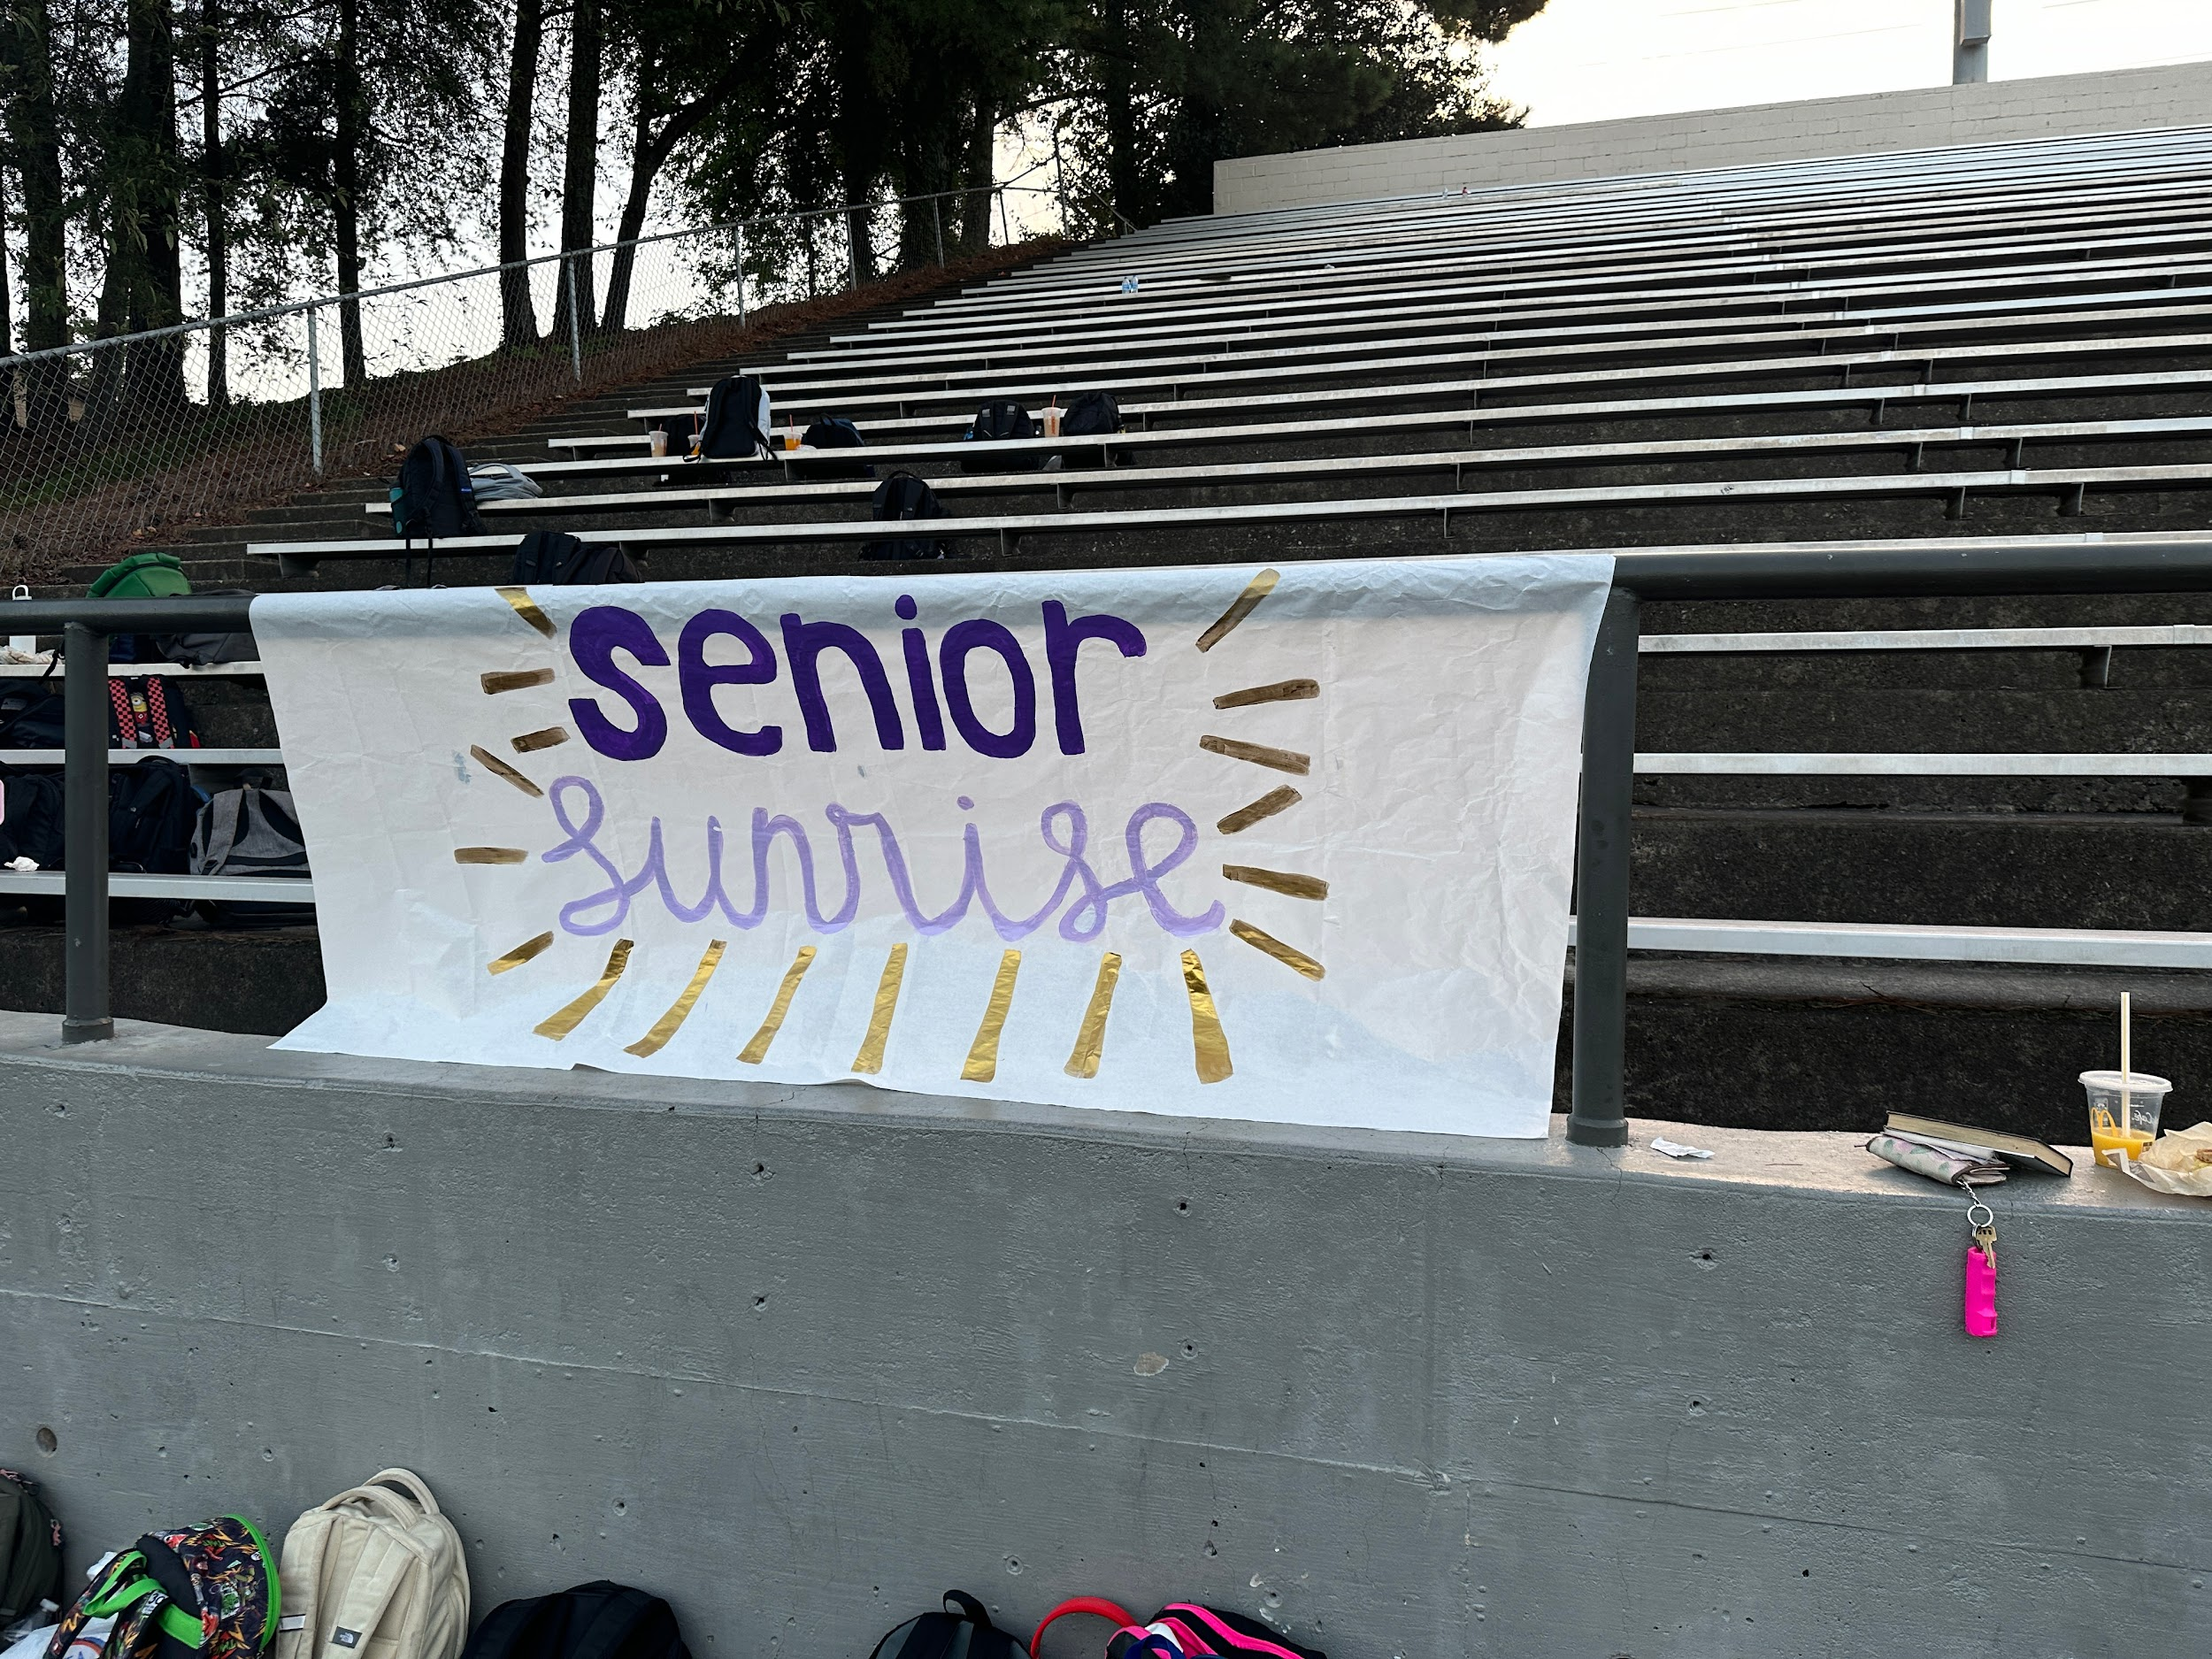
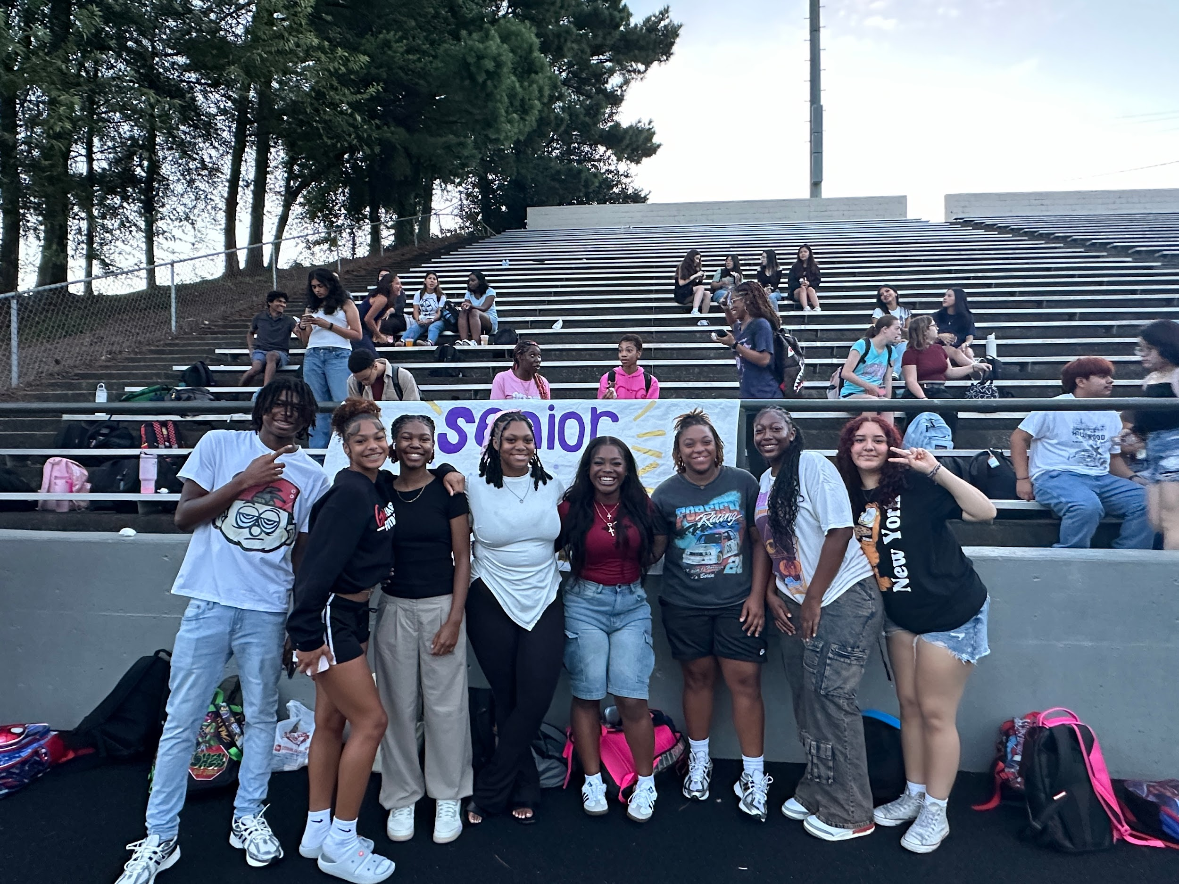
Senior Sunrise!

Slide 9
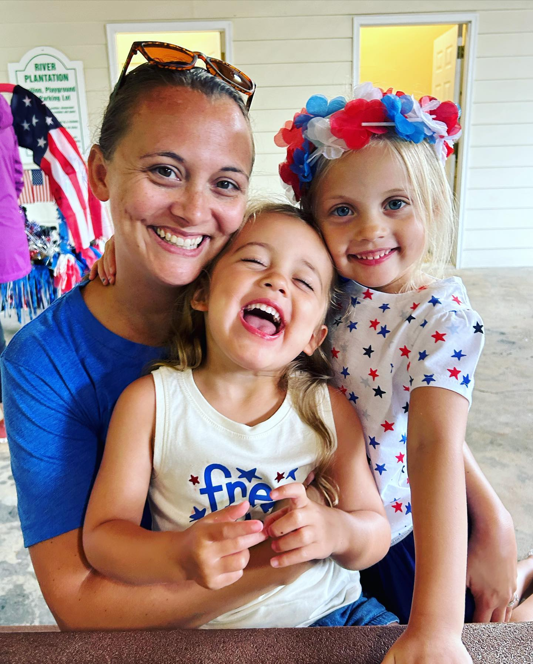
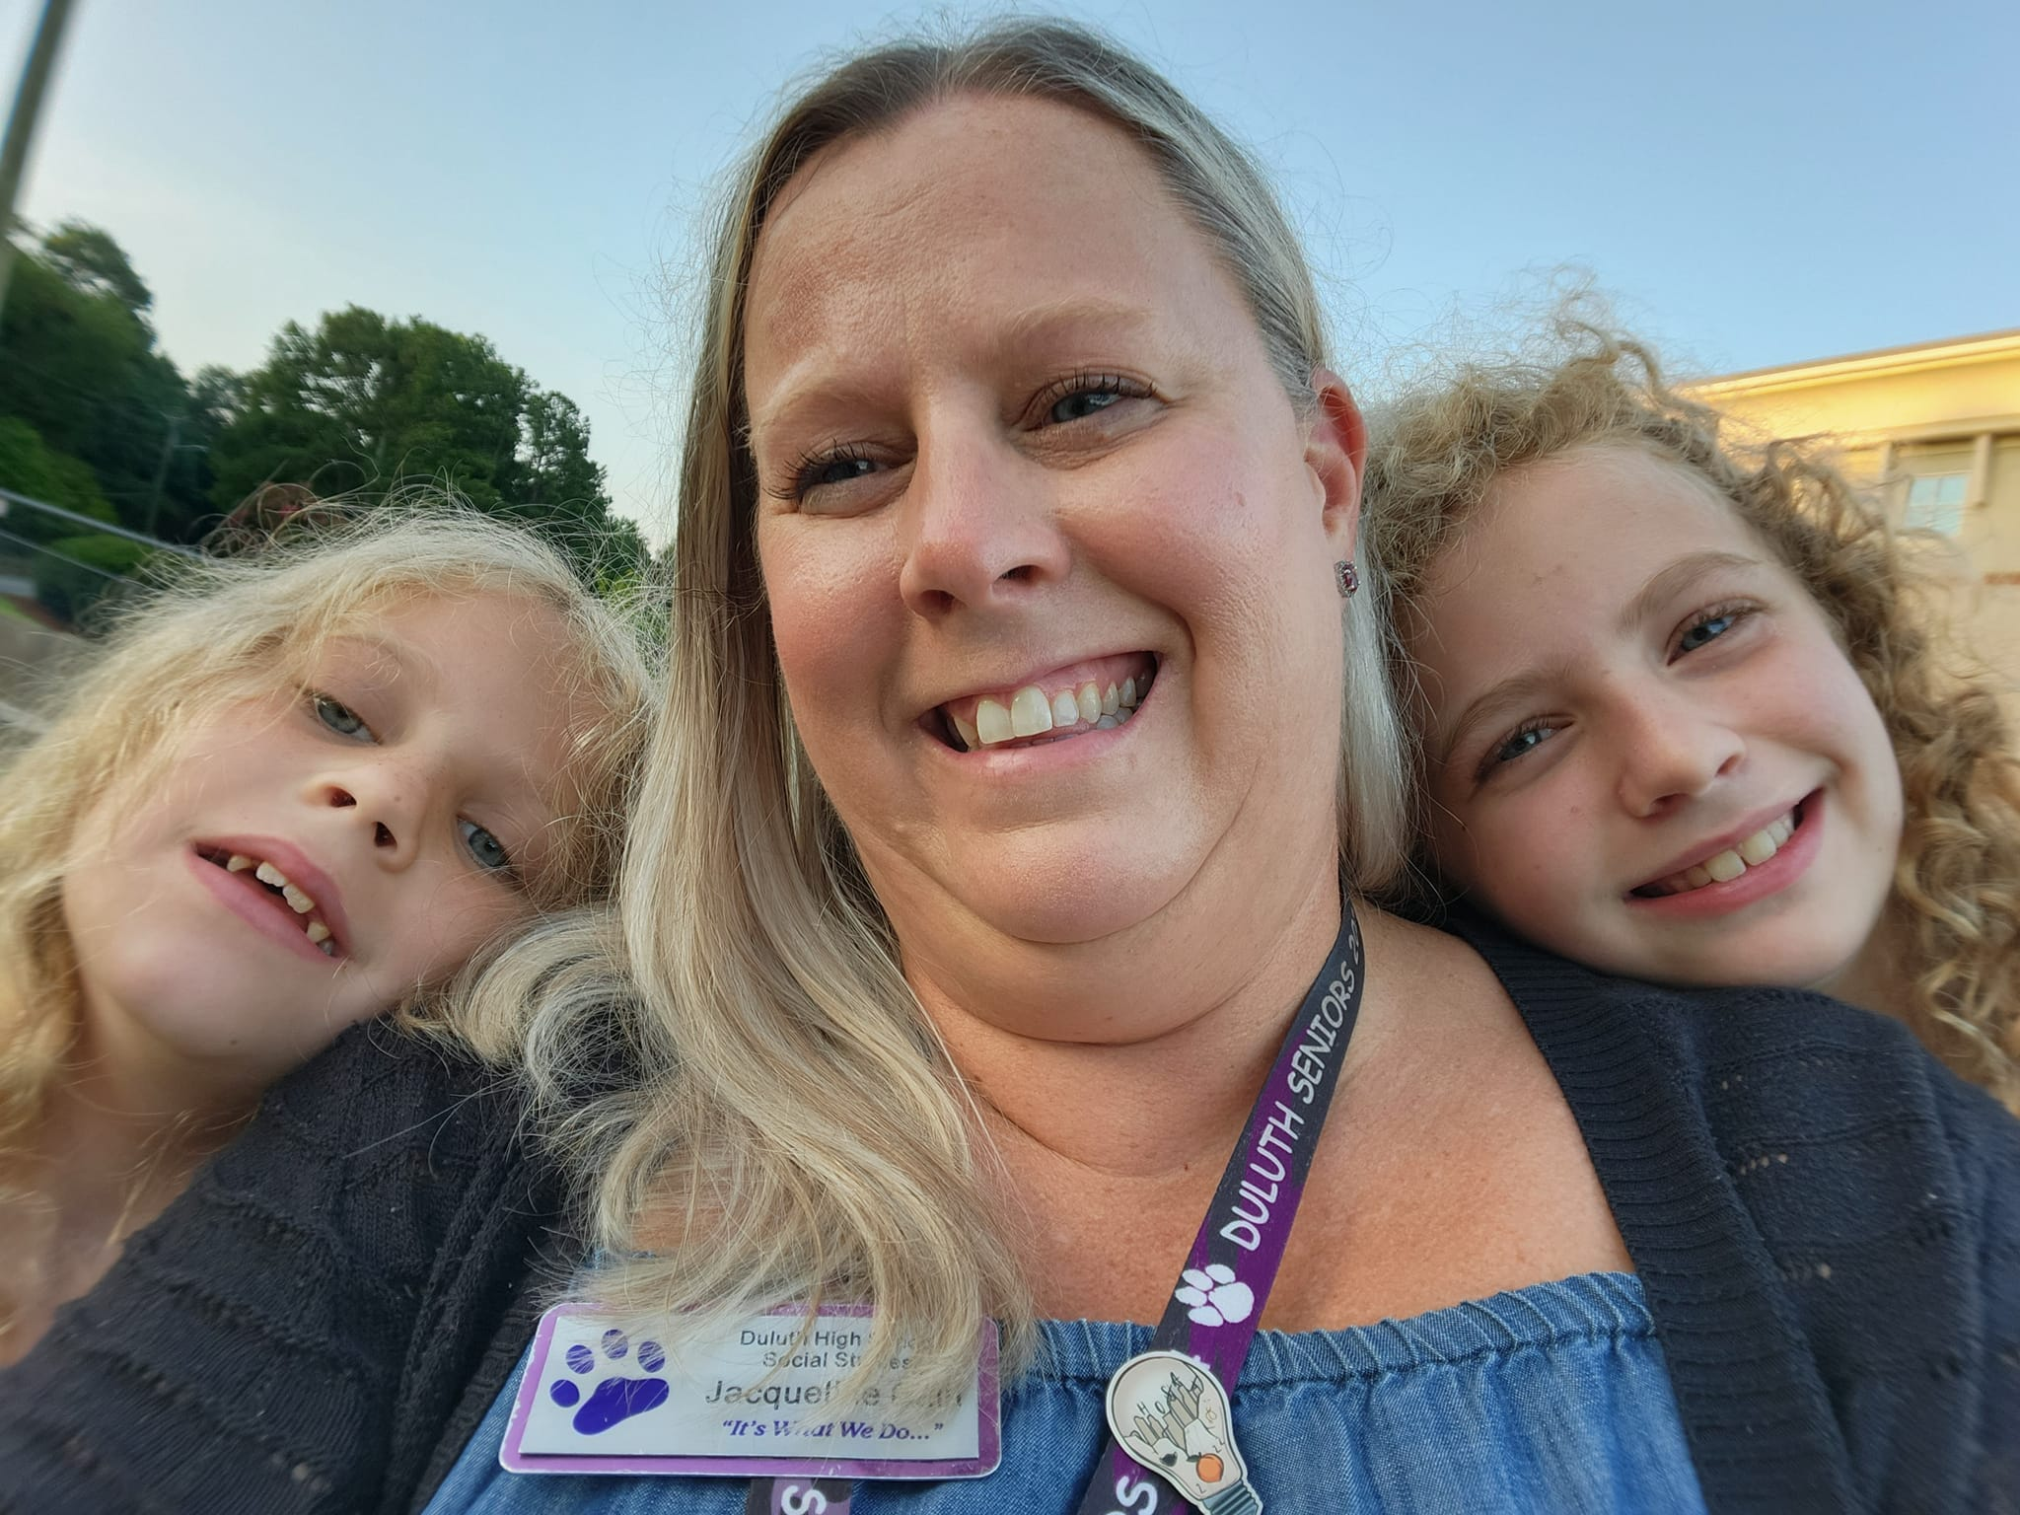
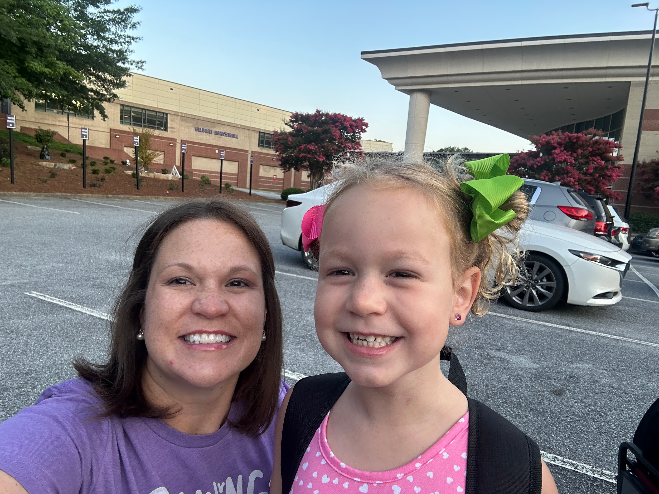
Senior Sponsors
Mrs. Cain
Dr. Edwards
Mrs. Lombardo- AP
located in
room 6-211
located in the
orchestra room
Located in Testing Office
500 building

Slide 10
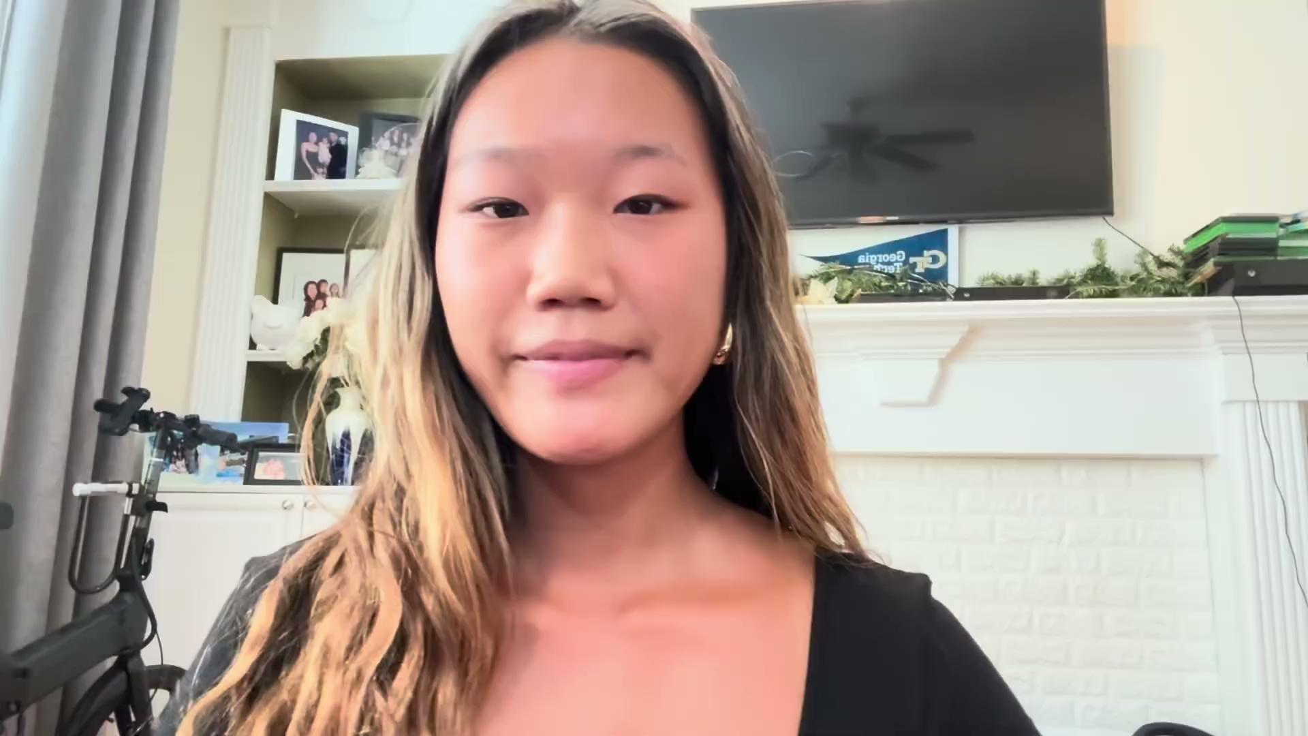
Senior Class President
Jessica Park

Slide 11
Our Events
Graduation
Senior Movie Night
Date to be announced!
It will be in May 2025.
Senior Celebration
Date to be Determined
April 18th

Slide 12
Senior Class photo
Mark your Calendar October 29th, 2024
during 1st period

Slide 13
Communication
Parent Square
Student Square
Please make sure the school Has your correct email.
Smores are sent monthly.

Slide 14
Follow US on Instagram :
@duluthhs2025

Slide 15
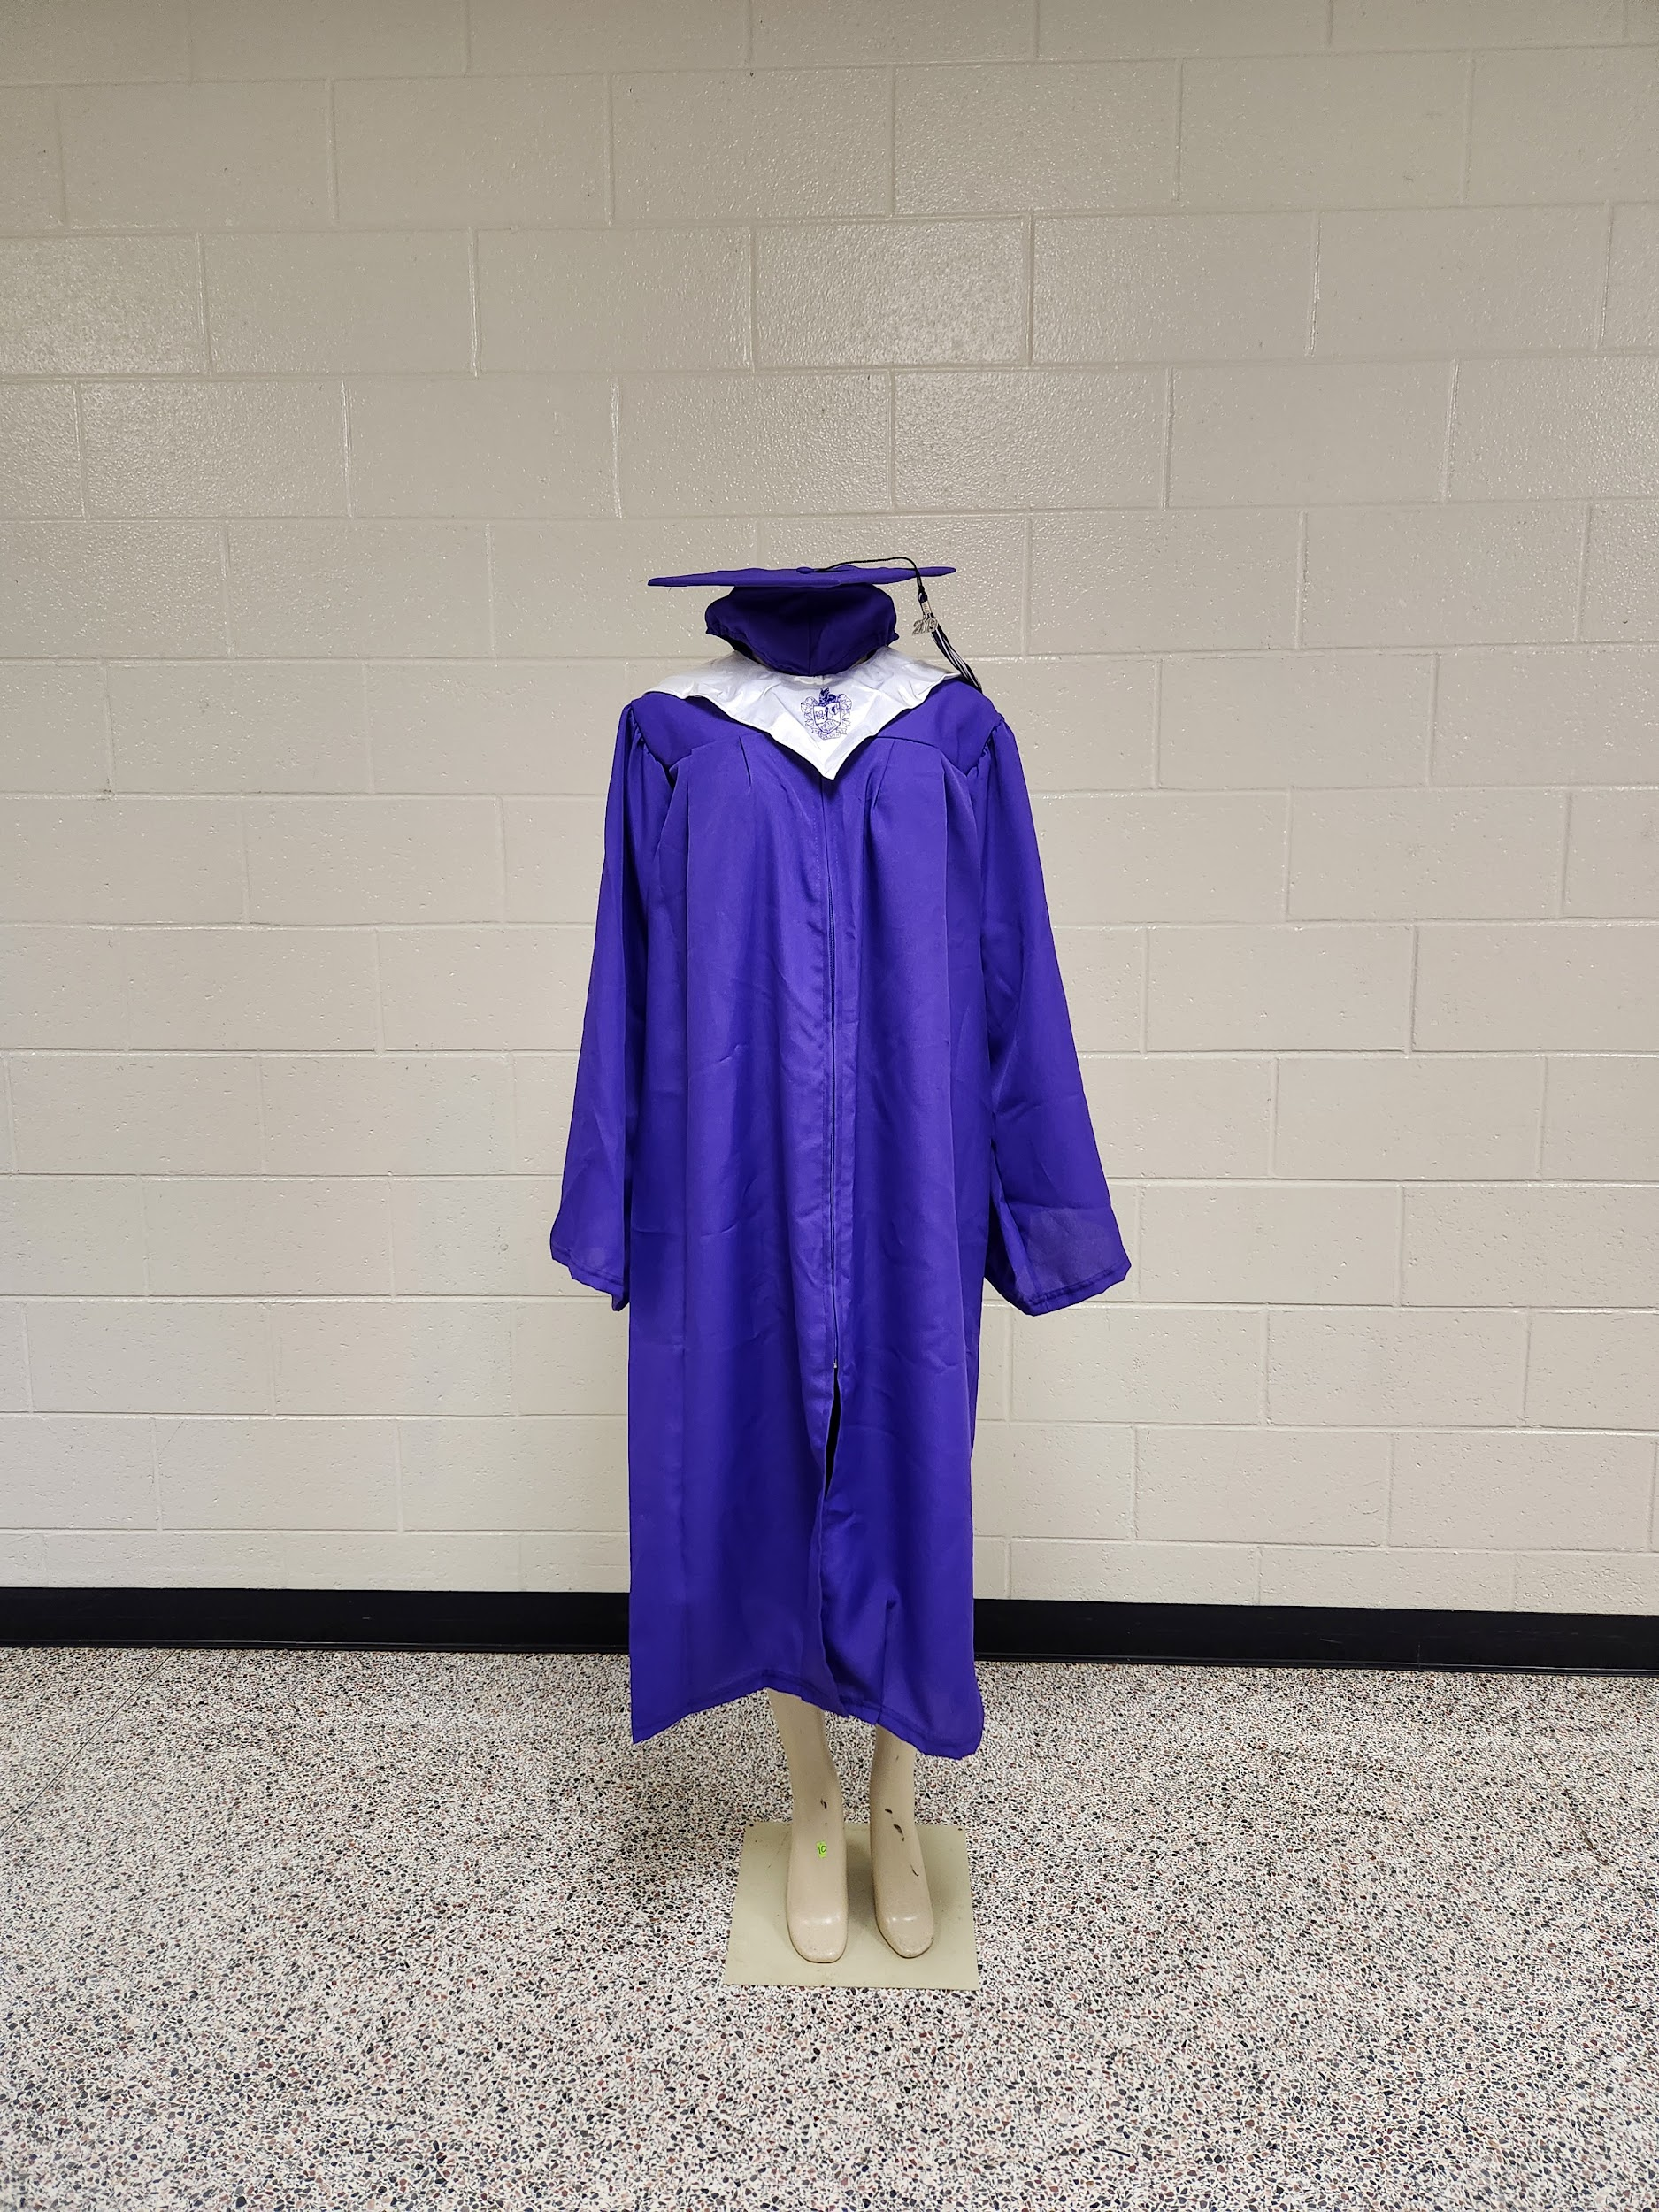
Senior Dues
Pay your
Senior DUES
(cap and gown fees)
$150 dollars
Scholasticimages.com

Slide 16
Yearbooks

Slide 17
Senior Memories and Spotlight Videos
The filming Days for Senior Memories will take place on:
Monday, September 30th
Wednesday, March 26th
Find out more in the senior SMORE

Slide 18
Grad Nite
2025 Grad Nite Friday: May 2rd
7:00 PM – 2:00 AM

Slide 19
Grad Nite
Grad Nite Package
Admission to Six Flags Over Georgia Grad Nite
An All-You-Can-Eat Dinner Buffet
FREE Grad Nite Souvenir
One Photo Voucher
Pre Reception
Food & Drinks
Event T-shirt

Slide 20
Grad Nite
Grad Nite Experience
Completely PRIVATE admission – just the seniors and their chaperones (not open to the general public)
World Class Thrilling Roller Coasters including our newest additions.
Foam Parties
Dance areas throughout the Park hosted by Live DJs
And of course, the memories created with friends!

Slide 21
Duluth High School
Class of 2025
Make it a great year!!
Good talk, GO CATS!

Slide 22
What You Need for Tonight
A Copy of your child’s Senior Application for Graduation (at the check-in table)
Senior Information Packet
Flyer for PROBE Fair

Slide 23
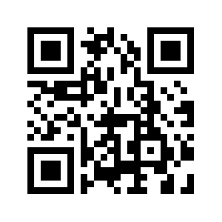
Senior Information Packet
Please use this resource as you navigate your child’s senior year.
Included :
Graduation Requirements
College Application Process
SAT/ACT information
Scholarship Websites
HOPE / Zell Miller

Slide 24
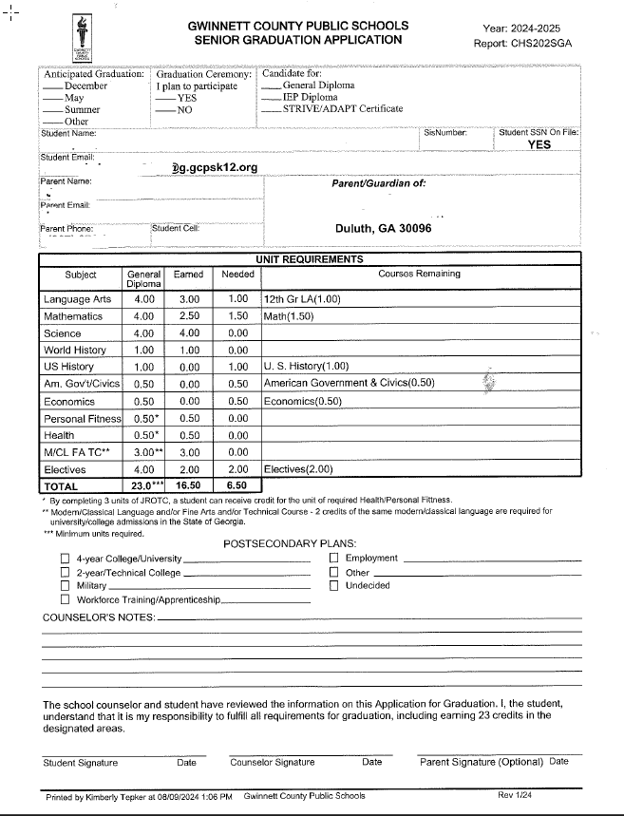
1
1
What are you doing well?
What sets yu apart? What are your good qualities?
Graduation & Diploma Type
2
2
What are your goals?
Are demands shifting? How can it be improved?
Demographics
3
3
Credit Requirements
4
4
Plans/Signatures

Slide 25
Section by Section
Section 1
The counselor has marked the anticipated graduation date and type of diploma
Section 2
Please review this information and notify the counseling office if changes are needed.

Slide 26
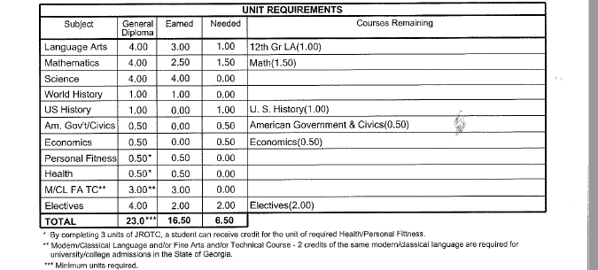
Continued
Section 3
Lists the credits your child has already earned and the credits needed for graduation.
The courses remaining are the classes your child should be taking this year.
NOTE!
If the number of credits needed is more than 6.0, additional classes are needed to graduate.

Slide 27
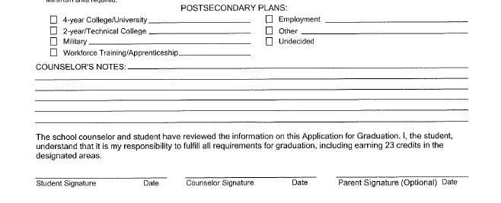
Continued
Section 4
Your child should have listed tentative plans when we met with them in class.
Counselors may have written a note.
Signatures
The student and counselor signature are required.
If your student has not signed it yet, please have them visit their counselor to sign the “official” copy.

Slide 28
Let’s Recap
One
Two
Review the senior letter with your child.
**Senior letters will be available in ParentVue in Oct.**
Contact the counseling office for any demographic corrections that need to be made.
**Additional documentation may be needed**
Three
Contact Info
If you have questions regarding the senior letter, please contact your child’s counselor.
Counseling Office Phone:
770-232-3322
Email: DuluthHSCounseling@gcpsk12.org

Slide 29
What is Georgia Match?
A simple way for you to know where you are eligible for admission (to be admitted to college).
Based on your high school HOPE grade point average (GPA) through 11th grade.
You will still need to submit an application.
Your GEORGIA MATCH colleges are on your GAfutures Student Dashboard by October 1.
A letter will be mailed to your listed address notifying you of the college/universities your student has “matched” with.
Note: GEORGIA MATCH works with public and private accredited high schools in Georgia.
DISCLAIMER: The colleges and universities listed on the student’s GEORGIA MATCH letter or Dashboard represent a provisional acceptance only and does not guarantee acceptance to a college or university or a specific major/program of study. An official admissions status is determined by the college or university using their admission criteria and the student’s final transcript and high school graduation status.

Slide 30
If your child is interested in attending Augusta, Georgia State, UGA or GA Tech, attend the Peach State Tour!
In-Person Sessions
Suwanee- Tuesday, August 27 6:00-8:00 PM
Norcross- Tuesday, September 3 6:00-8:00 PM
Atlanta- Thursday, September 5 6:00-8:00 PM
Online - Virtual Sessions
Wednesday, August 28 6:00-7:00 PM
Wednesday, September 4 6:00-7:00 PM
Wednesday, September 11 6:oo-7:00 PM
Register for either of the sessions at peachstatetour.org

Slide 31
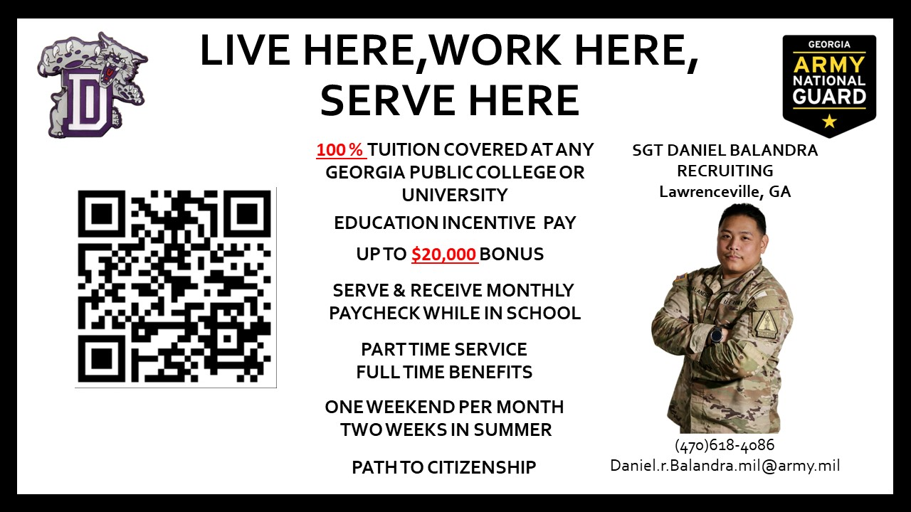

Slide 32
FAFSA Night
Date: TBD - Spring 2025

Slide 33
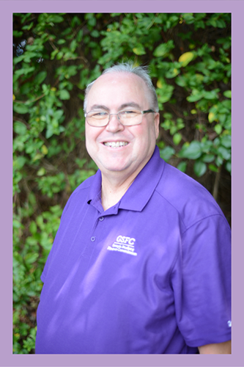
Financial Aid Presentation
ABOUT HAL
Hal Wilkerson is a native of Jonesboro, Georgia. He joined Georgia Student Finance Commission’s Outreach Team in 2007. Prior to joining GSFC Hal worked as a college admissions representative under the University System of Georgia. Hal also served as a chair of the GAIE, Georgia Association of International Educators. He is known for his charming jokes and extensive knowledge of unique scholarships.
Hal J. Wilkinson
K12 Outreach Staff
Email: halw@gsfc.org
Phone: 678-495-8965
HAL WILKINSON
GSFC - Georgia Student Finance Commission

Slide 34
State Aid/HOPE Program
Hal J. Wilkinson
K12 Outreach Staff
Email: halw@gsfc.org
Phone: 678-495-8965

Slide 35
HOPE Program
General Eligibility Requirements
Be a legal resident of Georgia
Be registered with the Selective Service, if required
Be in compliance with the Georgia Drug-Free Postsecondary Education Act of 1990
Meet U.S. citizenship or eligible non-citizen requirements
Be in good standing on all student loans and other financial aid programs
Attend an eligible postsecondary institution
Must be working toward the first undergraduate program
Notes:
These are the general eligibility requirements for the HOPE Program. I’d like to point out two of the requirements.
Click

Slide 36
HOPE Scholarship
HOPE Program
HOPE
Scholarship
Zell Miller
Scholarship
HOPE
Grant
Zell Miller
Grant
HOPE GED
Grant
HOPE Career Grant
Notes:
Next, lets talk about the eligibility requirements for the HOPE Scholarship.
Click

Slide 37
HOPE Scholarship Eligibility Requirements
Students must pursue an associate or bachelor’s degree
Graduate with a 3.0 high school HOPE GPA
After high school graduation, may also be earned in college
4 academically rigorous course credits
Notes:
First, the HOPE Scholarship is awarded to students pursuing an associates or bachelors degree.
Students must graduate with a 3.0 high school HOPE GPA from a Georgia high school, and 4 academically rigorous course credits.
For home school students, the requirements differ. For more information, contact us.
Click

Slide 38
Academically Rigorous Courses
Courses must be on Academic Rigor Course List. This includes:
Advanced Placement (AP)
International Baccalaureate (IB)
Dual Enrollment in degree level core subjects
Advanced math
Advanced science
Foreign language II or higher
Notes:
Rigor credits can be earned by taking AP, IB, or Dual Enrollment core courses.
Rigor credits can also be earned from advanced courses. For example, Anatomy and Physiology, Chemistry, Biology 2, Pre-Calculus, Algebra 2, and a second or third year of a foreign language, are all considered rigor courses.
If unsure about a course and whether it is considered academically rigorous, visit GAfutures.org to select the tab for HOPE and State Aid Programs or, for quicker access simply utilize the GAfutures webinar documents link that was provided.
Click

Slide 39
Maintaining the HOPE Scholarship
Students must maintain 3.0 college HOPE GPA at all checkpoints including:
End of every Spring semester/quarter
30/45 attempted semester/quarter hours
60/90 attempted semester/quarter hours
90/135 attempted semester/quarter hours
Three-Term Checkpoint, if enrolled less than full time for first three semesters/quarters
Notes:
To maintain the HOPE Scholarship while in college, a student must maintain at least a 3.0 college HOPE GPA at all checkpoints including every spring term of enrollment.
Click

Slide 40
Zell Miller Eligibility Requirements
Rigor Requirements and one of the following:
Designated valedictorian or salutatorian AND Meet minimum HOPE eligibility requirements |  |  | Minimum 3.7 high school HOPE GPA, as calculated by GSFC, in core curriculum courses AND 1200 SAT total test score OR .26 ACT composite score update. The current equivalent ACT score of a 1200 SAT is a 25 composite score for students who graduate after December 31, 2023.
Notes:
To receive the Zell Miller Scholarship, a student must meet the general eligibility requirements of the HOPE Program, as well as the following:
If the student is designated as the valedictorian or salutatorian, they are eligible to receive the Zell Miller Scholarship.
All other students, must graduate with:
a 3.7 high school HOPE GPA,
4 rigor course credits and
a 1200 on the SAT OR a 26 on the ACT
Students can take the tests multiple times and use the highest score. The test scores must be earned in one sitting and taken prior to graduation.
Click

Slide 41
Student Document Upload
Students may upload documents for State Financial Aid Programs
SAT test score reports may be uploaded
Directions for SAT:
Print test score report from College Board
Student must sign, date, and write this statement on report: “This is a true and exact copy of the original score report.”
Sign into GAfutures account and select Document Upload, on left side of page.
Select Document type: SAT Scores
Attach document file and select submit

Slide 42
Submitting ACT Scores for Zell Miller
Steps for submitting ACT scores:
Go to ACT.org and sign into student account
Select ACT score report be sent to GSFC by entering recipient code: 2225
ACT will then send GSFC and electronic file to update student’s record.

Slide 43
Maintaining the Zell Miller Scholarship
Students must maintain 3.3 college HOPE GPA at following checkpoints:
End of every Spring semester/quarter
30/45 attempted semester/quarter hours
60/90 attempted semester/quarter hours
90/135 attempted semester/quarter hours
Three-Term Checkpoint, if enrolled less than full time for first three semesters/quarters
Notes:
Maintaining the Zell Miller Scholarship is similar to the HOPE. The checkpoints are the same, but a student must have at least a 3.3 college HOPE GPA.
Click

Slide 44
HOPE & Zell Miller Scholarships
Students lose eligibility due to one of the following:
GPA requirement not met (3.0 for HOPE; 3.3 for Zell Miller)
Reaching maximum attempted hours
127 semester
190 quarter
Failing to use funds within ten years of high school graduation or equivalent
Exception for active duty military service in United States Armed Forces
Received bachelor’s or first professional degree
Notes:
There are a few ways students can lose their eligibility for the HOPE Scholarship and Zell Miller Scholarship:
Not maintaining your GPA
Reaching the maximum hours allowed
Failing to use your award within seven years
and receiving a bachelor’s or professional degree.

Slide 45
HOPE Grant
Eligibility Requirements:
Enrolled in certificate or diploma program
High school diploma/GED not required
High school GPA and/or test scores not considered
Notes:
Like all components of the HOPE Program, the general eligibility requirements will also apply to the grants.
Yet, what’s different is that grants can only be used for students who are enrolled in a certificate or diploma program.
Also, there is no high school HOPE GPA requirement, and test scores are not considered.
Click

Slide 46
Maintaining the HOPE Grant
Students must maintain a 2.0 college cumulative GPA at the following checkpoints:
30 HOPE Grant paid semester hours
60 HOPE Grant paid semester credit hours
Maximum 63 paid semester hours
Notes:
To maintain the HOPE Grant, Terri must have a 2.0 college cumulative GPA at the checkpoints.
Click

Slide 47
Zell Miller Grant
Eligibility Requirements:
Minimum 3.5 college cumulative GPA
Checkpoints occur at the end of every term of enrollment
Must be a HOPE Grant recipient initially
May be paid retroactively for first term
Maximum 63 combined paid hours Zell Miller and HOPE Grants
Notes:
To keep the Zell Miller Grant, must maintain at least a 3.5 college cumulative GPA every term.
Not eligible for Zell Miller Grant until one semester is completed because would have to have at least a 3.5 college cumulative GPA.
Click

Slide 48
Award Amounts
 | HOPE Scholarship | Zell Miller Scholarship
Public Institutions | portion of tuition | full standard tuition
Private Institutions Full-time | $2,496 per semester (fall, spring, summer) $1,664 per quarter (fall, winter, spring, summer) | $2,985 per semester (fall, spring, summer) $2985 per quarter (fall, winter, spring, summer)
Notes:
At public institutions, the HOPE Scholarship and Grant cover a portion of the tuition. Tuition rates can vary at each institution.
The Zell Miller Scholarship and Grant provide full tuition at our public institutions.
Neither award can be used for books, housing, meal plans, or fees. Only tuition.
Students can receive the HOPE or Zell Miller Scholarship at private institutions; it is a set amount per term of enrollment.
Students do not have to be enrolled full-time for these grants and scholarships. However, the awards are capped at 15 credit hours. This also applies to courses taken in the summer.
Click

Slide 49
HOPE Scholarship Change

Slide 50
HOPE/Zell Miller Scholarship Updates
HOPE Scholarship and Grant at TCSG and USG Institutions
New – HOPE Award Rate set the award amount for all eligible public institutions to 100% of the prior year (FY 2023) standard undergraduate tuition rate
TCSG’s standard tuition rate remains at $100 per credit hour
HOPE Scholarship and Grant will pay $100 per hour
Zell Miller Scholarship & Grant will pay $100 per hour
USG’s Board of Regents has not set the standard undergraduate rates for their institutions yet
Award Charts will be made available once all info is available
The scholarships award amounts have increased for private institutions in Georgia (2023-2024 Award Year):
HOPE Scholarship award amount is 2,496 per semester (12-15 semester hours)
Zell Miller award amount is 2,985 per semester (12-15 semester hours)

Slide 51
Tuition Equalization Grant
Tuition Equalization Grant Regulations
New – Award amounts
Award rate increases
Per semester increase from $500 to $550
Per quarter increase from $333 to $366/$366/$367 (per term)

Slide 52
HOPE and Zell Miller Grant
HOPE Career Grant in the HOPE Grant and Zell Miller Grant Regulations
Revision of award rates
Award rate for Basic Law Enforcement and Basic POST Certification certificate programs
Maximum award amount increase from $3,500 to $3,750
Award rate for Commercial Truck Driving certificate programs
Maximum award amount increase from $1,000 to $1,100

Slide 53
HOPE Career Grant
HOPE Grant and Zell Miller Grant recipients eligible for HOPE Career Grant
Movie Production and Set Design
Computer Programming
Computer Technology
Practical Nursing
Early Childhood Care and Education
Welding and Joining Technology
Precision Manufacturing
Commercial Truck Driving
Health Sciences
Diesel Equipment Technology
Automotive
Aviation
Construction
Electrical Line Worker
Logistics
Notes:
The HOPE Career Grant has become a great financial resource for many students.
Students receiving the HOPE Grant or the Zell Miller Grant may also be eligible for additional financial assistance from this program.
This program was created to boost enrollment in high-demand certificate and diploma programs such as Commercial Trucking, Early Childhood Care/Education and Practical Nursing.
There are 17 in-demand career fields with more than 300 approved certificate and diploma programs eligible for the HOPE Career Grant.
Five new fields were added in FY 2018: Construction, Aviation, Electrical Line Work, Logistics and Automotive Technology.
The award is a fixed amount depending on the program and number of hours the student is enrolled.
You can find a list of approved programs and award amounts at GAfutures.org
This program is not available for dual enrollment students.

Slide 54
HOPE Career Grant
Enrolled Semester Hours | Award Amounts
1-2 hours | $125
3-8 hours | $250
9+ hours | $500
9+ hours | $1,100 award per truck driving program
Notes:
The HOPE Career Grant is a set amount which is based on two factors: the number of credit hours within the term of enrollment AND the program of study.
Just a side note, a student could have full standard tuition paid with the combination of the HOPE Grant and the HOPE Career Grant.
Click

Slide 55
Scholarships
Scholarship examples:
Height
Ethnicity
Religious affiliation
Gender
Being a multiple (twin, triplet, etc.)
Left-handed
Video on social media
Notes:
It is always best to first utilize money that doesn’t have to be repaid such as scholarship and grants.
A scholarship is a type of financial aid that is typically awarded based on a student’s GPA and/or test scores. But don’t let that limit the search. Many can be found based on a variety of criteria.
Most grants on the other hand are need-based, which means they are usually awarded to student’s with high financial need. We will talk more about need-based aid later.

Slide 56
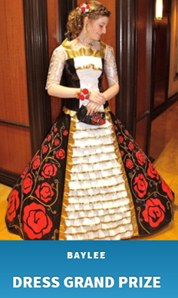
Duct Tape Scholarship
To enter the Duct Tape Scholarship, you and your partner must be legal residents and at least 14 years old. Either opposite sex or same sex partners may participate. You must attend a high school prom and have your photo taken before, during or after the prom in your attire made using duct tape.
Costumes must be original and will be judged based on workmanship, originality, use of color, use of accessories, and use of duct tape.
Photos of the 10 finalist couples will be posted online for online voting.
For more information about the Duct Tape Scholarship Contest see, duckbrand.com

Slide 57
Tuition Assistance
Bank of America
Dollar General
Chilis
United Postal Service
QT ( Gas Station)
Racetrac
Kroger's
Publix
Sprouts
Wells Fargo
TGI Fridays

Slide 58
Job Opportunities & Scholarships
- offers scholarships of $2000/term
- - offers $1600 tuition reimbursement
- offers $1,000 scholarships

Slide 59
Scholarship Search
Notes:
The Scholarship Search uses a national database that can be searched by key word or you can use various filters to help narrow down your search.

Slide 60
Additional Scholarship Resources
www.fastweb.com
www.collegeboard.com
www.finaid.org/scholarships
UNIGO.COM

Slide 61
FAFSA Updates/Reminders
The 2025-2026 FAFSA (Free Application for Federal Student Aid) opens December 1st , 2024.
New – Selective Service Registration is no longer a requirement for Federal Student Aid.
Please note Selective Service is still a requirement for State Aid.
It is recommended that FSA IDs are created at least 10 days before the student starts to complete the FAFSA.

Slide 62
2025-26 FAFSA Simplification
Parents without SSN, will have to create an FSA ID.
Individuals without a social security number will be able to create an FSA ID.
The signature page will no longer be available. Student will need to print the Summary Page.
No more DRT, so students nor parents will be able to see OR change IRS data.
All parents who have a tax return will need an FSA ID.
Married – File Jointly: one (1) FSA ID
Married – File Separately: two (2) FSA IDs

Slide 63
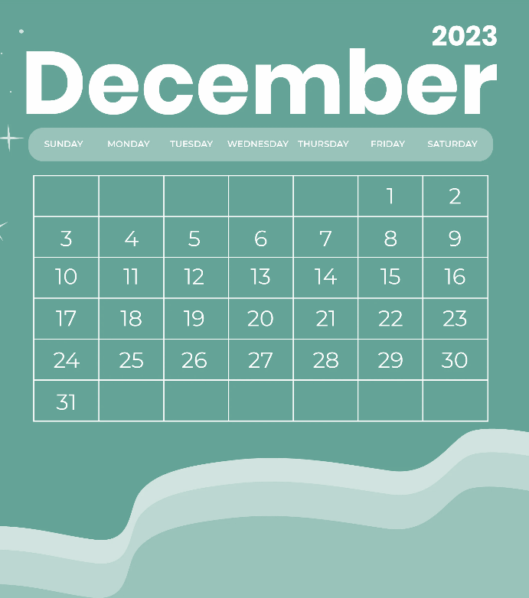
2023-24 FAFSA Simplification
EFC, now Student Aid Index (SAI)
Pell Grant increased to $7,395
FAFSA can open anytime between Dec. 1st, 2024

Slide 64
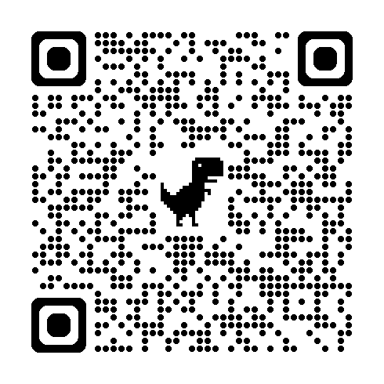
Thank you for attending! Before you go to the PROBE College Fair, please
complete the evaluation form.
We appreciate your attendance and feedback!
Congratulations Class of 2025!

