Slide 1
9th-12th grade Parent Night
Archer HS Counseling Dept
Tuesday, September 23, 2024
2024-2025 School Year
Notes:
Nicole
Green lines - hyperlinks

Slide 2
Grade Level | Alphabet | Counselor
9-10 | A-G | Ms. Brittany Culbreath
 | H-O | Mrs. Shawnta Clarke
 | P-Z | Ms. Cayla McMichael
11-12 | A-C | Mrs. Nicole Hamilton
 | D-J | Mr. William Maloney
 | K-Q | Dr. Erin Kilpatrick
 | R-Z | Ms. Jennifer Roe
School Support
9-12 | A-Z | Ms. Sonya Cruel – School Social Worker
9-12 | A-Z | Ms. Tess Gibbs – School-based Mental Health Clinician
School Counseling Intern & Practicum Students
Ms. Alisha Freeman & Ms. Drew Miles
Notes:
Nicole

Slide 3
Attendance
Children chronically absent in kindergarten and 1st grade are much less likely to read at grade level by the end of 3rd grade.
By 6th grade, chronic absence is a proven early warning sign for students at risk for dropping out of school.
By 9th grade good attendance can predict graduation rates even better than 8th grade test scores.
Absences can add up quickly. A child is chronically absent if he or she misses just two days every month!!!
Notes:
Sonya

Slide 4
Attendance Tips Archer Bell Schedule School Calendar AHS Attendance Procedures
Make sure your children keep a regular bedtime and establish a morning routine.
Lay out clothes and pack backpacks the night before.
Ensure your children go to school every day unless they are truly sick
Avoid scheduling vacations or doctor’s appointments when school is in session.
Talk to teachers and counselors for advice if your children feel anxious about going to school.
Develop back up plans for getting to school if something comes up.
Notes:
Sonya

Slide 5
Academic Planning
SENIOR Information
Senior Sponsors- Samantha Sinclair (samantha.sinclair@gcpsk12.org), Stephen Lindsay (stephen.lindsay@gcpsk12.org)
Senior Portraits
Senior Dues- $150 (Archer items, cap/gown, diploma cover, grad tickets)
Senior letters going home early November regarding Graduation Status from Counseling Department
Notes:
Cayla

Slide 6
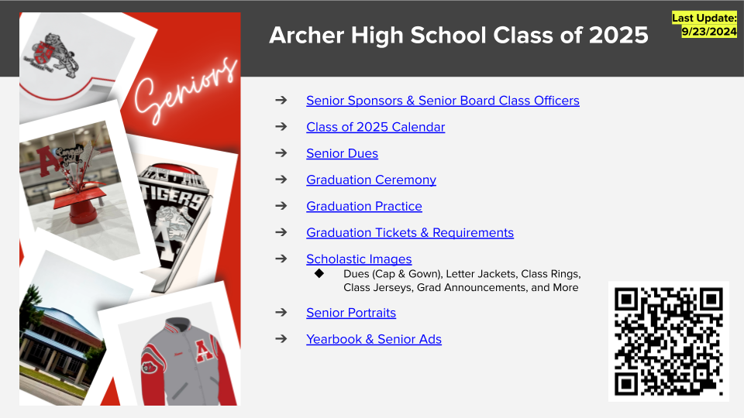
Notes:
Cayla

Slide 7
Graduation Requirements
4 credits Language Arts credits
4 credits Math
4 credits Science (Bio, Chem, Physics, Elective)
3 credits Social Studies (World, US, Econ/Am Gov)
0.5 credit Health/0.5 credit Personal Fitness
4 credits General Electives
3 credits Fine Art/Tech/Foreign Language
2 years of the same Foreign Language is required by every 4-year University in the state of Georgia
Grading Scale
A 90-100
B 80-89
C 70-79
F 0-69
23 CREDITS TOTAL for GRADUATION
Notes:
Cayla
Mention its best to take 4 yrs of MA and SC in high school
Students will start selecting classes for the 2024-25 sy in January.

Slide 8
Staying on Track
If you fail any courses, please contact your school counselor.
There are options to make-up credits and get back on track for graduation
Summer School
Credit Recovery (failed grade 50-69)
Archer School Plus
Gwinnett Online Campus Supplemental
Phoenix High School 7th Period
Viewing your Credits:
Students – StudentVUE under course history
Parents – Parent Portal under course history; transcript available under documents
Notes:
Cayla

Slide 9
Testing Update
There is no current testing requirement for graduation, including the removal of the Gateway exam.
There will be an opportunity for SAT for all in the spring.
Notes:
Erin

Slide 10
Advanced Placement (AP)
Students who take AP classes:
Learn essential time management and study skills needed for college and career success.
85% of selective colleges and universities report that a student’s AP experience favorably impacts admission decisions.
And receive a score of 2 on their AP Exams are ready for college work.
Experience greater academic success in college and have higher graduation rates than their non-AP peers. 3 out of 4 AP students enrolled in a four-year college start school with some AP credit.
AP Credits – each college accepts every course differently
AP Request Process – talk to your current teachers in January about taking an AP course during the 2025-2026 school year. A Google AP Request form will also be available on eCLASS. AHS's AP department handles AP schedule change requests.
Notes:
Erin

Slide 11
Archer HS Dual Enrollment
State of GA will pay for 30 semester (or 45 quarter hours) hours for students to take approved DE courses. Equivalent of taking about 10 college classes during entire high school career.
10th-12th graders only per state of GA regulations. Must meet DE college admissions requirements. Student-driven process.
10th graders may only take CTAE courses at a TCSG institution.
Transportation NOT provided by GCPS.
eCLASS-Archer HS Counseling Corner—Dual Enrollment & on Gafutures.org
Multiple step process, starting point is (a) local school procedures: interested student & parent/guardian attending Dec. 12th DE Information Night at AHS, submitting mandatory paperwork, and student attends mandatory DE student group mtg TBD in Feb/March 25 & (b) student following instructions of the DE college.
Notes:
Erin

Slide 12
Notes:
Erin

Slide 13
Best Kept Post-Secondary Secret
What is it???
CTAE- Career, Technical, and Agricultural Education.
Can allow you to attend a 4yr. College/University debt-free.
Obtain a marketable skill set & gain Soft Skills
Notes:
William

Slide 14
CTAE
No wasting time with 2 yrs. of core classes. Students get hands on experiences combined with class learning.
Shorter time frame. 18-24 months typically with advancement opportunities.
Earn while you learn. Students get paid while learning a trade with no debt.
Flex schedules allow for more time in the field.
Notes:
William

Slide 15
CTAE
Obtain industry certifications
Upon graduation will be employed if not before.
Can double your salary making six figures in 10 years or less in certain fields.
Notes:
William

Slide 16
Archer High Pathway Certificates
Arts, A/V Technology, and Communications – Audio-Video Tech & Film
Business Accounting
Environmental Agricultural Systems
Human Services – Nutrition and Food Science
Information Technology – Game Design
Marketing – Marketing and Management
STEM – Engineering & Technology
Notes:
William

Slide 17
CTAE CLUB
Archer High CTAE Club was established to bring awareness and show the benefits of Career, Technical, & Agricultural Education to students, staff, parents, and the Archer Cluster community.
CTAE Club that meets on the 2nd Wednesday of the month from 2:15pm-3:00pm.
Notes:
William

Slide 18
Maxwell & Grayson
Opportunity for students to gain exposure in their projected area of study
Must be on track for graduation and rising 11th or 12th grader at time of applying
Attend Archer and Maxwell/Grayson Tech (half & half)
Embedded academic credits
Must apply Online through eCLASS (Opens in January)
Notes:
Alisha

Slide 19
Maxwell High
Animation & Digital Media General Automotive Technology
Architectural Drawing & Design Graphic Design
Carpentry HVACR
Collision Repair I Law Enforcement Services/Forensic Science
Culinary Arts Manufacturing
Early Childhood Education Personal Care Services (Cosmetology)
Electronics Therapeutic Services/Healthcare
Fire & Emergency Services/Firefighting Welding
Flight Operations Work Based Learning
Notes:
Alisha

Slide 20
Grayson Tech
Commercial Photography Information Support Services & Game Design
Culinary Arts Law & Justice
Cybersecurity Music Technology
Entrepreneurship Sports Medicine
Exercise Physiology TV & Video Production
Graphic Design Veterinary Science
Notes:
Alisha

Slide 21
College Admission Testing
PSAT Testing
Practice test for the SAT
All 10th graders will take it for free on Tuesday, October 29th
11th graders can register for free
9th graders can register for $25 on MyPaymentsPlus
Notes:
Jennifer

Slide 22
College Admission Testing
SAT/ACT Testing
Should start testing in 11th grade
Can take multiple times to earn a higher score
Colleges look at both tests equally. It is recommended that students take both to see which they perform better on.
Fee Waivers
Available to 11th and 12th graders who qualify for Free or Reduced Lunch
Must complete the lunch application on GCPS website
Can receive 2 SAT and 4 ACT
Request on Counseling Corner eClass page
Notes:
Jennifer

Slide 23
Test Prep
Collegeboard and ACT offer FREE test prep resources
Practice Tests
Khan Academy (SAT) – Students can link their PSAT scores for individualized practice
Can purchase books/materials on your own
Outside organizations offer tutoring/test prep
Community School offers College Prep resources
Archer does not endorse or recommend any particular company/organization
Notes:
Jennifer
Mention daily practice app & practice tests

Slide 24
Test-Optional Policy
Many out-of-state colleges and most GA colleges are currently test-optional
This could change in the future
Students can check college website to see average scores of admitted students
College Search on Naviance
College Search on GAfutures
Students applying for the Zell Miller Scholarship still need qualifying SAT/ACT scores
Notes:
Jennifer
Zell Miller -
Meet the following criteria:
Graduate with a minimum 3.7 Calculated HOPE GPA.
Earn a minimum of four full rigor credits from the Academic Rigor Course List.
Earn a qualifying test score on a single national or state/district administration of the ACT or single national administration of the SAT prior to high school graduation.
A minimum composite score of 26 is required for the ACT.
A minimum score of 1200 is required for the SAT.

Slide 25
Transcripts
Most can be sent electronically via Naviance
$5 flat fee for all electronic transcripts on MyPaymentsPlus
$5 per hard copy – order on MPP; can be picked up in the front office
Free/Reduced Lunch students can waive the fee
Transcripts to in-state colleges can be sent via GAfutures.org for FREE
Students can contact their counselor if they have questions about college apps or transcripts
If students have DE credits, they must order official transcripts from each college attended
Notes:
Nicole

Slide 26
GA FUTURES
GAFUTURES is a one stop shop for high school, college, and career planning and financial aid research. By creating a free account, students can access their HOPE GPA, send transcripts electronically, and complete college applications.
ALL students should create a GAfutures.org account to monitor their HOPE/Zell Miller scholarship eligibility
Students must complete their “Profile” section that includes full LEGAL NAME, address and SS#
Students must also have their SS# on file at Archer HS. You must bring your card or a copy of your card to the counseling office.
Notes:
Nicole
talk about requirements
HOPE – 3.0
Zell – 3.7 and 1200 SAT or 26 ACT

Slide 27
College & Career Information
Private Visits: Open to 11th & 12th; Students must sign-up on eCLASS Counseling Corner
Lunch Visits: Table set up in the commons; Open to all students
College Fairs: Probe Fair Tour, Infinite Scholars Fair, Community & Virtual Events
College Tours & Open House Events:
Students must schedule these on their own
We recommend starting in 10th or 11th grade
Archer allows 2 excused absences per year for college visits – fill-out Pre-Arranged Student Absence form and bring proof of registration to the attendance office
Notes:
Nicole

Slide 28
Military
MILITARY MONDAYS:
All branches are welcome to come for lunch visits
No sign-up required
ASVAB is offered twice per year – Fall & Spring
Fall Date: October 2, 2024
Open to 10th – 12th
Must register on eCLASS Counseling Corner
Results can be used for vocational and career planning, even if you decide not to join the Military.
Notes:
Nicole

Slide 29
Financial Aid/Scholarships
Students should check the college website for institutional scholarships (Apply Early)
Search for independent scholarships
Counseling Corner eCLASS page & Website – list of scholarships and websites
Google
GCPS Foundation Scholarships
Apply for FAFSA Senior year – Opens December 1st
Counts as the HOPE/Zell Miller application
Income-based financial aid and grants
Federal student loans
Create an FSA ID before applying
Financial Aid Parent Night in January
Notes:
Nicole
Mention FSA ID

Slide 30
Applying to College
Apply to College Month is November!
Students may apply beginning in August of their Senior year
College app fee waivers are also available for Free/Reduced Lunch students
Seniors should apply to various colleges – Reach, Match, Safe
Seniors can apply to multiple colleges via the Commonapp or directly on the college website
Seniors must link their Commonapp account to Naviance to request transcripts and recommendation letters
Must complete Brag Sheet in Naviance
Instructions are posted on the Counseling Corner eCLASS page
Notes:
Nicole
Brag Sheet – allows counselors & teachers to write rec letters

Slide 31
Mental Health: School Counselor Role (ASCA, 2020)
Advocate for the mental health needs of all students by offering instruction that enhances awareness of mental health, appraisal and advisement addressing academic, career and social/emotional development
Short-term counseling interventions & crisis-intervention
Referrals to community resources for long-term support
Notes:
Sonya

Slide 32
Mental Health—Recognize Warning Signs (ASCA, 2020)
Changes in school performance and attendance
Mood changes
Complaints of illness before school
Increased disciplinary problems at school
Problems at home or with the family situation (e.g., stress, trauma, divorce, substance abuse, exposure to poverty conditions, domestic violence)
Communication from teachers about problems at school
Dealing with existing mental health concerns
Notes:
Tess

Slide 33
Mental Health Prevention
See mental health resource handout for more info.
National Alliance on Mental Illness
Mental Health America
Notes:
Tess

Slide 34
Notes:
Tess

Slide 35
Notes:
Tess

Slide 36
Notes:
Tess

Slide 37
Future Events
Upcoming Parent Night Dates
Dual Enrollment - Tuesday, December 12 @ 6pm
Financial Aid Night – Thursday, January 23rd from 6:00-7:30pm
Maxwell/Grayson Recruitment Visit @ Archer during lunch – Date TBD per both schools
Maxwell HS Open House
Grayson Tech Open House
Rising Ninth Grade Night - TBD
Notes:
Brittany

Slide 38
Counseling Website
Notes:
Brittany

Slide 39
Counseling eCLASS
Notes:
Brittany

Slide 40
Counselor Meetings
Classroom Lessons
9th grade: Teen Lures, Lifelines Suicide Prevention, Career Interest Profiler, Individual Graduation Plan (IGP), Dual Enrollment (DE) Information
10th grade: Career Aptitude Inventory, IGP, DE; 11th grade: College Super Match, Local Workforce Development Initiatives, IGP, DE; 12th grade: Graduate Exit Survey
Small Groups
12th grade: Meet with all seniors to review graduation requirements (September/October)
11th grade: review all students credits & graduation status; mail home Junior letters
All students: we highly encourage students to email or make an appointment on eCLASS to see their counselor
All parents: can email, call, or make an appointment on school website
Notes:
Brittany
Please keep in mind counselors have case loads of 500 students, we try our best to meet with students in a timely manner, but unfortunately things come up that delay us.

Slide 41
The Archer HS Counseling Department thanks you for coming tonight.
Please see the school website or QR code for access to tonight's PowerPoint.
All words underlined in green are hyperlinks to external websites with more information.
Please contact your student's counselor with any questions.
Notes:
Brittany
Counselors are available by phone, email, or appointment to answer any questions you may have after tonight's presentation. The powerpoint will be available on Archer's website and eCLASS page. Thank you everyone for coming out tonight!

