Slide 1
Social Media Safety
Presented by SHS Counseling Department (Spring 2020)

Slide 2
FOCAL POINTS
Keeping Up with Your Child’s Academics, Emotion & Social Activities
What is Social Media?
How to use Social Media (Safe Online Profile, Protecting yourself)
To Post or Not to Post
Hazards
Teen Lures: Creepers, Trolls and Stalkers.

Slide 3
What is Social Media?
Social Media is where people create, share/exchange information, ideas and pictures/videos.
Examples: Facebook, YouTube, Tumblr, Twitter, Instagram
Social Media is different from traditional media in many ways including quality, number of people who can see it, easy to use, permanently there even after deleted.
Used worldwide by millions of people for personal use, business and illegal activity.

Slide 4
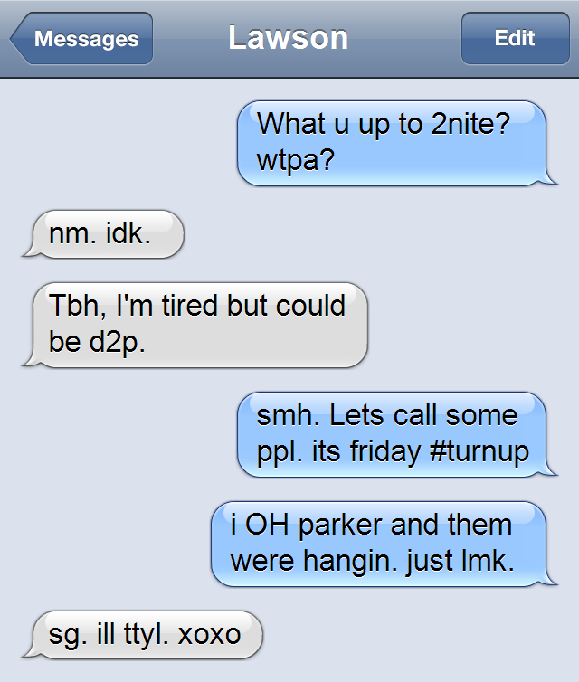
Keeping Up with Social Activities - Texting
How much time are they spending on their phones?
Do you know the slang?

Slide 5
Keeping Up with Social Activities - Sexting
DEFINITION - DATA
LEGAL ISSUE
Definition: sending/receiving sexually explicit photos/messages via cell phone/internet
39% of teens have sent a sext.
48% of teens have received a sext.
22% of females and 18% of males have sexted semi-nude/nude photos of themselves.
Teens caught sexting can be charged with production, distribution, or possessing pornography.

Slide 6
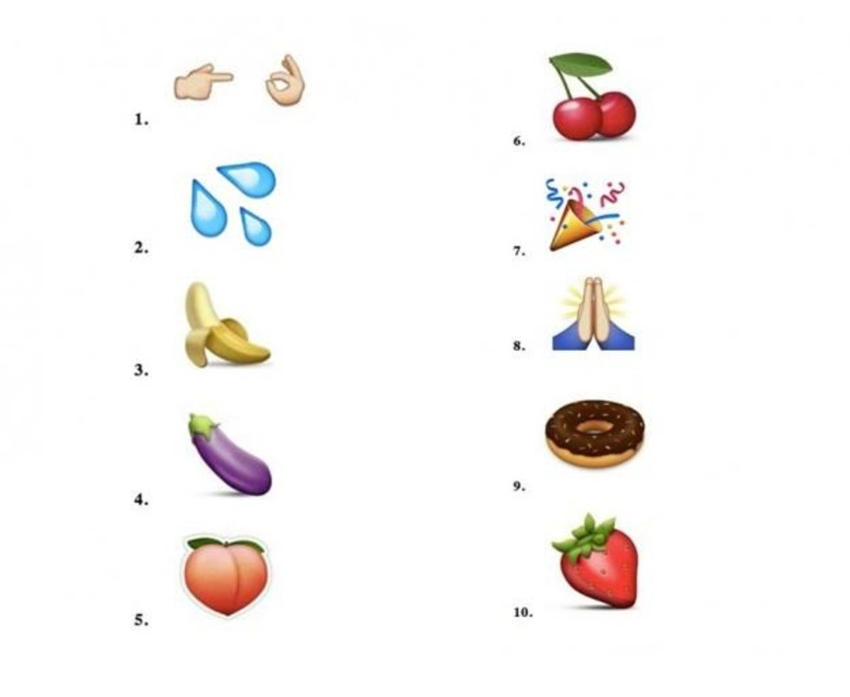
Keeping Up with Social Activities - Sexting
All of these emoji's have sexual meanings.

Slide 7
Keeping Up with Social Activities – Social Apps

Slide 8
Social Media and Your Child’s Future
Colleges and employers are using social media to recruit and research candidates!
27% of admissions officers used Google or social media to screen students.
35% found something that negatively impacted the students’ chances.
37% of employers used social media to screen applicants.
There’s no such thing as a delete button!!!!!
If you wouldn’t show your grandmother, don’t post it!

Slide 9
Keeping Up with Emotions – Life for Teens
Yesterday (a long time ago)
Today (currently)
Bullying at a school
Person/people don’t like you.
Change friends
Change schools
Cyberbullying
No options!

Slide 10
Keeping Up with Emotions – Signs
Sadness or hopelessness
Irritability, anger, or hostility
Tearfulness or frequent crying
Withdrawal from friends and family
Loss of interest in activities
Poor school performance
Changes in eating and sleeping habits
Restlessness and agitation
Feelings of worthlessness and guilt
Lack of enthusiasm and motivation
Fatigue or lack of energy
Difficulty concentrating
Unexplained aches and pains
Thoughts of death or suicide
http://www.helpguide.org/articles/depression/teen-depression-signs-help.htm

Slide 11
Keeping Up with Emotions – Reading Signs
Is it depression or teenage “growing pains”?
Two things to look for!
Look for extremes!
Is your child is acting very different from his/her usual self?
Look for persistence!
Is it a continuous and unrelenting unhappiness lethargy, or irritability?

Slide 12
Keeping Up with Emotions – What to do!
Don’t ignore the problem!
Ask
Be gentle but persistent
Listen
Acknowledge feelings
Connect with your teen.
Set aside time every day.
Encourage volunteerism.
Make physical health a priority.
Get him/her moving!
Limit screen time.
Provide nutritious meals.
Talk to your physician.
Determine if teen needs to see a community counselor.
http://www.helpguide.org/articles/depression/teen-depression-signs-help.htm

Slide 13
Social Media Safety
Your User-name, e-mail address and passwords are your internet security, remember that when your setting up an account on any site because people can use this to find you online.
Privacy level usually can be customized in the website or sites settings menu.
Tips:
Use different email for social media accounts.
Pick user-name that is not your email address.
NEVER POST your e-mail address or any personal details online, people can steal your identity.
Use a phrase you will remember for your password.
NEVER share your password.
IF you have any doubts or concerns do not join.

Slide 14
Social Media Safety
Rule 1: Assume everything you post is public and accessible to anyone forever. THINK BEFORE YOU POST!!!
Never post ANY personal information you don’t want shared with the world.
Manage privacy settings regularly.
Rule 2: Consider who has access
Who can read your profile?
Who can see your post/activity?
What information is shared with external sites and businesses.
Which applications can access your data?
What information are your friends sharing about you?

Slide 15
Social Media Safety
Creeper – a stranger who goes through your profile to get information on you.
To avoid make sure your profile is set to private if you do not want strangers seeing it.
Troll - person who monitors online forums waiting to comment negatively on a post or person seeking an argument.
Avoid trolls by ignoring the comment, keep track of content directed at you.
Dealing with a stalker:
If trolled and they continue to harass you then this can become cyber-stalking.
Keep track of all content directed at you, days, times, take and keep screen shots.
Once you have this go to the police and report them immediately.

Slide 16
Social Media Safety
Cyber-Bullying – use of the Internet and social networking to deliberately cause repeated harm to another individual.
Have been known to post personal information such as phone numbers, private messages, addresses and full names in groups.
Can lead to suicide, even among adults.
Can follow a victim everywhere 24/7.
Dealing with Cyber-Bullying
Ignore them
Block their emails/messages
Do not respond
Keep content, record days, times etc. and report this to the police if it does not stop.

Slide 17
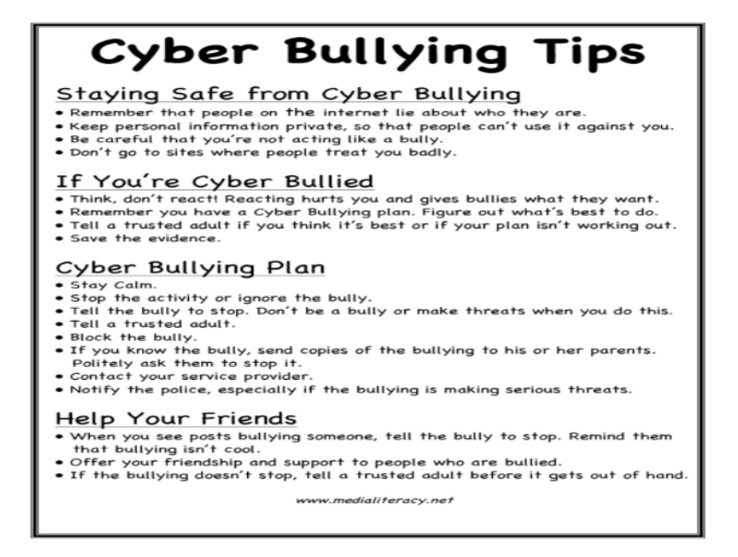
Social Media Safety (Resources)

Slide 18
THANK YOU!!!

