Slide 1
New Kindergarten Parent Workshop
Amaya Chavez “Parent Liaison”

Slide 2
Agenda
Parent Portal
My payment plus account
Cafeteria, Free or reduced lunch application
Clinic and forms
Transportation
GCPSK12.ORG

Slide 3
Parent Portal
-All parents who did online registration already have a parent portal.
-Sign in with email and password.
-​Parent Portal gives parents access to grades, assignments, and communication with teachers.
-The Parent Portal gives families a direct line to the classroom, anywhere access, with in-portal translation in multiple languages.(video)
-Class dojo is the best way of contact with teachers. (You will receive an invitation to sign up from your child homeroom teacher)
-Under ParentVUE you can access messages, school calendar, attendance, grades and more.
-Transportation you will have bus information and route.
-Access to mypaymentplus
- Under parent resources you will have access to school calendar, lunch menu, parent handbook and school websites.

Slide 4
www.mypymentsplus.com
MyPaymentsPlus is linked directly to your school’s student information system (SIS), enabling us to show real-time balances and invoices.
-Sign schools forms
-Add money to your cafeteria account
-Pay for field trips, activities and fees
-Donations
-It allows you to see cafeteria purchases and balances
-Receive an alert for low balance
-Add a payment method to add fund easier.
GCPSK12.ORG

Slide 5
Cafeteria & free or reduce lunch Application
Free or reduce lunch application can be found at the school web page and filled out online,
(All siblings go under the same application)
decision is based on family income.
Every school year you will need to enter a new application.

Slide 6
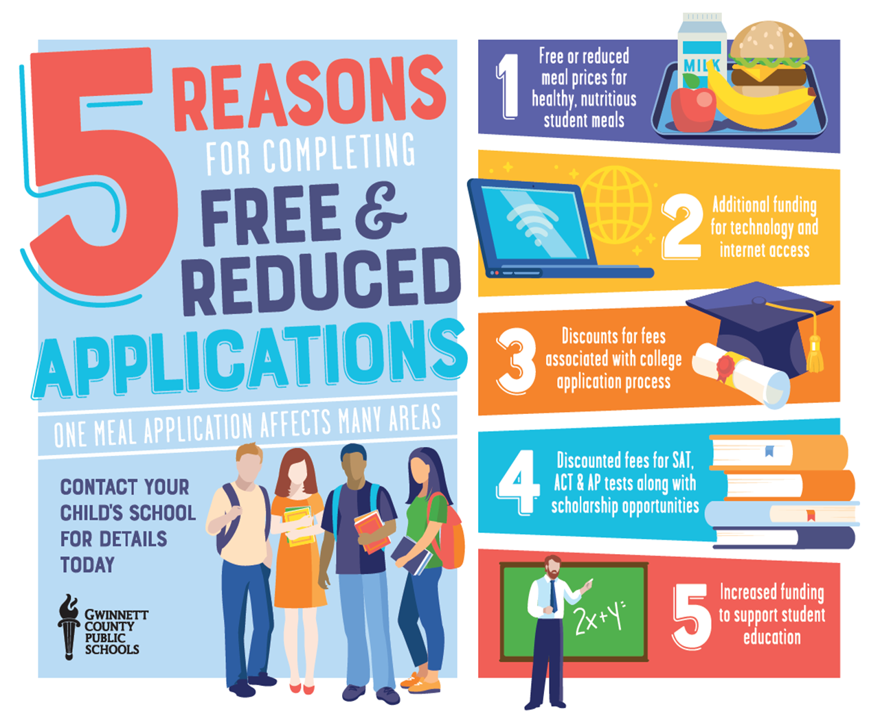
WHO CAN GET FREE OR REDUCED-PRICE MEALS?
All children in households receiving benefits from SNAP or TANF are eligible for free.
Foster children that are under the legal responsibility of a foster care agency or court are eligible for free. Children participating in their school’s Head Start program are eligible for free. Children who meet the definition of homeless, runaway, or migrant are eligible for free. Children may receive free or reduced-price meals if your household’s income is within the limits on the Federal Income Eligibility Chart.
TAKUMA HAYASHI
MIRJAM NILSSON​
president
chief executive officer

Slide 7
Cafeteria & free or reduce lunch Application
“No fast food or restaurant food in the cafeteria.”
Parents can come to have lunch with student, but they will have to buy lunch from the cafeteria.
Students: breakfast $1.25, lunch $2.50, extra entrée $2.25, extra side .40 and water $1.25
Adults: lunch $3.75
Check or cash only or it can be deducted from student's cafeteria account.

Slide 8
Cafeteria
-FOOD ALLERGIES
-LACTOSE INTOLERANCE
-VEGAN OR VEGETARIAN
-ANY TYPE OF FOOD ALLERGY
SCHOOL NEEDS MEDICAL NOTE.

Slide 9
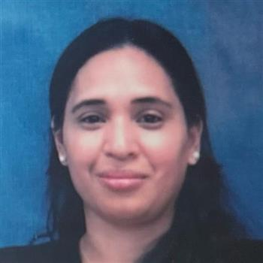
Clinic
Health Conditions
School needs to be aware of health conditions like asthma, allergies, diabetes, etc.
Medicine
Students cannot carry meds in their bookbag, you will need to fill out an Administration of Medication Request form available in Spanish and English.
Medication must be kept at the clinic.
Please update your contact information in case of an emergency, make sure you unblock our school number or add us to your contacts.
If you selected yes for us to administer Tylenol or Advil to your child please make sure you bring it to the school and fill out the form.( we do not provide medicine)
Keiry Arano

Slide 10
​Transportation: request a transportation change for your student only if it is an emergency. Send an email to Ms. Rease by noon with your student's name, photo of your ID and specify if they will be car riders or bus riders for the day.
Tardies: 7:45am students are allowed in the building, after 8:15am student is late.
Absences: send doctors or written notes within 10 days. Notes need to specify name, last name and teacher. After 5, 10 or 15 absences you will receive a letter from Gwinnett County.
Check out: all parents checking out a students please do so before 2:00pm. After 2:00pm it requires Admin approval. Everyone checking out a student needs to be listed on your parent portal/emergency contact list.
Photo ID is required for visitors or for anyone checking out a student.
Paulette Rease
Paulette.rease@gcpsk12.org

Slide 11
Security system
Be patient
If dropping off something for your student or the classroom leave at the desk, write student name and teacher’s name on the sticky note paper and we will deliver to the right classroom.
Checking in late you will fill out a tardy paper from the table and send your student in.
For check outs, drop your ID into the raptor system, have a seat an we will call your student out.
If you have a meeting, please drop ID into the raptor system and we will give you a visitors pass.

Slide 12
www.gcpsk12.org
Make sure to check our website and social media for all type of information.
GCPSK12.ORG

Slide 13
Thank you
Amaya Chavez
Amaya.Chavez@gcpsk12.org
Parent Liaison

