Slide 1
Amplify Your Ally Score
PowerPoint

Slide 2
Choose or Create an Accessible Slide Design
Initiate the Accessibility Checker
Use Pre-formatted Layouts
Use Slide Layouts provided or use Slide Master to build your own.
Color Contrast
Use a larger font sizes (18pt or larger)
Notes:
Change font size to 18 or larger on this slide
Check color contrast.

Slide 3
Slide Titles & Layout
Using the Built-in Layout
Text boxes should not be used in place of Slide Titles
Each Slide Title should be Unique
Verify Slide Titles have been added using the Outline View

Slide 4
Reading Order
This text is currently read 2nd.
This text is currently read 1st
Use the OUTLINE VIEW to organize your content.
Notes:
To change the Reading Order
HOME
ARRANGE
SELECTION PANEL

Slide 5
Links, Lists & Images
Blackboard Accessibility Help Site
https://onblackboard-my.sharepoint.com/personal/tamatha_leuschen_blackboard_com/Documents/Amplify-Ally/h%20ttps:/help.blackboard.com/Web_Community_Manager/Administrator/Accessibility
Amplify Training Series
https://cerc.blackboard.com/Page/119
Notes:
ALT TEXT: Additional information for creating accessible content for Websites and documents.

Slide 6
SmartArt Graphics & Shapes
Upload Your File
Ally Scans and Scores File
Correct Original File
Ally Re-Scans & Scores
Upload Your Corrected File
Notes:
ALT TEXT: 5 steps for how to use Ally and your files. Step 1 , Upload Your File; Step 2, Ally Scans and Scores...

Slide 7
Charts & Tables
Color Contrast
Add Alternative Text
Enter most important on first line
Consider including the type of chart
Be as concise as possible
Notes:
Sample Alternative Text: Clustered column chart comparing values of two Ally scores for two types of files.

Slide 8
Charts & Tables
Day of the Week | Start Time | End Time
Monday | 8:05 AM | 3:05 PM
Tuesday | 8:05 AM | 3:05 PM
Wednesday | 10:05 AM | 3:05 PM
Thursday | 8:05 AM | 3:05 PM
Friday | 8:05 AM | 2:05 PM
Color Contrast
Use simple table structure
Specify column/row header information.
Add Alternative Text
Using built in Table Design.
Tables should not contain split cells, merged cells, or nested tables, use the

Slide 9
Video and Captioning

Slide 10
Saving a File
PPT
Add A Title
PDF
Add A Title
Save As PDF

Slide 11
Add a file Title (Windows)

Slide 12
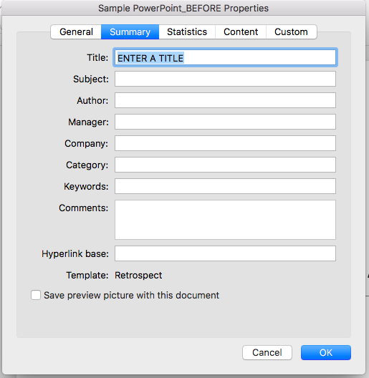
Add a file Title (Mac)

Slide 13
Save as a PDF (Windows)

